Slide 1
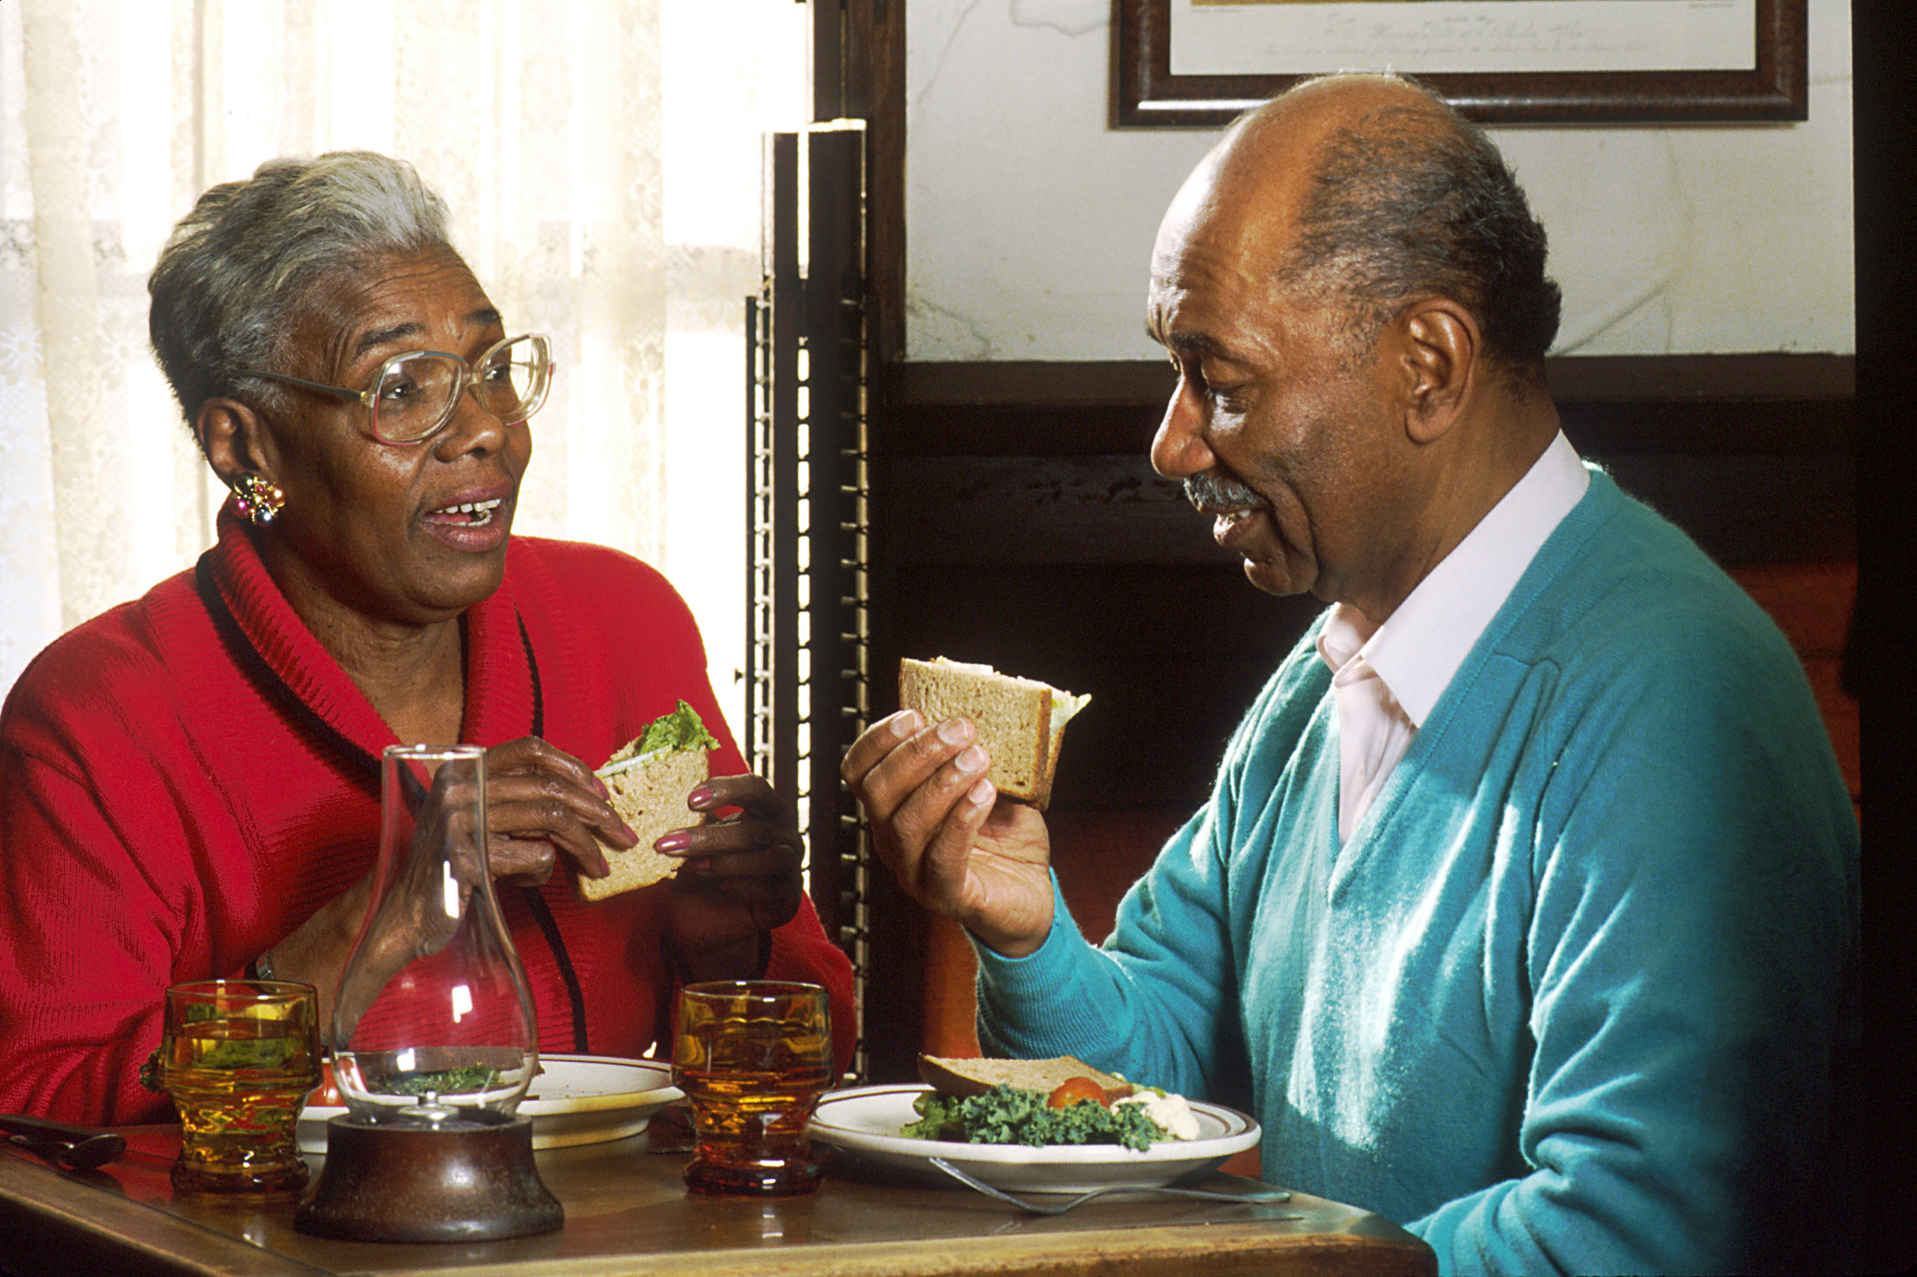
Academy of Nutrition and Dietetics Evidence Analysis Library®
www.andeal.org
Malnutrition in Older Adults
Evidence-Based Nutrition Practice Guidelines Executive Summary of Recommendations
Guideline published December 2023

Slide 2
Definition
What is Evidence-based Dietetics Practice?
“Evidence-Based Dietetics Practice is the use of systematically reviewed scientific evidence in making food and nutrition practice decisions by integrating best available evidence with professional expertise and client values to improve outcomes.”
A.N.D. Scope of Dietetics Practice Framework: Approved by A.N.D. House of Delegates
© 2023 Evidence Analysis Library®

Slide 3
Overall Guideline Objective
The objective of this evidence-based nutrition practice guideline is to provide evidence-based recommendations to identify, prevent or treat protein-energy malnutrition (further referred to as malnutrition) in older adults (mean age of ≥65 years) living in long-term care facilities and in community settings. Improved nutrition status may improve quality of life, prevent decline in physical function, and may decrease the risk of hospitalization and mortality.
© 2023 Evidence Analysis Library®

Slide 4
Target Population
Adults (≥65 years of age)
Male and Female
Target Population Description
The intended population is older adults (≥ 65 years of age) within the general population living in long-term care facilities or in community settings..
© 2023 Evidence Analysis Library®

Slide 5
Guideline Scope Characteristics
Guideline Category
These recommendations focus on the following major outcomes:
Assessment
Intervention
Clinical Specialty
Geriatrics, Nutrition
© 2023 Evidence Analysis Library®

Slide 6
Statement of Intent
Evidence-based nutrition practice guidelines are developed to help Registered Dietitian Nutritionists, practitioners, patients, families, and consumers make shared decisions about health care choices in specific clinical circumstances. If properly developed, communicated, and implemented, guidelines can improve care.
While the evidence-based nutrition practice guideline represents a statement of promising practice based on the latest available evidence at the time of publication, the guideline is not intended to overrule professional judgment. Rather, it may be viewed as a relative constraint on individual clinician discretion in a particular clinical circumstance. The independent skill and judgment of the health care provider must always dictate treatment decisions. These nutrition practice guidelines are provided with the express understanding that they do not establish or specify particular standards of care, whether legal, medical or other.
© 2023 Evidence Analysis Library®

Slide 7
Disclaimer
While A.N.D. evidence-based nutrition practice guidelines represent a statement of best practice based on the latest available evidence at the time of publishing, they are not intended to overrule professional judgment. Rather, they may be viewed as a relative constraint on individual clinician discretion in a particular clinical circumstance. The independent skill and judgment of the health care provider must always dictate treatment decisions. These nutrition practice guidelines are provided with the express understanding that they do not establish or specify particular standards of care, whether legal, medical or other.
© 2023 Evidence Analysis Library®

Slide 8
Guideline Rating
Each Recommendation is Rated:
Strong,
Weak, or
Consensus
Recommendation statements include terms:
“Recommend/should” (Strong)
“Suggest/may” (Weak)
“It is reasonable” (Consensus)
Each Recommendation Statement is:
Conditional or
Imperative
© 2023 Evidence Analysis Library®

Slide 9
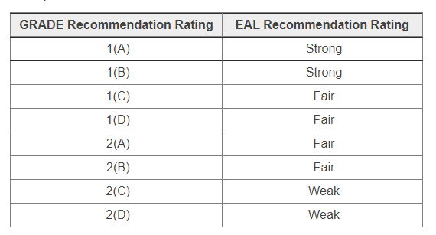
Recommendation Translation
© 2023 Evidence Analysis Library®

Slide 10
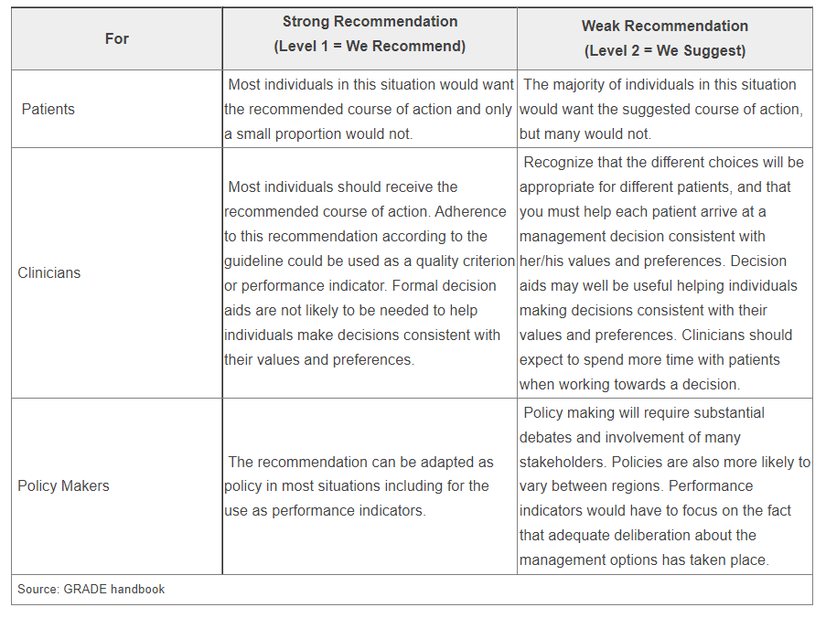
Implications of Strong/Weak Recommendations
© 2023 Evidence Analysis Library®

Slide 11
Conditional/Imperative
Imperative recommendations are broadly applicable to the target population and are stated as “require,” or “must,” or “should achieve certain goals.”
Conditional statements clearly define a specific situation and contain conditional text that would limit their applicability to specified circumstances, or to a sub-population group. More specifically, a conditional recommendation can be stated in if/then terminology.
© 2023 Evidence Analysis Library®

Slide 12
Recommendation Topics
Malnutrition Assessment in Long-Term Care
Long-Term Care Mini-Nutritional Assessment
Long-Term Care Subjective Global Assessment and Patient-Generated Global Assessment
Malnutrition Assessment in the Community
Community Mini-Nutritional Assessment
Community Subjective Global Assessment
Oral Nutrition Supplements
Oral Nutrition Supplements in Long-Term Care
Oral Nutrition Supplements in the Community
Oral Nutrition Supplements when Discharged from Acute Care to the Community
Food Fortification
Food Fortification in Long-Term Care
Food Fortification in the Community
Home Delivered Meals and Congregate Meals
Dietitian Effectiveness
Dietitian Effectiveness in the Community
Dietitian Effectiveness Post-Discharge
© 2023 Evidence Analysis Library®

Slide 13
Malnutrition in Older Adults Evidence Based
Nutrition Practice Guideline
Executive Summary of Recommendations
Guideline published December 2023
© 2023 Evidence Analysis Library®

Slide 14
Nutrition Assessment
© 2023 Evidence Analysis Library®

Slide 15
MiOA: Long-Term Care Mini-Nutritional Assessment
We suggest that registered dietitian nutritionists use the Mini-Nutritional Assessment (MNA) for malnutrition assessment in older adults living in long-term care. The MNA is a valid tool that can identify older adults that are malnourished and may predict mortality.
Level 1(C)
Imperative
© 2023 Evidence Analysis Library®

Slide 16
MiOA: Long-Term Care SGA and PGA-SGA
We suggest that registered dietitian nutritionists consider using the Subjective Global Assessment (SGA) or Patient Generated Global Assessment (PGA-SGA) if use of the Mini-Nutritional Assessment (MNA) is not feasible for malnutrition assessment in older adults living in long-term care. The SGA and PG-SGA may be valid tools that can identify older adults with malnutrition, although more evidence is needed.
Consensus
Conditional
© 2023 Evidence Analysis Library®

Slide 17
MiOA: Community Mini-Nutritional Assessment
We suggest that registered dietitian nutritionists use the Mini-Nutritional Assessment (MNA) for malnutrition assessment in older adults living in the community. The MNA is a valid and reliable tool that can identify older adults that are malnourished and may predict mortality.
Level 1(C)
Imperative
© 2023 Evidence Analysis Library®

Slide 18
MiOA: Community Subjective Global Assessment
We suggest that registered dietitian nutritionists consider use of the Subjective Global Assessment (SGA) if the Mini-Nutritional Assessment (MNA) is not feasible for malnutrition assessment in older adults living in the community. The SGA may be a valid and reliable tool that can identify older adults with malnutrition, although more evidence is needed.
Consensus
Conditional
© 2023 Evidence Analysis Library®

Slide 19
Nutrition Intervention
© 2023 Evidence Analysis Library®

Slide 20
MiOA: Oral Nutrition Supplements in Long-Term Care
Healthcare practitioners should recommend oral nutrition supplements (ONS) for older adults with malnutrition or at risk for malnutrition living in long-term care. ONS intake 1–2 times per day to meet caloric, and protein deficit is associated with increased calorie and protein intake, weight gain, and improved nutrition status.
Level 1(B)
Imperative
© 2023 Evidence Analysis Library®

Slide 21
MiOA: Oral Nutrition Supplements in the Community
Healthcare practitioners should consider oral nutrition supplements (ONS) as part of an individualized and comprehensive nutrition intervention for older adults with malnutrition or at risk for malnutrition living in the community. ONS intake of 1–2 servings per day is likely to increase calorie and protein intake.
Level 1(B)
Imperative
© 2023 Evidence Analysis Library®

Slide 22
MiOA: Oral Nutrition Supplements when Discharged from Acute Care to the Community
Healthcare practitioners should consider oral nutrition supplements (ONS) as part of an individualized and comprehensive nutrition intervention for older adults with malnutrition or at risk for malnutrition discharged from acute care to the community. ONS intake of 1–2 servings per day is likely to increase calorie and protein intake and improve nutrition status.
Level 1(C)
Imperative
© 2023 Evidence Analysis Library®

Slide 23
MiOA: Dietitian Effectiveness in the Community
Older adults living in the community and considered malnourished or at risk of malnutrition should receive nutrition interventions from a dietitian. Dietitian interventions are associated with weight maintenance or desired gain, and improved calorie and protein intake.
Level 1(C)
Imperative
© 2023 Evidence Analysis Library®

Slide 24
MiOA: Dietitian Effectiveness Post-Discharge
Older adults discharged from acute care to the community and considered malnourished or at risk for malnutrition should receive nutrition interventions from a dietitian. Dietitian interventions are associated with increased calorie and protein intake, weight maintenance or desired gain, and improved nutrition status.
Level 1(C)
Imperative
© 2023 Evidence Analysis Library®

Slide 25
MiOA: Food Fortification in Long-Term Care
Healthcare practitioners may consider food fortification as part of a comprehensive nutrition intervention for older adults with malnutrition or at risk of malnutrition living in long-term care. Food fortification is commonly used and is a feasible nutrition intervention to improve calorie and protein intake.
Level 2(C)
Conditional
© 2023 Evidence Analysis Library®

Slide 26
MiOA: Food Fortification in the Community
Healthcare practitioners may consider food fortification as part of a comprehensive nutrition intervention for older adults with malnutrition or at risk of malnutrition living in the community. Food fortification is commonly used and is a feasible nutrition intervention to improve calorie and protein intake.
Consensus
Conditional
© 2023 Evidence Analysis Library®

Slide 27
MiOA: Home Delivered Meals and Congregate Meals
Older adults living in the community, especially those considered malnourished or at risk for malnutrition, should be referred to home-delivered and congregate meal services to improve calorie and protein intake and reduce incidence and risk of malnutrition.
Level 1(C)
Imperative
© 2023 Evidence Analysis Library®

Slide 28
No Implied Endorsement
No endorsement by the Academy of Nutrition and Dietetics of any brand-name product or service is intended or should be inferred from a Guideline or from any of its components (including Question, Evidence Summary, Conclusion Statement, Conclusion Statement Grade, Recommendation or Recommendation Rating).
Evidence-based Nutrition Practice Guidelines are intended to serve as a synthesis of the best evidence available to inform registered dietitians as they individualize nutrition care for their clients. Guidelines are provided with the express understanding that they do not establish or specify a particular standard of care, whether legal, medical or other.
Evidence-based Nutrition Practice Guidelines are intended to summarize best available research as a decision tool for A.N.D. members.
© 2023 Evidence Analysis Library®

Slide 29
Guideline Implementation
Information and Resources
© 2023 Evidence Analysis Library®

Slide 30
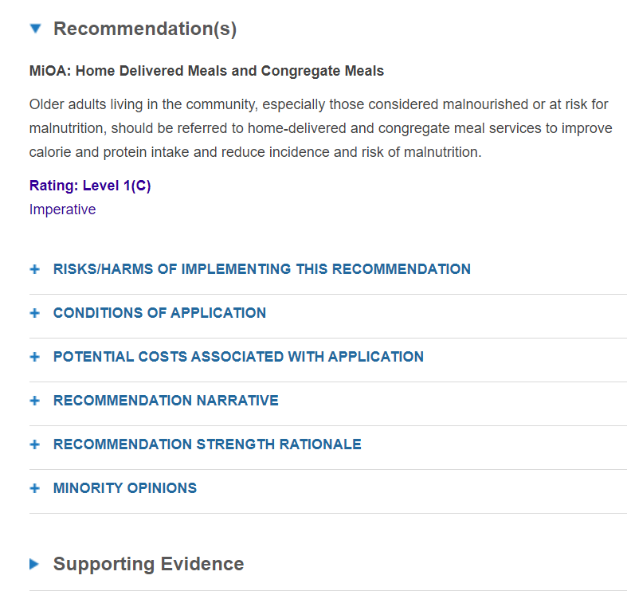
Implementation
Implementation involves integration of the evidence-based interventions into practice and includes examination of barriers and facilitators that can influence the effectiveness of the recommendations.
See the section titled “Considerations for Application” in the guideline for tools and expert advice regarding how to implement recommendations.
© 2023 Evidence Analysis Library®

Slide 31
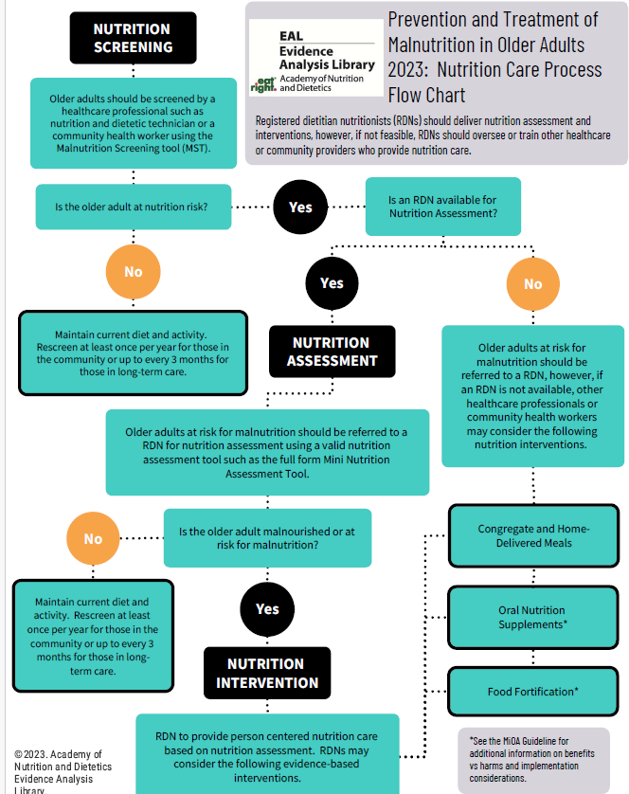
Flow Chart
Utilizing a treatment flowchart can provide a flexible guide for nutrition and dietetics practitioner to customize care, considering each individual’s unique requirements and goals.
Here is an overview of a flow chart for prevention and treatment of malnutrition in older adults.
© 2023 Evidence Analysis Library®

Slide 32
Interventions: Long-Term Care
© 2023 Evidence Analysis Library®

Slide 33
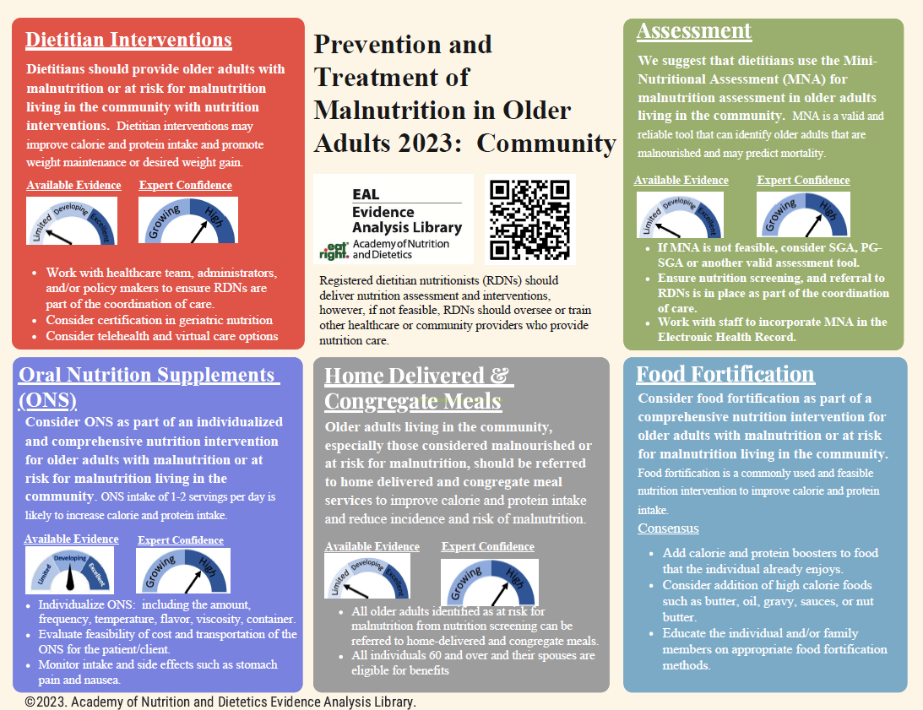
Interventions: Community
© 2023 Evidence Analysis Library®

Slide 34
Guides
To assist nutrition and dietetics professionals with implementing evidence-based practice recommendations and clinical practice innovations into daily practice, the Academy developed Implementing Evidence: From Guidelines to Daily Practice. Download it from: www.andeal.org/guideline-implementation
For tips on implementing the guideline recommendations, download the Malnutrition in Older Adults Community Practitioner Guide and Long-Term Care Practitioner Guide. These guides are designed with clear and unambiguous language that may help practitioners and their patients/clients to actively participate in shared decision making for their nutrition care. Visit www.andel.org/mioa and select the Dissemination and Implementation tab.
© 2023 Evidence Analysis Library®

Slide 35
Guideline Development
© 2023 Evidence Analysis Library®

Slide 36
Methods
The methodology for this project was developed using the process of the Academy of Nutrition and Dietetics,^{1,2} in accordance with the Standards for Developing Clinical Practice Guidelines from the National Academy of Science using grading and guideline development tools from the GRADE (Grading of Recommendations Assessment, Development and Evaluation) group.^{3,4}
Visit the EAL for the complete MiOA guideline methods.
Handu D, Moloney L, Wolfram T, Ziegler P, Acosta A, Steiber A. Academy of Nutrition and Dietetics Methodology for Conducting Systematic Reviews for the Evidence Analysis Library. J Acad Nutr Diet. 2016;116(2):311-318.
Papoutsakis C, Moloney L, Sinley RC, Acosta A, Handu D, Steiber AL. Academy of Nutrition and Dietetics Methodology for Developing Evidence-Based Nutrition Practice Guidelines. J Acad Nutr Diet. 2017;117(5):794-804.
The GRADE Working Group. GRADE handbook for grading quality of evidence and strength of recommendations. Cochrane Collaboration. https://gdt.gradepro.org/app/handbook/handbook.html. Published 2013. Updated October 2013.
Collaboration TC. Cochrane Handbook for Systematic Reviews of Interventions Version 5.1.0 [updated March 2011]. . In: Higgins JPT GSe, ed.
© 2023 Evidence Analysis Library®

Slide 37
Malnutrition in Older Adults Project Team
Expert Panel Workgroup
Nancy Munoz, DCN, MHA, RDN, FAND, Chair
Anne E. Coltman, MSHA, MS, RDN, FAND, FACHE, Co-Chair
Krista M. Clark, MBA, RD, LD, CSG, FAND
Nancy Collins, PhD, RDN, LD, NWCC, FAND
Shina Nishioka, PhD, RD
Emily Riddle, PhD, RD
Terese M. Scollard, MBA, RDN, LD, FAND, FASPEN
Judy R. Simon, MS, RD, LD
Lamia C. Nasrallah, MPH, RDN, LDN, Patient Advocate
Beth A. Smith, MS< RD-AP, LDN, Patient Advocate
Project Leaders
Lisa Moloney, PhD, RDN, Project Manager
Mary Katherine Hoy, Med, RDN, Lead Analyst
Amanda Wanner, MLIS, AHIP, Medical Librarian
Visit the EAL for affiliations and any disclosures of potential conflicts of interests
© 2023 Evidence Analysis Library®

Slide 38
Major Recommendations
This presentation consisted of the Executive Summary of Recommendations for the Academy of Nutrition and Dietetics Malnutrition in Older Adults Evidence-Based Nutrition Practice Guideline.
The Major Recommendations and more detail (including the evidence analysis supporting these recommendations) is available for free to Academy members and EAL subscribers.
www.andeal.org
© 2023 Evidence Analysis Library®

Slide 39
Learn more:
Academy of Nutrition and Dietetics Evidence Analysis Library®
^{www.andeal.org}
eal@eatright.org
© 2023 Evidence Analysis Library®

