Slide 1
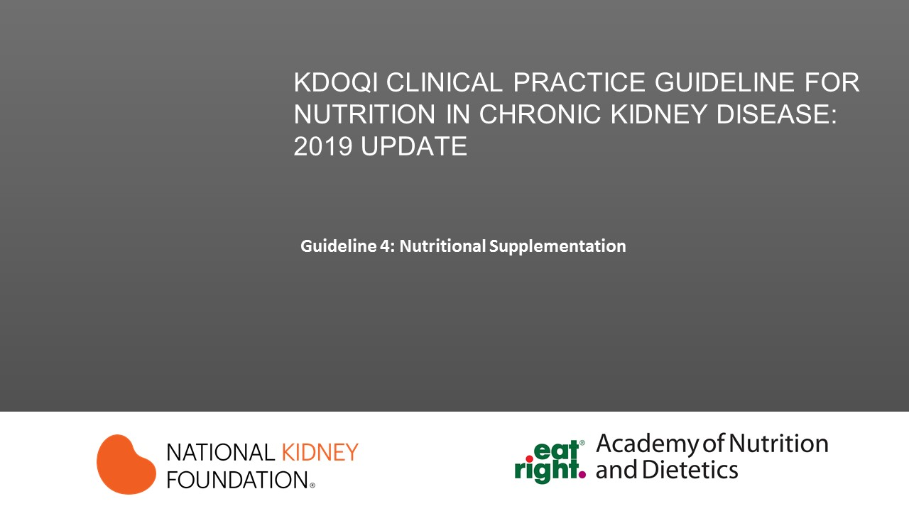

Slide 2
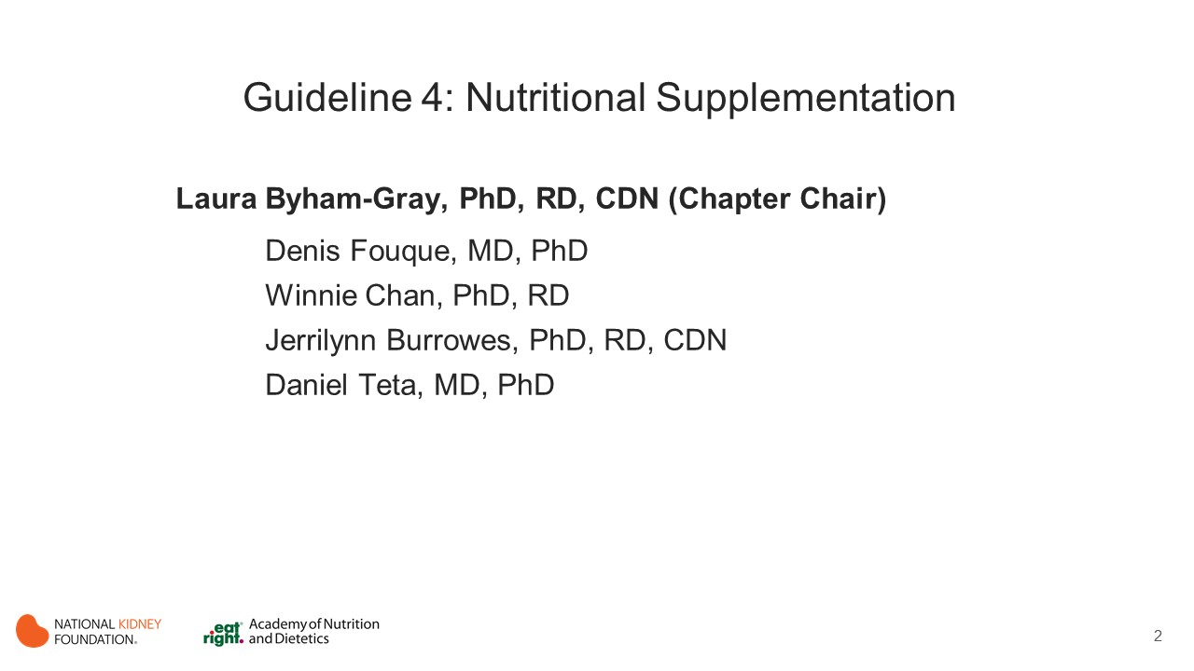
Notes:
Chapter (Macronutrients) Chair: Laura Byham-Gray, PhD, RD, CDN
Chapter Committee
Denis Fouque, MD, PhD
Winnie Chan, PhD, RD
Jerrilynn Burrowes, PhD, RD, CDN
Daniel Teta, MD, PhD

Slide 3
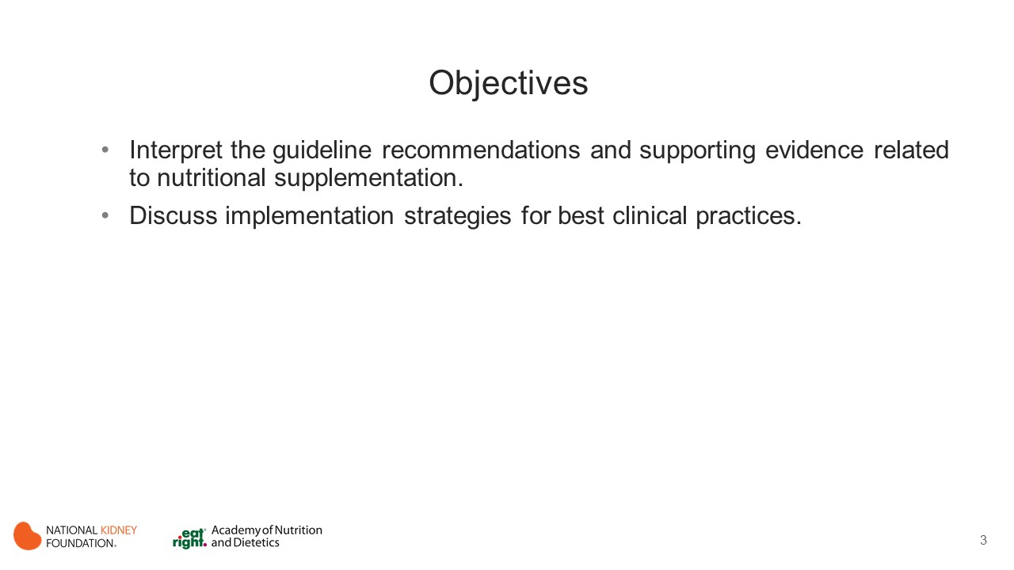
Notes:
The learning objectives for this activity are to:
Interpret the guideline recommendations and supporting evidence related to electrolytes.
Discuss implementation strategies for best clinical practices.

Slide 4
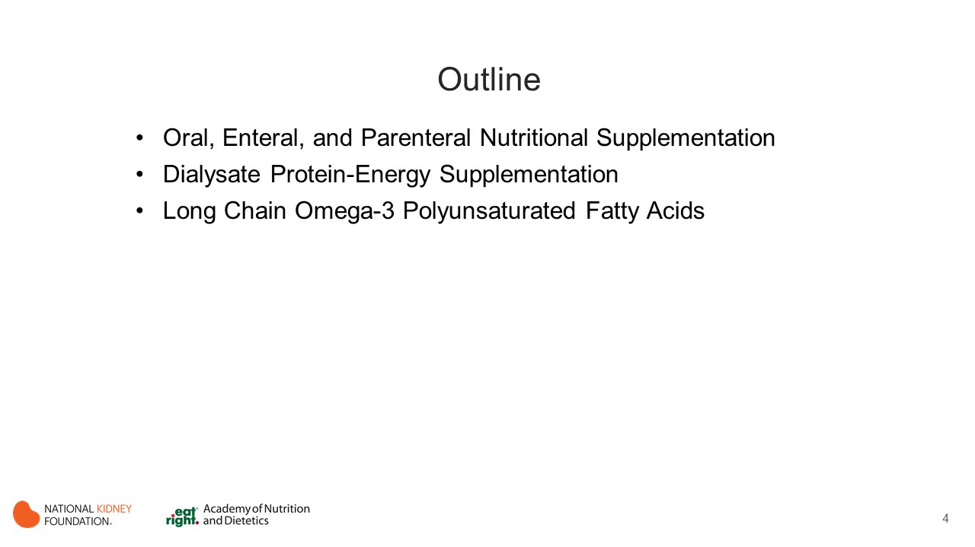
Notes:
Sections
General considerations
Acid-Base
Calcium
Phosphorus
Sodium
Potassium

Slide 5
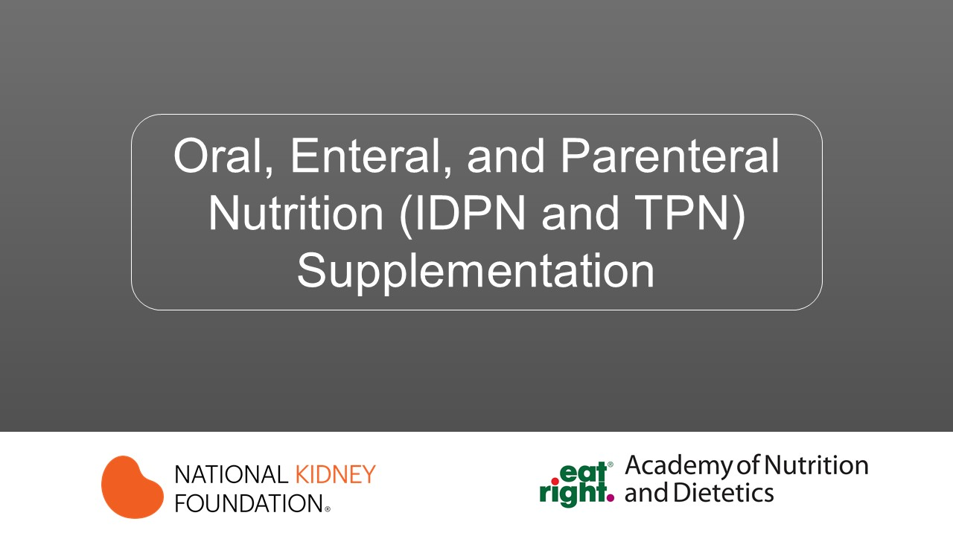

Slide 6
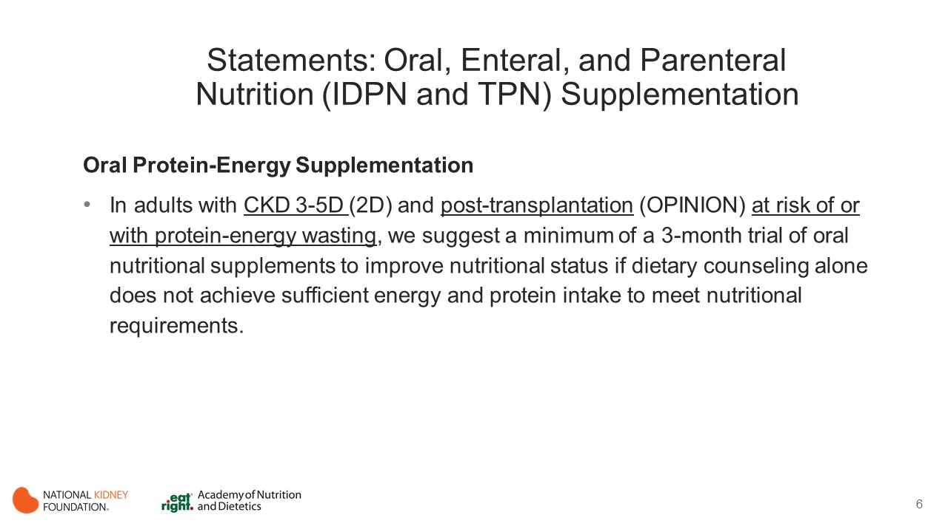
Notes:
PEW is common among patients with CKD, especially those undergoing maintenance dialysis, and is associated with increased morbidity and mortality. The cause of PEW in patients with CKD is complex and multifactorial and includes reduced energy and protein intake resulting from anorexia and dietary restrictions, inflammation, hypercatabolism, protein losses during dialysis, metabolic acidosis, uremic toxicity, and the presence of comorbid conditions. As a result, patients with CKD may develop an imbalance between dietary intake and nutritional requirements. Many patients with CKD consume less protein and energy than their recommended intakes even when individualized dietary counseling is provided by a renal dietitian.
When dietary counseling alone proves insufficient to bridge the gap between protein-energy intake and the target requirements in patients with CKD, provision of ONS is often the next appropriate step to prevent and treat PEW. Therefore, it is important to establish the effectiveness of ONS on nutritional status, clinical outcomes, and QoL in patients with CKD.
Although feeding through the gastrointestinal route should be the preferred choice of nutritional supplementation, feeding through the parenteral route may be a safe and convenient approach for patients who cannot tolerate oral or enteral administration of nutrients. A form of parenteral nutrition specifically designed for MHD patients is called intradialytic parenteral nutrition (IDPN). The use of the HD access for IDPN provides a significant advantage by eliminating the need for an additional permanent venous catheter placement. Because HD access is routinely used for the HD procedure, IDPN can be conveniently administered during HD through the dialysis tubing. When IDPN combined with oral intake fails to meet the target nutritional requirements, total parenteral nutrition (TPN) should be considered for nutritional support.

Slide 7
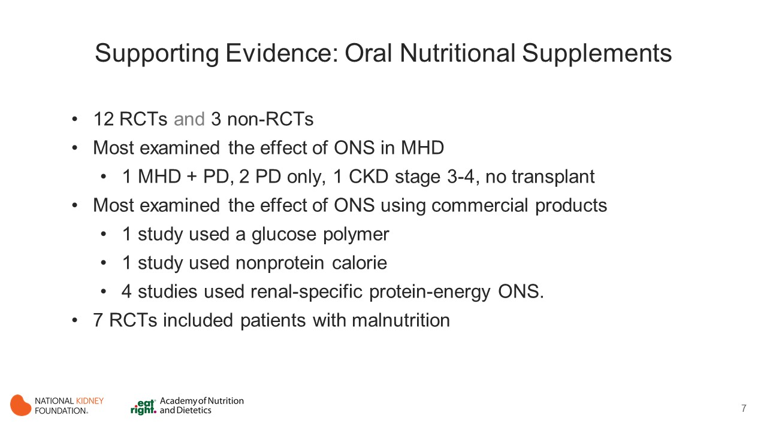
Notes:
This evidence review included 15 clinical trials: 12 RCTs (Allman 1990, Bolasco 2011, Calegari 2011, Fouque 2008, Gonzalez-Espinoza 2005, Hung 2009, Moretti 2009,Texixido-Planas 2005,Tomayko 2015, Wilson 2001, Wu 2013) and 3 NRCTs (Cheu 2013, Scott 2009, Sezer 2014)
Most of the studies examined the effect of ONS in patients receiving MHD. However, Moretti et al included patients receiving MHD and PD with the results merged, Gonzalez-Espinoza et al and Teixido-Planas et al studied patients receiving PD only, and Wu et al. studied patients with CKD stages 3-4. No studies were performed in patients with CKD with kidney allografts.
Most of the studies examined the effect of oral protein-energy or protein-based ONS using commercial products. However, Allman et al used a glucose-polymer ONS and Wu et al used a nonprotein calorie ONS. Four studies used renal-specific protein-energy ONS. (Fouque 2008, Hung 2009, Scott 2009, Sezer 2014)
A major drawback of the literature was the limited use of a placebo group, though most studies included a comparator group that was defined as participants not receiving ONS or receiving only nutritional counseling.
Study durations ranged from 12 weeks to 13.5 months.
Seven of the RCTs included participants with some level of malnutrition at baseline. (Allman 1990, Bolasco 2011, Calegari 2011, Fouque 2008, Gonzalez-Espinoza 2005, Wilson 2001, Hiroshige 1998) In contrast, 5 studies did not actively enroll malnourished patients. (Hung 2009, Moretti 2009,Texixido-Planas 2005,Tomayko 2015, Wu 2013). Of the NRCTs, Sezer et al enrolled malnourished patients as defined by serum albumin level or weight loss, Cheu et al enrolled patients with hypoalbuminemia, and Scott et al did not actively recruit patients with malnutrition.

Slide 8
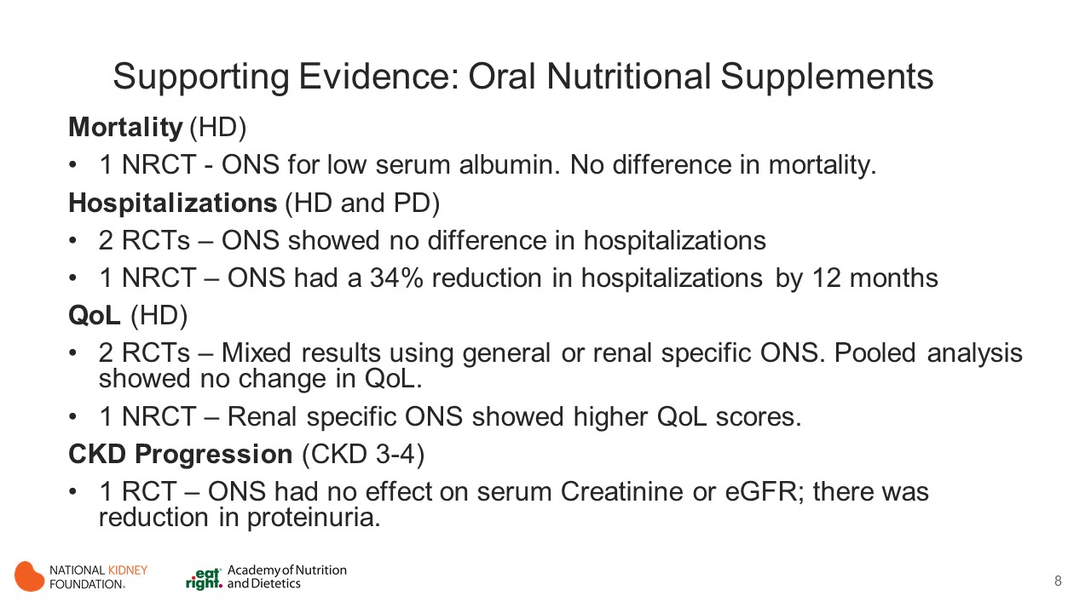
Notes:
Mortality
One NRCT examined the effect of ONS on mortality in 276 patients receiving MHD who received ONS for a low serum albumin level versus 194 similar patients who refused ONS or for whom treatment was deemed inappropriate. (Cheu 2013)
No difference in mortality (HR, 0.70 [95% CI, 0.36-1.35]) was noted over a median duration of 13.5 months.
Hospitalization
Two RCTs (Moretti 2009, Wilson 2001) and 1 NRCT (Cheu 2013) evaluated the effect of ONS on hospitalization over a period of 6 to 13.5 months in patients receiving MHD or PD.
A pooled analysis of the 2 RCTs (Moretti 2009, Wilson 2001) found no significant difference in the odds of hospitalization by group assignment, but an NRCT (Cheu 2013) reported a 34% reduction in hospitalization risk (0.66 [0.50, 0.85]) by 12 months in patients receiving ONS compared with controls.
QoL
Three studies (2 RCTs [Calegari 2011, Fouque 2008] and 1 NRCT [Scott 2009]), each of 3 months’ duration, examined the effect of ONS on QoL measures in patients receiving MHD.
One RCT (Calegari 2011) and 1 NRCT (Scott 2009) reported that patients receiving general or renal-specific protein-energy ONS, respectively, had higher QoL scores in the domains of physical functioning (Calegari 2011, Scott 2009) and bodily pain (Calegari 2011) compared to receiving dietary advice only (Calegarit 2011) or no supplementation, (Scott 2009) but another RCT (Fouque 2008) reported that renal-specific protein-energy ONS did not influence QoL scores in any domain.
A pooled analysis of the 2 RCTs (Calegari 2011, Fouque 2008) found that ONS did not significantly influence bodily pain, physical functioning, or general health QoL domain scores.
CKD Progression
A RCT (Wu 2013) conducted for 24 weeks examined the effect of an energy-based ONS on progression of CKD in 109 patients with CKD 3-4 who were following an LPD.
Although no difference in serum creatinine levels or eGFRs was observed between ONS and controls, there was a comparative reduction in proteinuria in the ONS arm (P < 0.05).

Slide 9
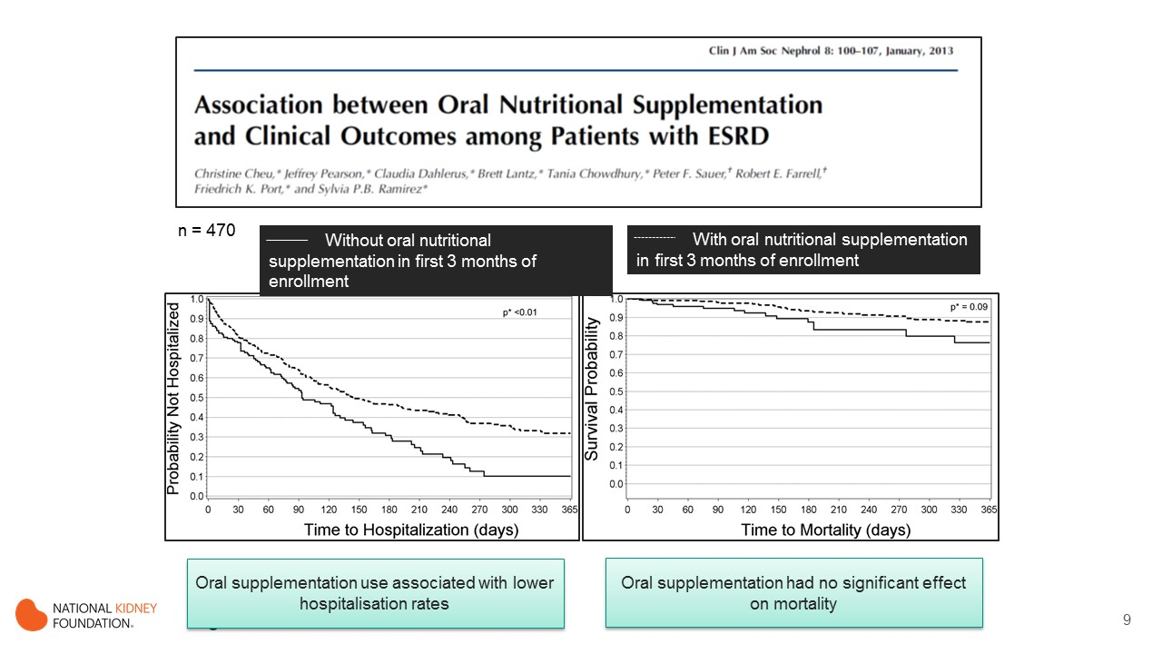
Notes:
The study looked at the association between oral nutritional supplementation and clinical outcomes in patients with end-stage renal disease.
As you can see, oral nutritional supplementation use was associated with significantly lower hospitalisation rates, but had no significant effect on mortality.

Slide 10
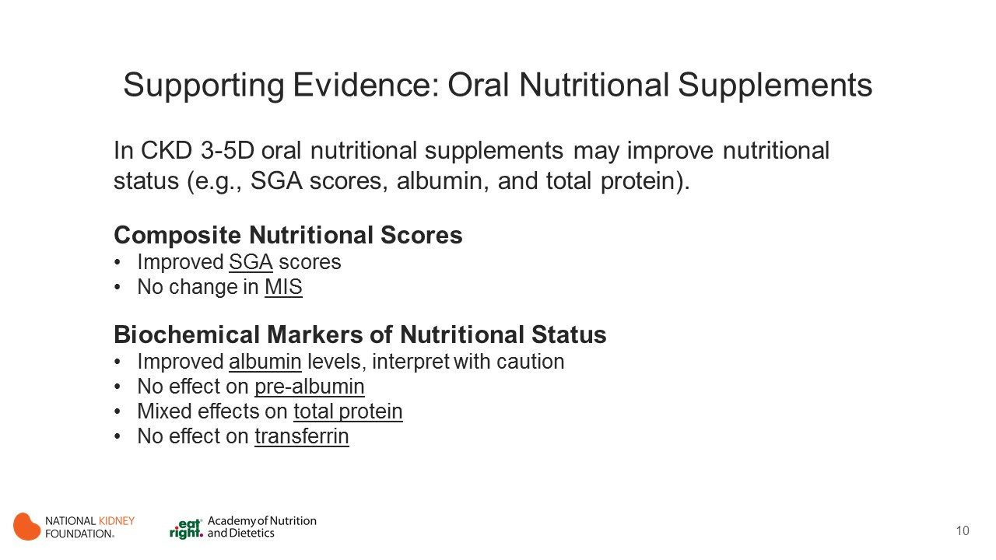
Notes:
Composite Nutritional Scores
A 3-month RCT in 18 patients receiving MHD examined the effect of a food-based ONS on SGA scores. (Calegari 2011) The authors describe a significantly greater SGA score improvement in patients receiving ONS compared with patients receiving nutritional guidance only.
One NRCT found that ONS over a 6-month period did not influence the MIS as compared with dietary advice. (Sezer 2014)
Biochemical Markers of Nutritional Status
Fifteen studies (12 RCTs [Allman 1990, Bolasco 2011, Calegari 2011, Fouque 2008, Gonzalez-Espinoza 2005, Moretti 2009, Teixido-Planas 2005, Tomayko 2015, Wilson 2001, Wu 2013, Hiroshige 2001] and 3 NRCTs [Cheu 2013, Scott 2009, Sezer 2014]) examined the effect of ONS on serum albumin levels in patients with CKD 3-5D. These included 11 studies in patients receiving MHD of 3 to 13.5 months’ duration, 1 RCT (Moretti 2009) in patients receiving MHD and PD of 6 months’ duration, 2 RCTs (Gonzalez-Espinoza 2005, Teixido-Planas 2005) in patients receiving PD of 6 months’ duration, and 1 (Wu 2013) in patients with CKD 3-4 of 24 weeks’ duration. Overall, the literature suggested that protein-energy ONS modestly improved serum albumin levels, though the results should be interpreted with caution.
One RCT in 86 patients receiving MHD reported that ONS did not influence serum prealbumin levels as compared with dietary advice. (Fouque 2008) ²¹⁷
Two RCTs of 3 to 6 months’ duration in patients receiving MHD reported conflicting effects of ONS on total-protein levels, perhaps related to the type of ONS.^{214,215} The first study of 30 patients reported a positive effect on total-protein levels using an amino acid–based ONS,²¹⁵ while a second of 21 patients found no effect of a 6-month energy-based ONS intervention. (Allman 1990, Bolasco 2011) ²¹⁴
Two studies (an RCT [Allman 1990[ and an NRCT [Scott 2009]) in patients receiving MHD of 3 to 6 months’ duration found no effect of ONS on serum transferrin levels, either individually or in a pooled analysis.

Slide 11
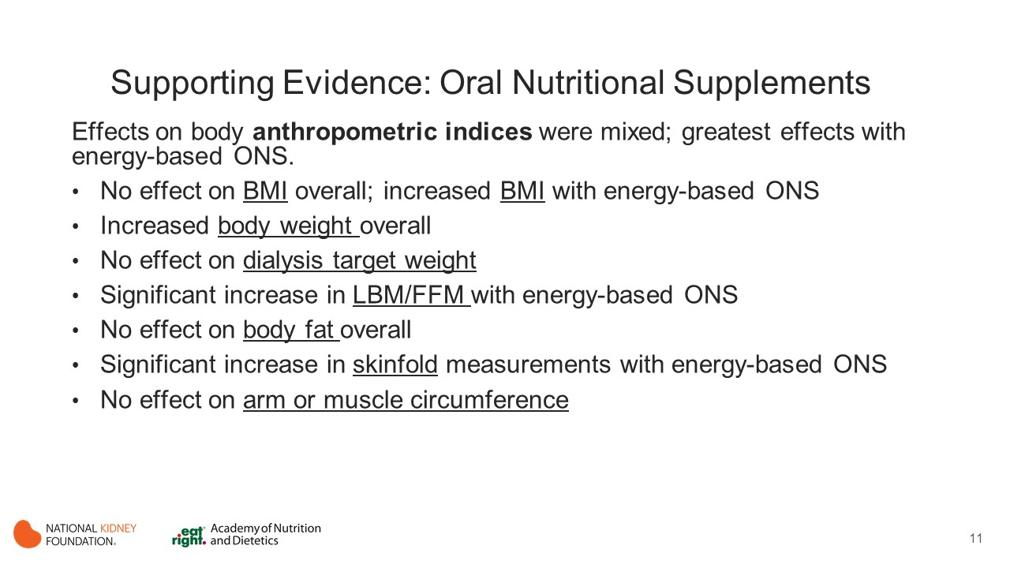
Notes:
The effect of ONS on anthropometric indices varied in large part according to the type of ONS used, with the greatest effects being seen in 1 study (Allman 1990) that used an energy-based ONS.
Body mass index
Seven studies (6 RCTs [Allman 1990, Bolasco 2011, Calegari 2011, Fouque 2008, Gonzalez-Espinoza 2005, Hung 2009] and 1 NRCT [Sezer 2014]) evaluated the effect of ONS on BMI during a 3- to 6-month period.
A pooled analysis demonstrated no overall effect of ONS on BMI, though the study using an energy-based ONS noted an increase in BMI. (Allman 1990)
Body weight
Six studies (5 RCTs and 1 NRCT) investigated the effect of ONS on body weight over 3 to 6 months in patients receiving MHD (Allman 1990, Bolasco 2011, Tomayko 2015, Scott 2009) or PD (Teixido-Planas 2005) and patients with CKD 3-4. (Wu 2013) Overall, ONS was linked to increased body weight but mainly in patients receiving MHD consuming an energy-based supplement.
One RCT in patients receiving PD that used a protein-based ONS reported increased body weight. (Teixido-Planas 2005)
A pooled analysis of all 6 studies found higher body weight in the ONS group compared with the control arm (mean, 2.77 [95% CI, 1.19-4.36] kg) in patients with CKD 3-5D. However, the difference was mainly driven by energy-based ONS in patients on MHD.
Dialysis target weight
Four studies (3 RCTs [Calegari 2011, Fouque 2008, Hiroshige 1998] and 1 NRCT [Sezer 2014]) in patients receiving MHD examined the effect of ONS on dialysis target weight over a 3- to 6-month period. Overall, no effect of ONS on target weight was observed, though 1 NRCT (Sezer 227) reported an increase in target weight using a renal-specific protein-energy ONS, as did 1 RCT (Hiroshige 2001) using a protein-based ONS.
A pooled analysis of 3 studies (Calegari 2011, Fouque 2008, Sezer 2014) found no overall effect. Hiroshige et al reported results in a figure and could not be included in pooled analysis.
LBM /FFM/muscle mass
Seven trials (6 RCTs [Allman 1990, Bolasco 2011, Calegari 2011, Teixido-Planas 2005, Tomayko 2015, Hiroshige 20012] and 1 NRCT [Sezer 2014]) in patients receiving MHD (Allman 1990, Bolasco 2011, Calegari 2011, Tomayko 2015, Sezer 2014, Hiroshige 2001) or PD (Teixido-Planas 2005) studied the effect of ONS on markers of lean mass over 3 to 6 months. Overall, ONS increased LBM or FFM only in patients receiving MHD who received an energy-based ONS.
In patients receiving MHD, the effect of protein-based ONS on LBM was mixed. In a pooled analysis of 6 studies (Allman 1990, Bolasco 2011, Calegari 2011, Teixido-Planas 2005, Tomayko 2015, Sezer 2014) ONS was associated with a significant increase in LBM or FFM (mean difference, 1.18 [95% CI, 0.16-2.20] kg) compared with the control arm, but a subgroup analysis found the effect to be significant only in patients receiving MHD using energy-based ONS.
Body fat
Seven studies (6 RCTs [Allman 1990, Bolasco 2011, Calegari 2011, Hung 2009, Tomayko 2015, Hiroshige 2001]; and 1 NRCT [Sezer 2014]) in patients receiving MHD evaluated the effect of ONS on BF over a period of 3 to 6 months.
A pooled analysis of 6 studies (Allman 1990, Bolasco 2011, Calegari 2011, Hung 2009, Tomayko 2015, Sezer 2014); reported no overall effect of ONS on body FM, though subgroup analyses demonstrated that energy (Allman 214) and protein-energy–based (Calegari 2011, Hung 2009, Sezer 2014) ONS significantly increased body FM compared with controls, but protein-based ONS had no effect.
Skinfold measurements
Five studies (4 RCTs [Allman 1991, Calegari 2011, Gonzalez-Espinoza 2005, Teixido-Planas 2005] and 1 NRCT [Sezer 2014]) in patients with CKD receiving MHD (Allman 1990, Calegari 2011, Sezer 2014) or PD (Gonzalez-Espinoza 2005, Teixido-Planas 2005) examined the effect of ONS on skinfold measurements over a 3- to 6-month period.
A pooled analysis of 4 studies (Allman 1990, Gonzalez-Espinoza 2005, Teixido-Planas 2005, Sezer 2014) reported that ONS significantly increased skinfold measurements (mean difference, 3.91 [95% CI, 0.93-6.90] mm) compared with dietary counseling or no supplementation, but this effect was significant only in patients receiving MHD using energy-based ONS.
Arm or muscle circumference
Four RCTs in patients receiving MHD (Allman 1990, Calegari 2011) or PD (Gonzalez-Espinoza 2005, Teixido-Planas 2005) evaluated the effect of ONS on arm or muscle circumference over a 3- to 6-month period. None of the studies showed any effect.

Slide 12
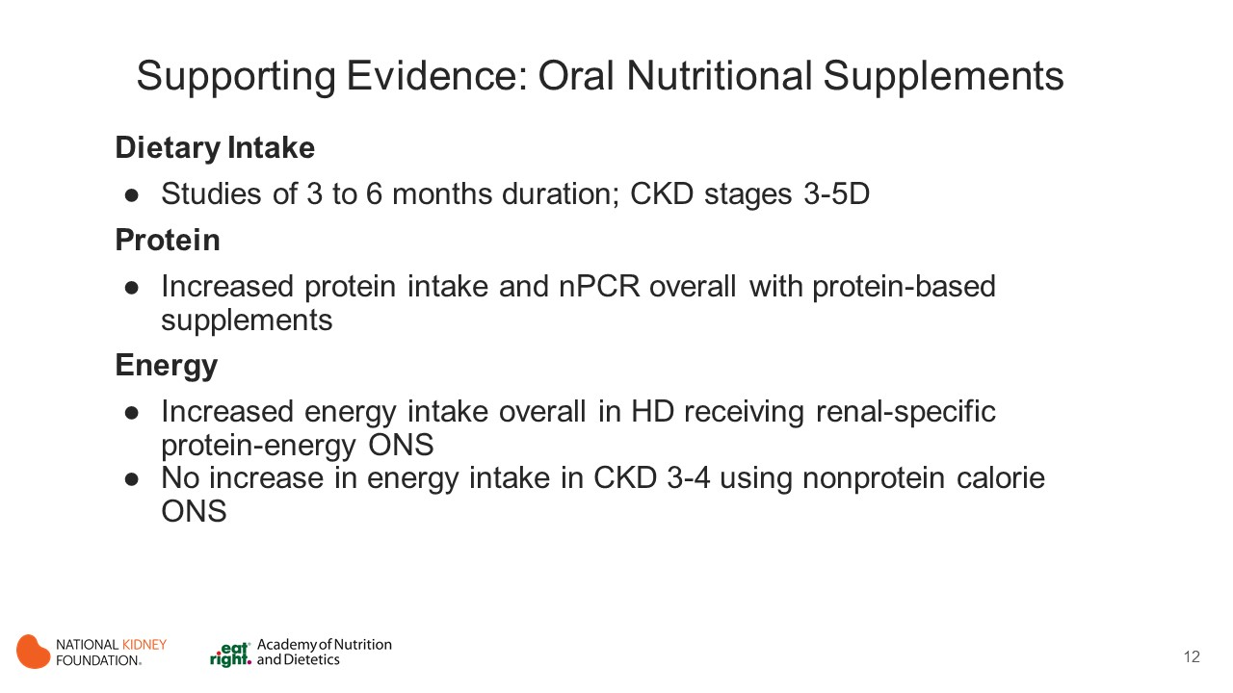
Notes:
Protein Intake
Ten studies (9 RCTs [Allman 1990, Bolasco 2011, Calegari 2011, Fouque 2008, Gonzalez-Espinoza 2005, Moretti 2009, Teixido-Planas 2005, Wu 2013, Hiroshige 2001] and 1 NRCT [Sezer 2014]) examined the effect of ONS on protein intake as estimated using nPCR/nPNA (nPCR), 24-hour dietary recall, or multiple-day food records with study durations of 3 to 6 months.
Overall, protein-based supplements using amino acids [Bolasco 2011] or branched chain amino acids [Hiroshige 2001]) increased reported protein intake and nPCR in patients receiving MHD and PD, but energy or protein-energy supplements (Allman 1990, Wu 2013) did not influence either marker in patients with CKD 3-5D.
A pooled analysis of 7 studies (Bolasco 2011, Calegari 2011, Fouque 2008, Gonzalez-Espinoza 2005, Moretti 2009, Teixido-Planas 2005, Sezer 2014) found that ONS significantly increased nPCR in patients receiving dialysis (SMD, 0.29 [95% CI, 0.04-0.53]), suggesting a potentially clinically relevant effect. However, a subgroup analysis found the effect to be significant only in persons receiving protein-based (Bolasco 2011, Gonzalez-Espinoza 2005, Moretti 2009) but not protein-energy–based ONS (Calegari 2011, Fouque 2008, Teixido-Planas 2005, Sezer 2014).
Similar results were noted in a pooled analysis of 3 studies (Fouque 2008, Gonzalez-Espinoza 2005, Teixido-Planas 2005) examining the effects of ONS on reported protein intake in which ONS increased reported protein intake in only 1 study that supplemented egg albumin protein (Gonzalez-Espinoza 2005).
Energy Intake
Six RCTs with study duration of 3 to 6 months examined the effect of ONS on energy intake in patients receiving MHD (Allman 1990, Fouque 2008, Hung 2009, Hiroshige 2001), receiving PD (Gonzalez-Espinoza 2005), and with CKD stages 3-4 (Wu 2013). Overall, ONS increased energy intake, though the effect was limited to patients on MHD receiving renal-specific protein-energy ONS.
Four of 5 studies in patients receiving dialysis reported that ONS increased energy intake. A subgroup analysis found the effect to be significant only for patients on MHD receiving protein-energy ONS, (Fouque 2008, Hung 2009) but not receiving protein-based (Gonzalez-Espinoza 2005) or energy-based (Wu 2013) ONS alone.
The only study in patients with CKD 3-4 found no improvement in energy intake using a nonprotein calorie ONS. (Wu 2013)

Slide 13
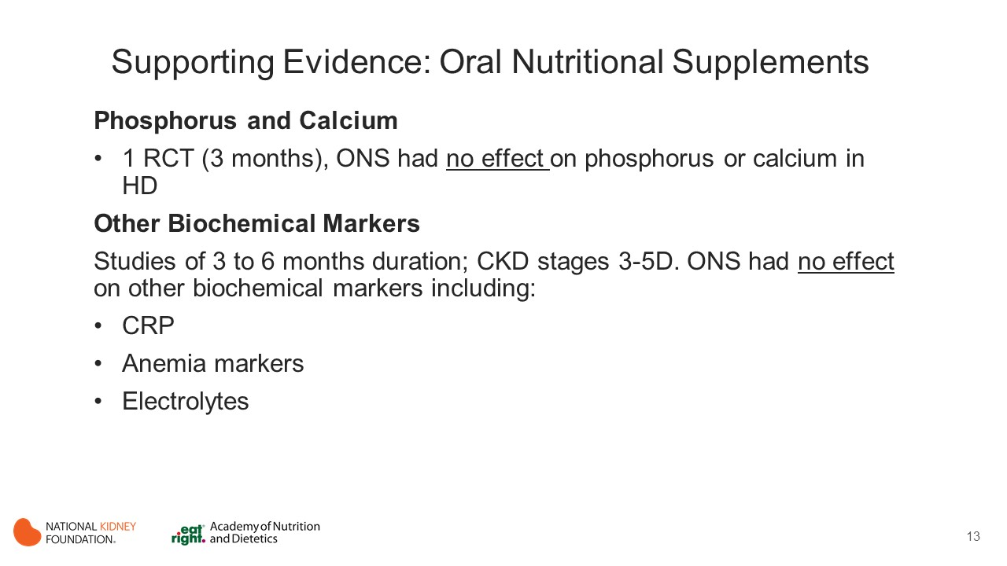
Notes:
Phosphorus and Calcium
An RCT of 3 months’ duration in patients receiving MHD found no effect on phosphorus or calcium intake. (Fouque 2008)
Other Biochemical Markers
Seven studies (6 RCTs [Bolasco 2011, Calegari 2011, Fouqpue 2008, Hung 2009, Tomayko 2015, Wu 2013] and 1 NRCT [Sezer 2014]) of 3 to 6 months’ duration in patients receiving MHD and with CKD 3-4 found no effect of ONS on CRP levels.
Six studies (5 RCTs [Allman 1990, Bolasco 2011, Calegari 2011, Tomayko 2015, Gonzalez-Espinoza 2005] and 1 NRCTs [Sezer 2014]) in patients receiving MHD or PD examined the effect of ONS on markers of anemia over a 3- to 6-month period. Overall, ONS had no effect on these markers.
Five studies (4 RCTs [Calegari 2011, Gonzalez-Espinoza 2005, Tomayko 2015, Wu 2013] and 1 NRCT [Scott 2009]) examined the effect of ONS on serum calcium, phosphate, and potassium levels over 3 to 6 months. Three of the trials were in patients receiving MHD, 1 was in patients receiving PD, and 1 was in patients with CKD 3-4. None of the studies found any effect on ONS on these electrolyte levels.

Slide 14
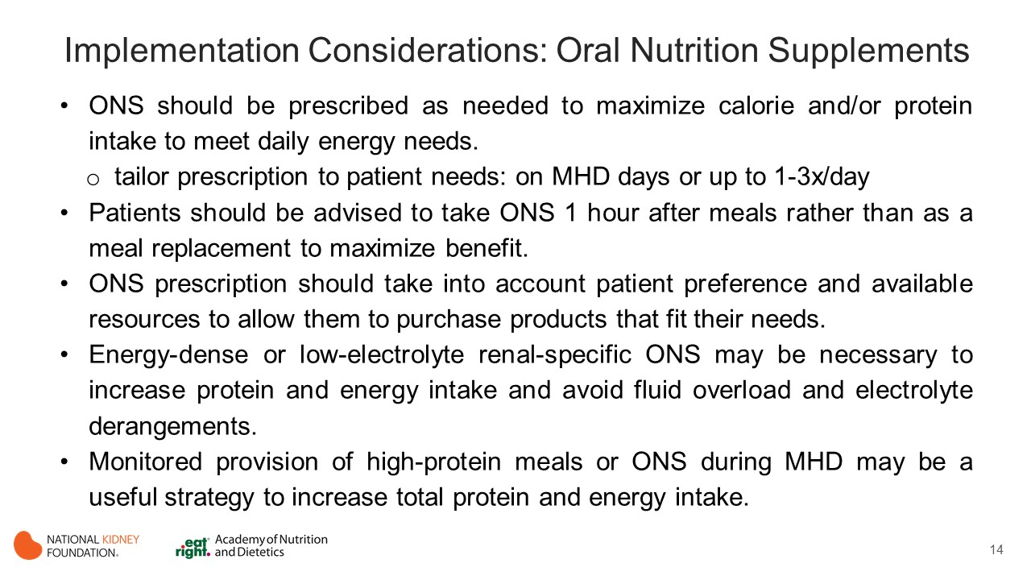
Notes:
Implementation Considerations
ONS should be prescribed as needed to maximize calorie and/or protein intake to meet daily needs. They can be prescribed intermittently, such as on dialysis days only, when patients are likely to eat less due to a missed meal as the result of treatment/travel time (i.e. on dialysis days only) or up to 3 times per day if necessary, to meet estimated calorie and/or protein needs.
Patients should be advised to take ONS 1 hour after meals rather than as a meal replacement to maximize benefit.
ONS prescription should take into account patient preference for a beverage, bar, powder or liquid. It is also important to discuss with patients resources available to allow them to purchase the needed products. If patient is unable to purchase ONS on their own it can be helpful to collaborate with the patient’s social worker to determine whether funds are available via a charitable organization to cover the cost.
ONS products that are more generally/easily available and possibly less expensive may be used if an individual’s lab parameters and fluid gains allow, but in many cases, energy-dense and low-electrolyte renal-specific ONS may be necessary to increase protein and energy intake and avoid fluid overload and electrolyte derangements.
Monitored provision of high-protein meals or ONS during MHD may be a useful strategy to increase total protein and energy intake. A collaborative effort between unit staff and dietitians is required to establish a successful program.

Slide 15
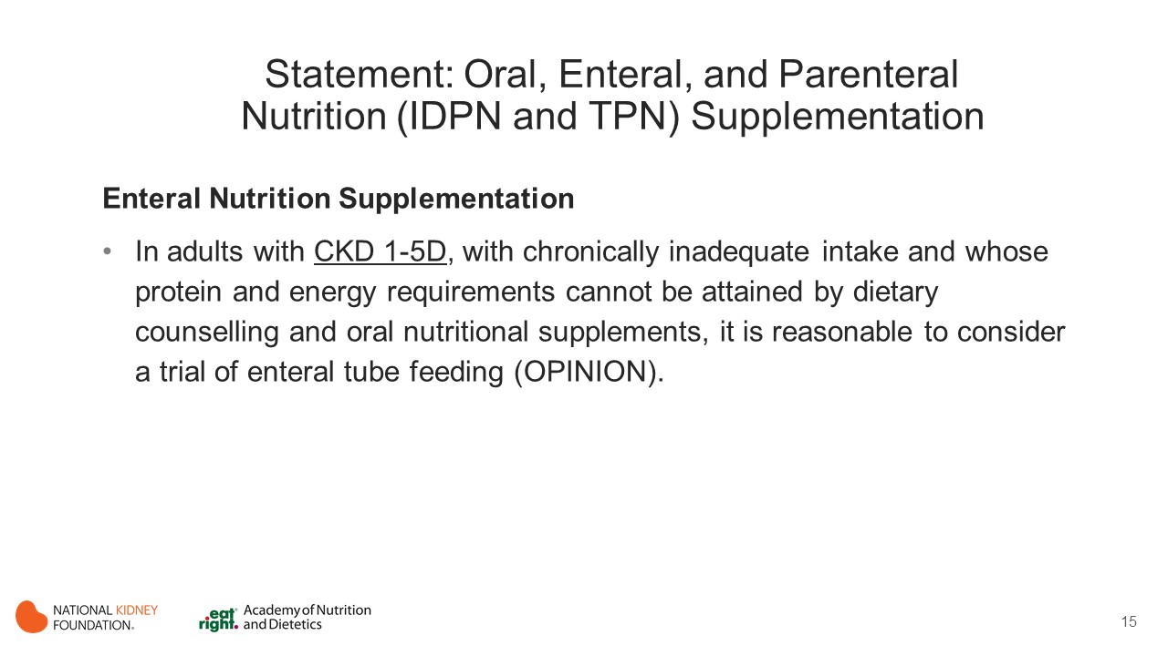
Notes:
Consideration of the use of enteral nutrition as a sole source of nutrition becomes a necessity when a patient is unable to consistently achieve calorie and protein goals despite intensive nutritional intervention and use of oral nutritional supplements.

Slide 16
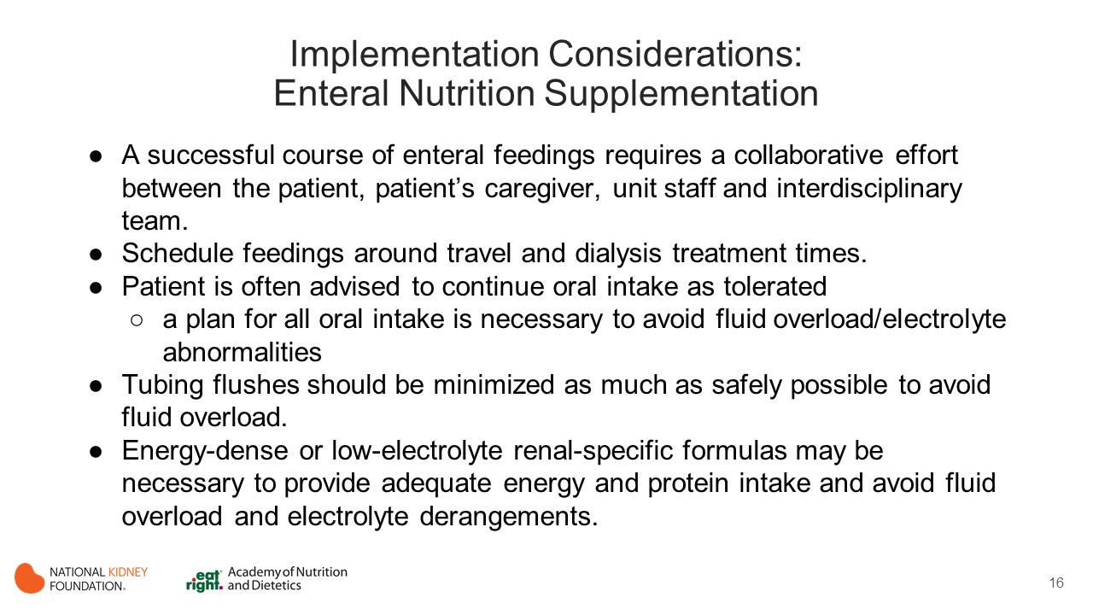
Notes:
A successful course of enteral feeding requires a collaborative effort between the patient, patient’s caregiver, unit staff and interdisciplinary team. Without this commitment, a successful enteral feeding regimen will not be achieved, especially in the long term. Frequent monitoring and adjustment of enteral regimen by the dietitian is required to ensure that patient doesn’t have difficulty with fluid overload or electrolyte derangements. With proper monitoring and management, enteral nutrition is not only possible, but well tolerated.
Schedule feedings around travel and dialysis treatment times. This is important to avoid interruptions in feedings that can lead to insufficient calorie and protein intake. It will also make it easier for caregivers and unit staff.
Often, patients receiving enteral feedings are allowed oral intake as tolerated. Unfortunately, comfort foods tend to consist of dairy foods, mashed potatoes and fruits which can contribute a significant amount of fluid and potassium over and above that already provided by the enteral feeding and needed flushes. A plan for all oral intake in necessary to avoid fluid overload/electrolyte abnormalities.
While tubing flushes is extremely important to maintain patency of the feeding tube, they should be minimized as much as safely possible to help avoid fluid overload.
ONS products that are more generally available and possibly less expensive may be used if an individual’s lab parameters and fluid gains allow, but in many cases, energy-dense and low-electrolyte renal-specific ONS may be necessary to ensure adequate protein and energy intake and avoid fluid overload and electrolyte derangements. Common difficulties to watch for include: fluid overload, hyperkalemia and hypophosphatemia. Note that it is possible to have hypokalemia as well as hyperphosphatemia in enterally fed patients. If fluid and electrolyte abnormalities cannot be adequately managed via use of a renal specific formula with minimal fluid flushes and controlled oral intake, additional dialysis may be required to help manage fluid and electrolytes.

Slide 17
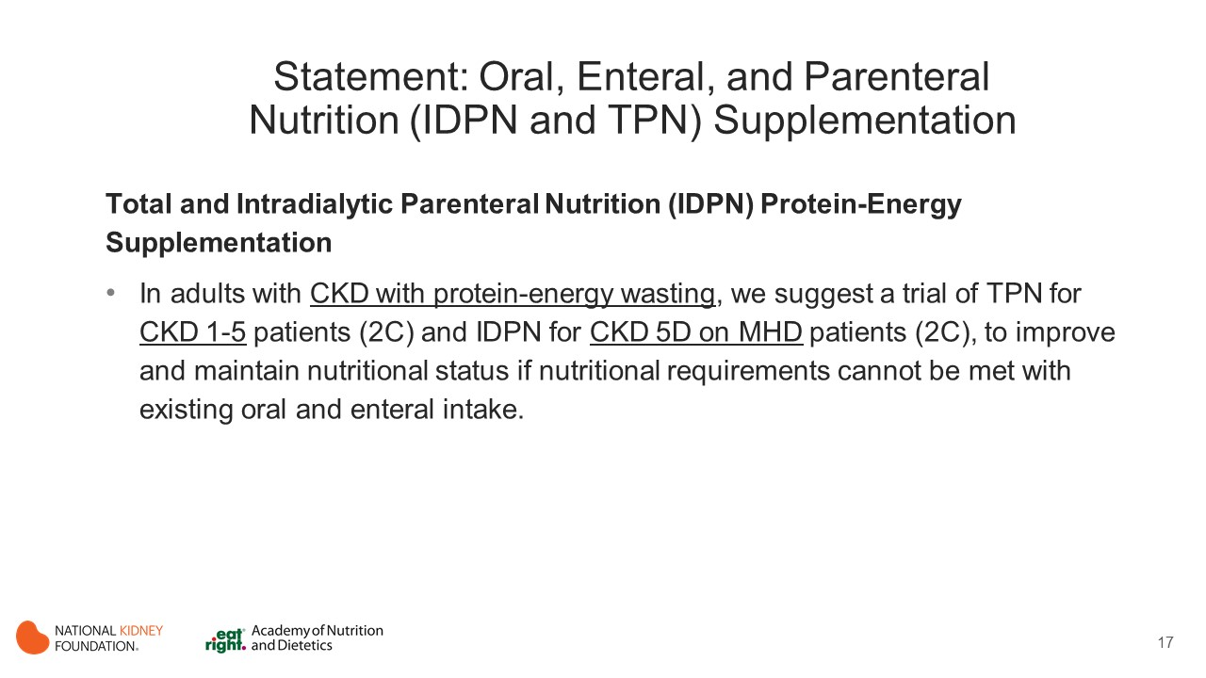
Notes:
Although feeding through the gastrointestinal route should be the preferred choice of nutritional supplementation, feeding through the parenteral route (i.e., total parenteral nutrition [TPN] and intradialytic parenteral nutrition [IDPN]) may be a safe and convenient approach for patients who cannot tolerate oral or enteral administration of nutrients.
In MHD patients, the use of the HD access for parenteral nutrition provides a significant advantage by eliminating the need for an additional permanent venous catheter placement. Because HD access is routinely used for the HD procedure, parenteral nutrition can be conveniently administered during HD through the dialysis tubing. This type of parenteral nutrition administration is called intradialytic parenteral nutrition (IDPN).

Slide 18
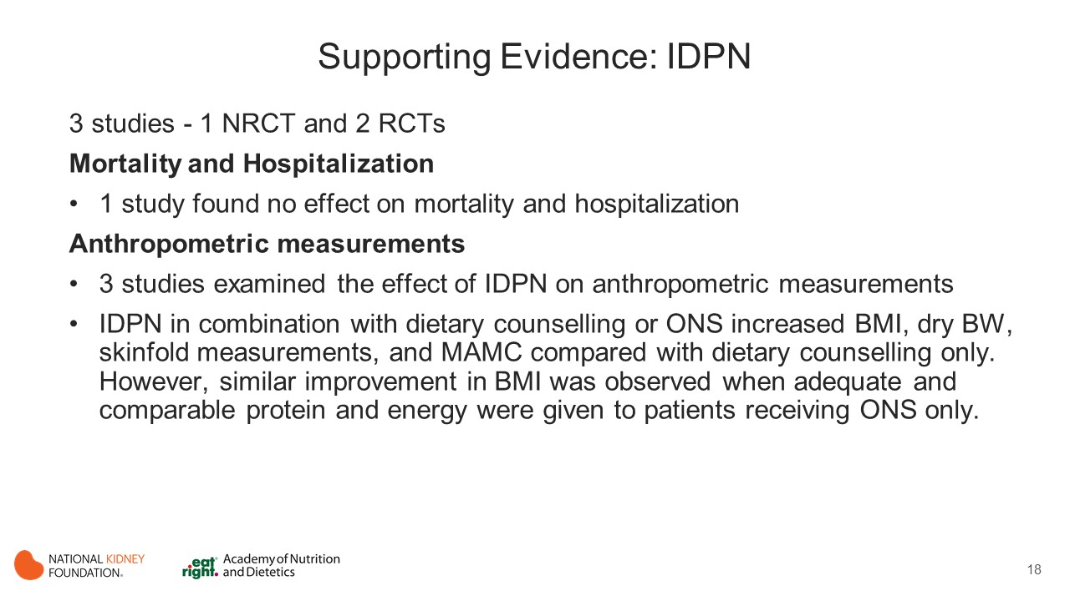
Notes:
Intradialytic Parenteral Nutrition
This evidence review encompassed 3 studies that examined the effects of IDPN on nutritional status and clinical outcomes in MHD patients, including 1 NRCT (Hiroshige 2001) and 2 RCTs (Cano 2007, Toigo 1989). In all these studies, participants were malnourished.
Mortality and Hospitalization
Only 1 study examined and found no effect of IDPN on mortality and hospitalization (Cano 2007). However, in this study, statistical comparisons were not provided but the authors described no significant differences in mortality and hospitalization events between the ONS-only and IDPN-with-ONS groups.
Anthropometric Measurements
Three studies examined the effect of IDPN on laboratory markers of nutritional status in malnourished MHD patients (Hiroshige 2001, Cano 2007, Toigo 1989).
The results from these studies concluded that IDPN combined with dietary counselling or ONS increased BMI (Hiroshige 2001, Cano 2007), dry BW (Hiroshige 2001), skinfold measurements (Hiroshige 2001), and MAMC (Hiroshige 2001) compared with dietary counselling only. However, similar improvement in BMI (Cano 2007) was observed when adequate and comparable protein and energy were given to patients receiving ONS only.

Slide 19
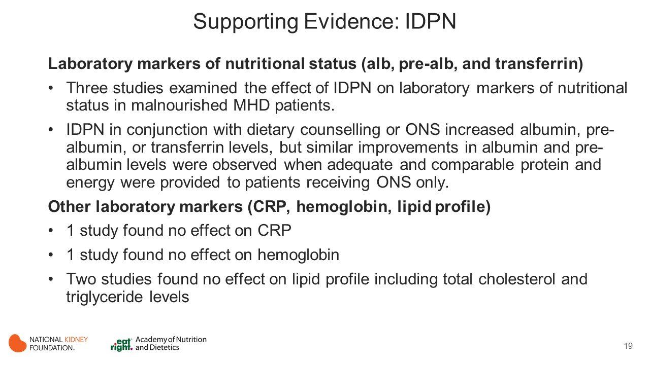
Notes:
Laboratory Markers of Nutritional Status
Three studies (Hiroshige 2001, Cano 2007, Toigo 1989) examined the effect of IDPN on laboratory markers of nutritional status in malnourished MHD patients.
IDPN in conjunction with dietary counselling or ONS increased albumin (Hiroshige 2001, Cano 2007), pre-albumin (Cano 2007), or transferrin levels (Hiroshige 2001), but similar improvements in albumin (Cano 2007 ) and pre-albumin (Cano 2007) levels were observed when adequate and comparable protein and energy were provided to patients receiving ONS only.
Other Laboratory Markers (CRP, hemoglobin and lipid profile)
One study evaluated and found no effect of IDPN on inflammation (Cano 2007) in malnourished HD patients.
One study examined and found no effect of IDPN on hemoglobin levels (Toigo 1989) after 6 months of IDPN therapy.
Two studies (Hiroshige 2001, Cano 2007) examined the effect of IDPN on lipid profile. The results from these studies showed that combining IDPN with dietary counselling or ONS did not affect total cholesterol (Hiroshige 2001) or triglyceride levels (Hiroshige 2001, Cano 2007).

Slide 20
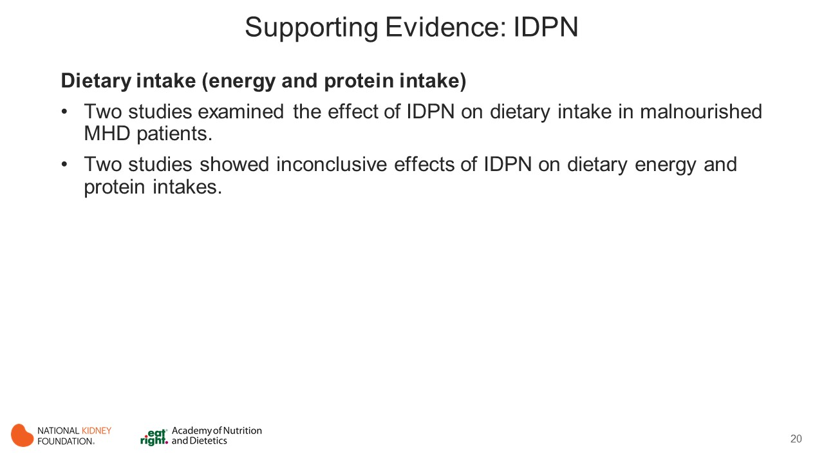
Notes:
Dietary Intake (Energy and Protein Intake)
Two studies (Hiroshige 2001, Cano 2007) examined the effect of IDPN on dietary intake in malnourished MHD patients.
The findings from these studies (Hiroshige 2001, Cano 2007) showed inconclusive effects of IDPN on dietary energy and protein intakes.

Slide 21
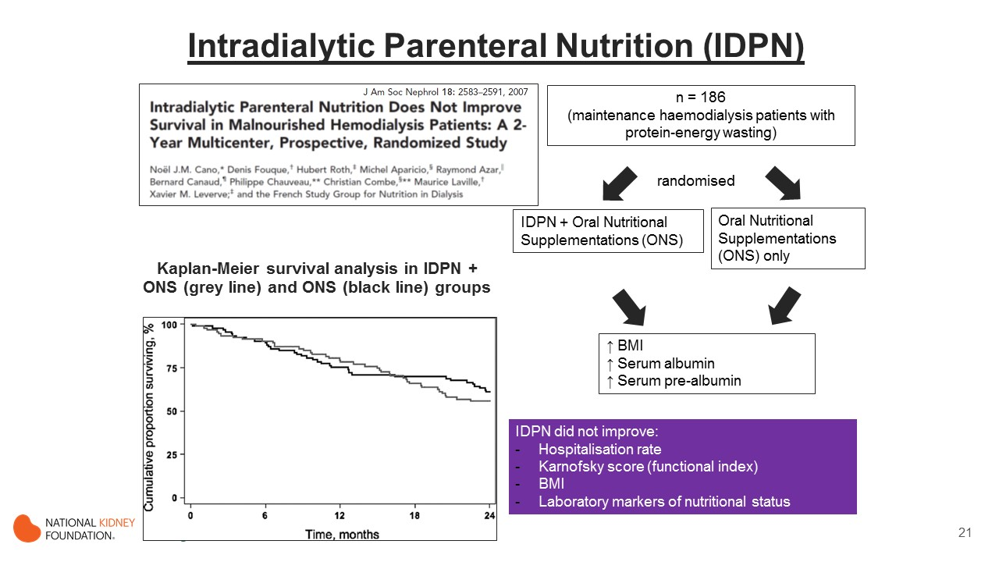
Notes:
This is a study from the French study group for nutrition in dialysis.
They carried out by-far the largest and best-executed nutritional intervention study on IDPN in maintenance haemodialysis patients presented with protein-energy wasting.
They enrolled 186 patients, with signs of protein-energy wasting.
Patients were then randomised to either IDPN plus ONS group, or ONS only groups, both groups were prescribed the same amount of calories and protein.
Over 2 years, they observed similar improvements of nutritional parameters in both groups, including raised BMI, serum albumin and serum pre-albumin.
If we now take a look at the survival analysis, comparing the 2 groups over 2 years. As you can see, mortality rates were similar at around 42%
In addition to mortality, IDPN did not improve hospitalisation rates, functional status, BMI and laboratory markers of nutritional status over 2 years.

Slide 22
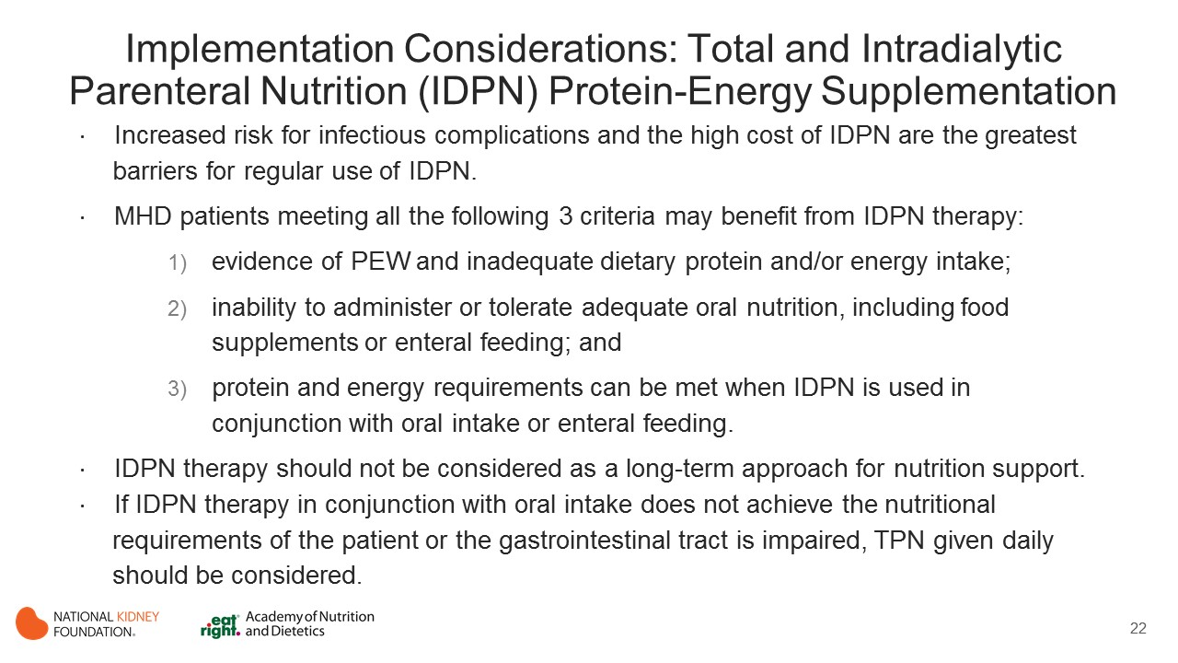
Notes:
Implementation Considerations
Increased risk for infectious complications and the high cost of IDPN are the greatest barriers for regular use of IDPN.
MHD patients meeting all of the following 3 criteria may benefit from IDPN therapy:
1) evidence of PEW and inadequate dietary protein and/or energy intake
2) inability to administer or tolerate adequate oral nutrition, including food supplements or enteral feeding
3) protein and energy requirements can be met when IDPN is used in conjunction with oral intake or enteral feeding
IDPN therapy should not be considered as a long-term approach of nutritional support. It should be discontinued and ONS should be attempted as soon as improvements in nutritional status are observed and patients are capable of using the oral or enteral route. Specific criteria for improvement should be patient specific.
If IDPN therapy in conjunction with oral intake does not achieve the nutritional requirements of the patient or the gastrointestinal tract is impaired, TPN given on a daily basis should be considered.

Slide 23
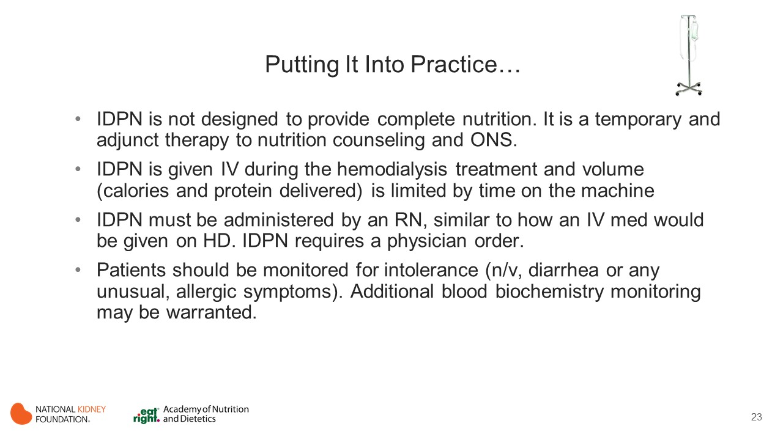

Slide 24
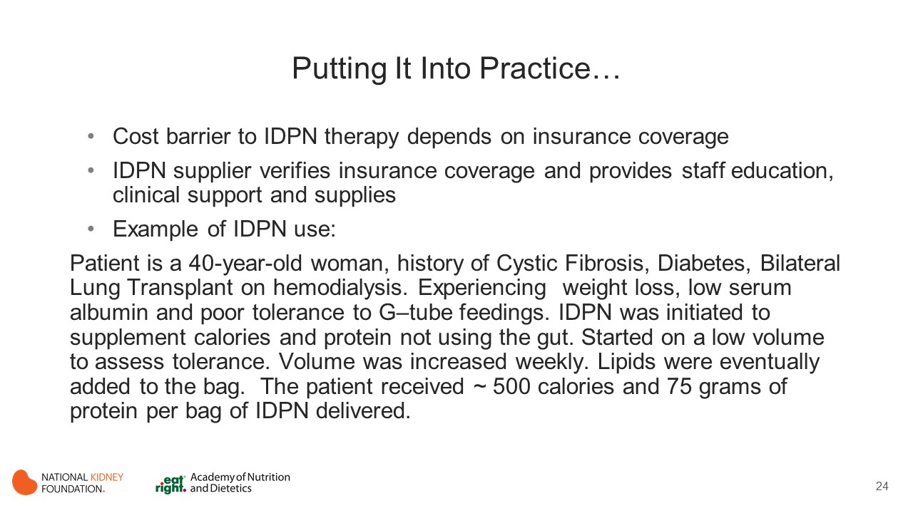

Slide 25
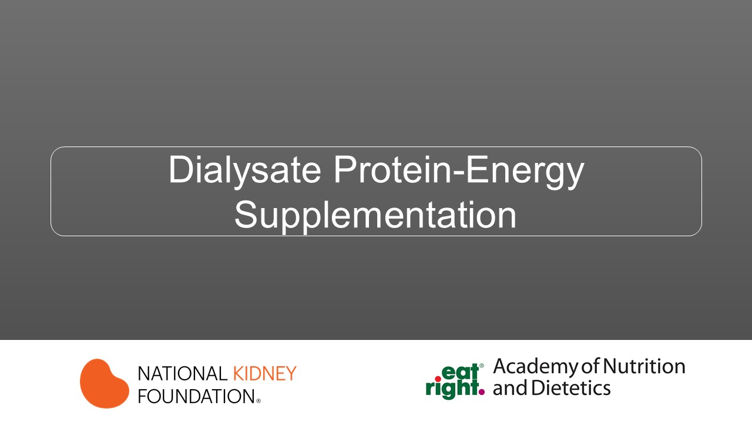

Slide 26
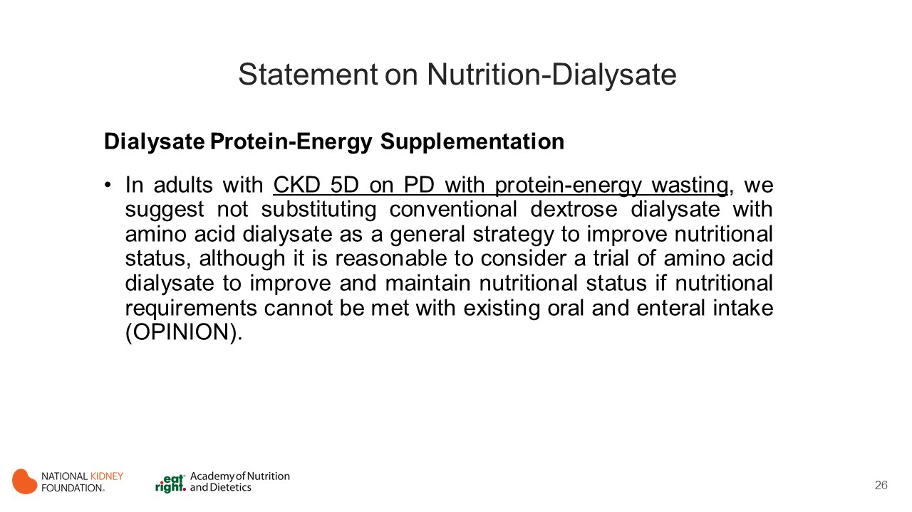
Notes:
PEW is common among patients receiving maintenance PD and is associated with increased morbidity and mortality. Inflammation, acidosis, insulin resistance, insufficient dietary intakes of protein and energy as a result of anorexia, and peritoneal losses of proteins and amino acids contribute to PEW.
Intraperitoneal amino acid (IPAA) supplementation was introduced to compensate for low protein intake and protein losses. Substituting amino acids for glucose in PD solutions should increase the amino acid intake and decrease the net amino acid losses of the patient, thereby increasing the net intake of protein precursors. IPAA supplementation may also reduce the infused carbohydrate load, thereby reducing the risk for hyperglycemia and the tendency to hypertriglyceridemia.

Slide 27
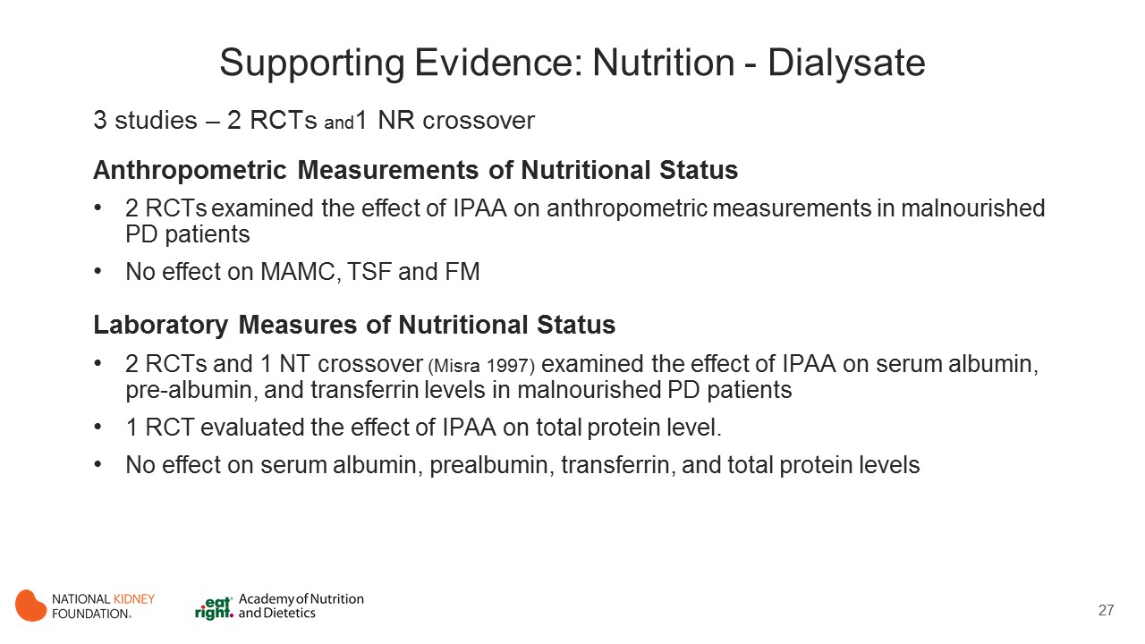
Notes:
This evidence review included 3 studies that examined the effect of IPAA supplementation on nutritional status in malnourished PD patients, including 2 RCTs (Jones 1998, Li 2003) and 1 nonrandomized crossover trial (Misra 1997).
Anthropometric Measurements of Nutritional Status
Two RCTs (Jones 1998, Li 2003) examined the effect of IPAA on anthropometric measurements in malnourished PD patients.
MAMC, TSF measurements, and FM were maintained at 3 months and 3 years in patients receiving either IPAA or standard dextrose dialysate (Jones 1998, Li 2003). The results from these studies indicated that substituting amino acid dialysate for dextrose dialysate had no effect on anthropometric measurements.
Laboratory Measures of Nutritional Status
Two RCTs (Jones 1998, Li 2003) and 1 NR crossover trial (Misra 1997) examined the effect of IPAA on serum albumin, prealbumin, and transferrin levels in malnourished PD patients.
One RCT (Jones 1998) evaluated the effect of IPAA on total protein level.
The findings from these studies concluded that substituting amino acid dialysate for dextrose dialysate in malnourished PD patients did not affect serum albumin, prealbumin, transferrin, and total protein levels compared with those receiving dextrose dialysate only.

Slide 28
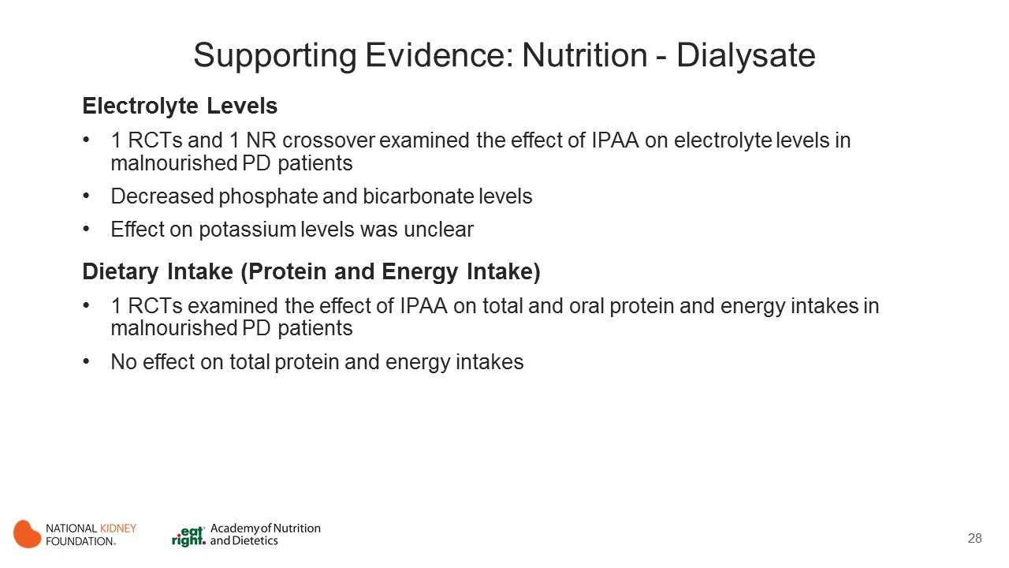
Notes:
Electrolyte Levels
One RCT (Jones 1998) and 1 NR crossover trial (Misra 1997) examined the effect of IPAA on electrolyte levels in malnourished PD patients.
The findings from these studies suggested that substituting amino acid dialysate for dextrose dialysate in malnourished PD patients decreased their phosphate and bicarbonate levels, but the effect on potassium levels was unclear (Jones 1998, Misra 1997).
Dietary Intake (Protein and Energy Intake)
Only one RCT (Jones 1998) examined the effect of IPAA supplementation on total and oral protein and energy intakes in malnourished PD patients.
Compared with baseline intake levels, total protein and energy intakes upon study completion increased significantly in patients receiving IPAA, but significant increases were not observed in patients receiving standard dextrose dialysate. Despite this, there were no between-group differences for both protein and energy intakes.

Slide 29
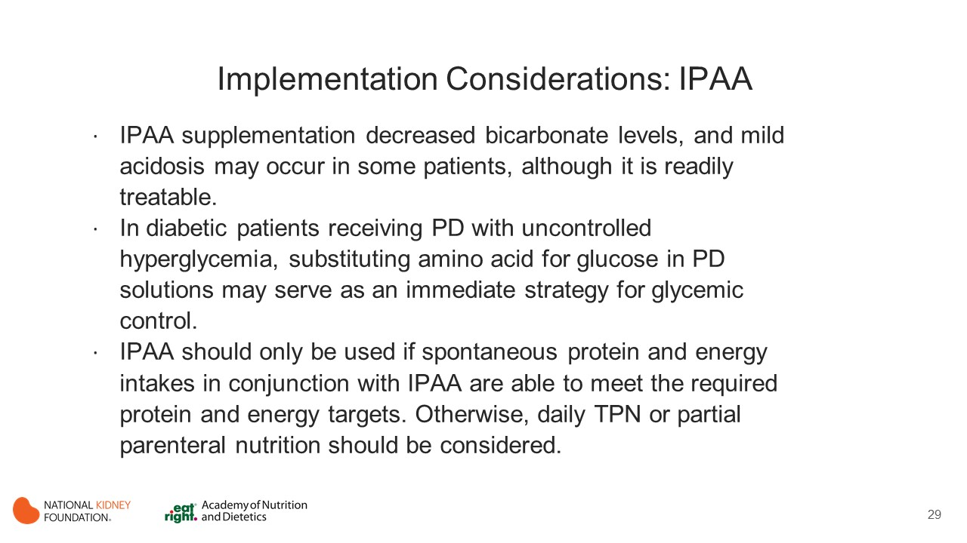
Notes:
The included studies assessed only intermediate nutrition-related outcome measures, including dietary intake (total energy and protein intakes and oral energy intake); laboratory markers of nutritional status (serum albumin, prealbumin, transferrin, and total-protein levels); and anthropometry (MAMC, TSF, and FM).
The effects of substituting amino acid dialysate for conventional dextrose dialysate on patient survival, hospitalization, other clinical outcomes, and QoL have not been adequately evaluated.
The long-term effect of IPAA therapy remains unclear.

Slide 30
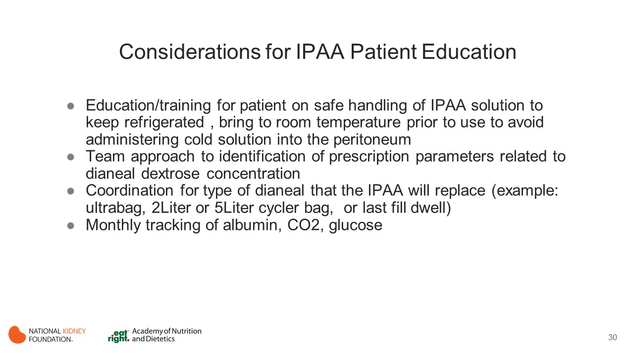

Slide 31

Intraperitoneal Amino Acid (IPAA) and Intraperitoneal Nutrition (IPN)
Practical Applications

Slide 32
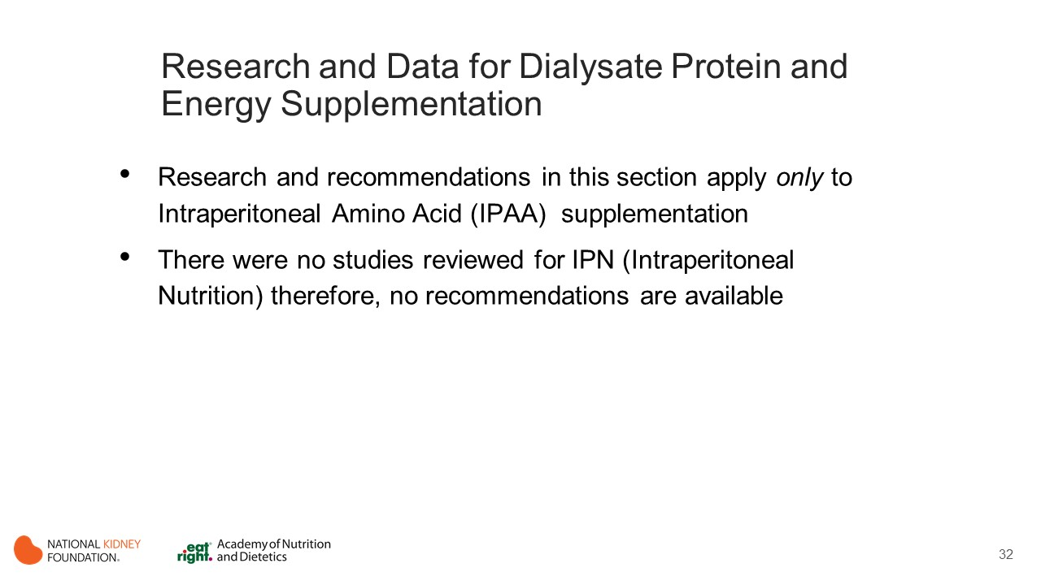

Slide 33
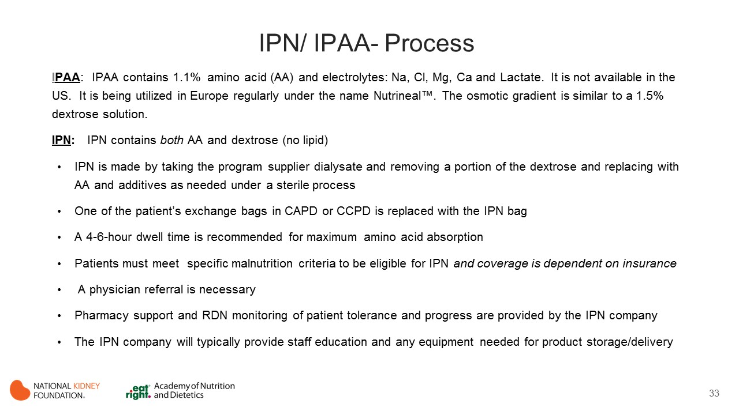

Slide 34
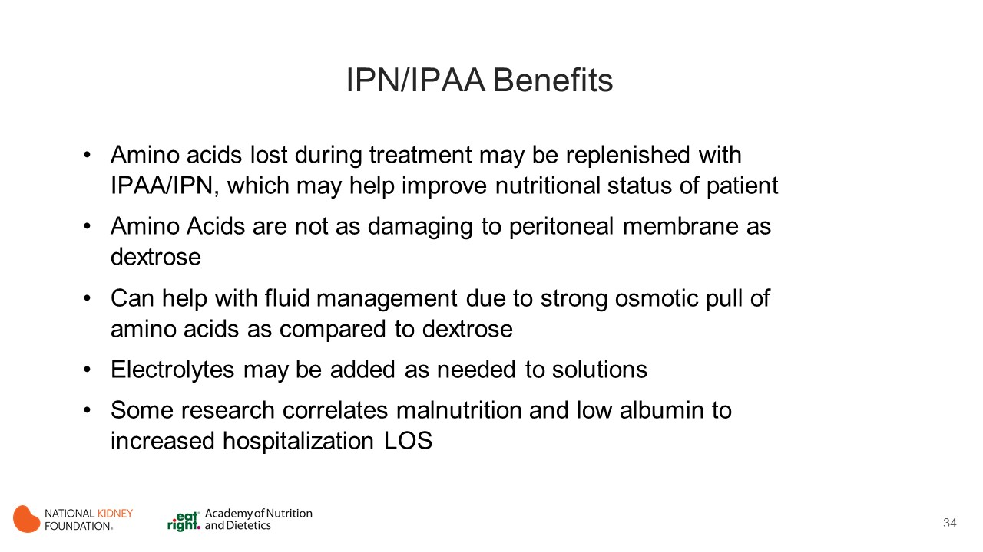

Slide 35
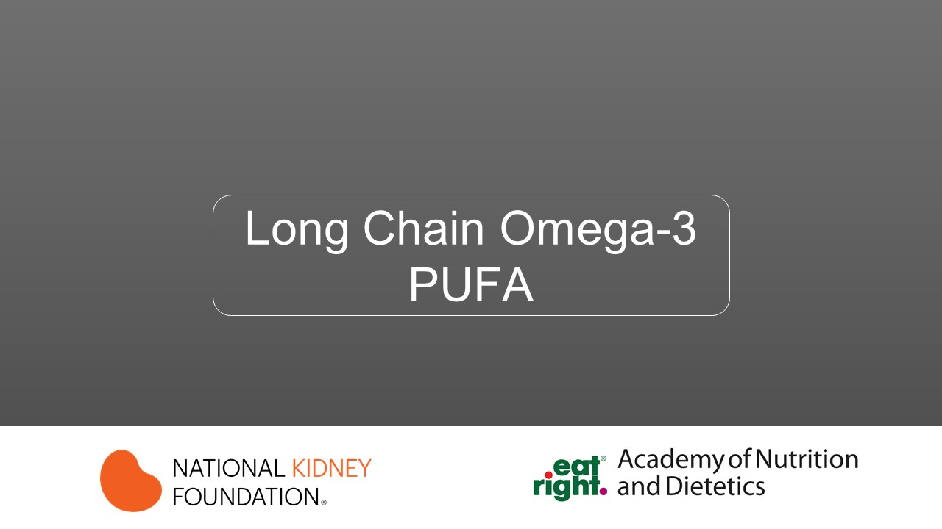

Slide 36
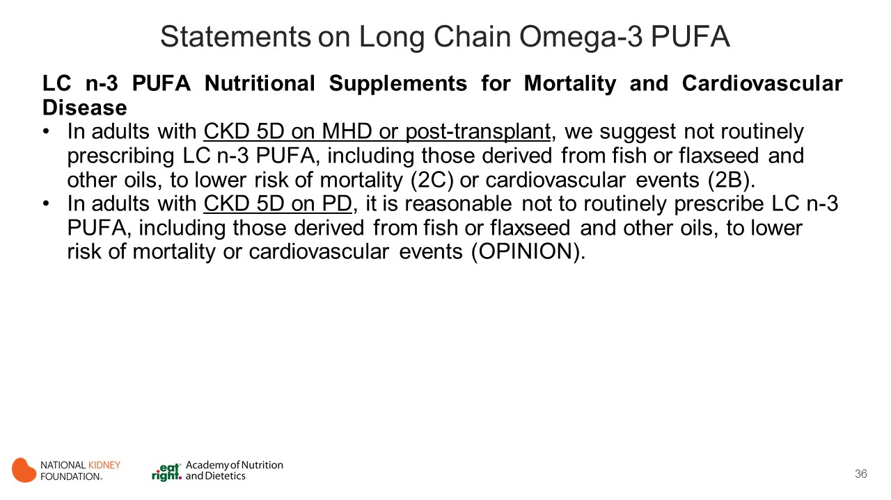
Notes:
Long chain omega-3 polyunsaturated fatty acids (LC n-3 PUFAs) include eicosapentaenoic (EPA) and docosapentaenoic and docosohexaenoic acids (DHA), all of which are obtained primarily from dietary sources such as cold-water fish (i.e., fish oil) or linoleic acid, which is derived from flaxseed or certain other vegetable oils.
In recent decades, LC n-3 PUFA have demonstrated protean biological effects on eicosanoid production, cell membrane physiology, signal transduction, metabolism, apoptosis, oxidation, and inflammation. Accordingly, they have been tested in a variety of medical conditions.

Slide 37
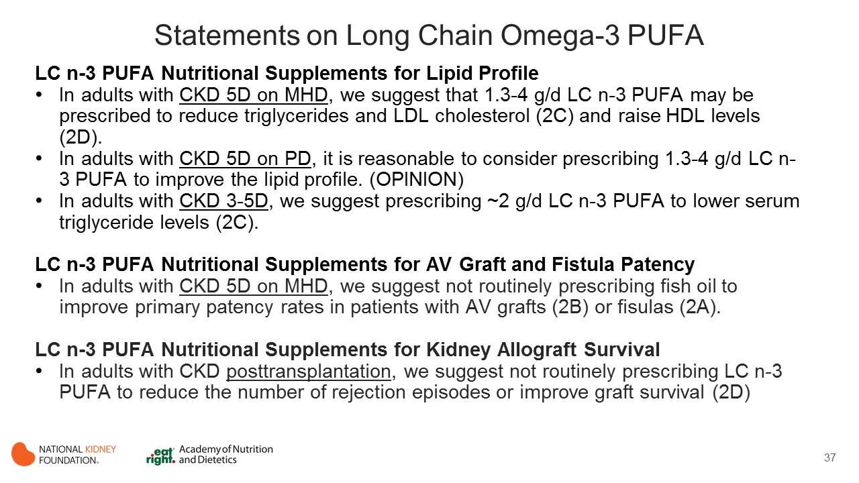
Notes:
Of particular interest has been their putative effects on cardiac membrane stabilization, leading to possible reduction of malignant arrhythmias and sudden cardiac death.
Patients with CKD have been documented to have some of the lowest blood levels of LC n-3 PUFAs on record, thus making them potentially very suitable candidates for supplementation interventions. LC n-3 PUFA supplementation has been studied as possible therapy for a number of conditions commonly observed in patients with CKD, including dyslipidemia, HD access failure, CVD, and death, as well as for their immunomodulatory effects in patients with kidney allografts.

Slide 38
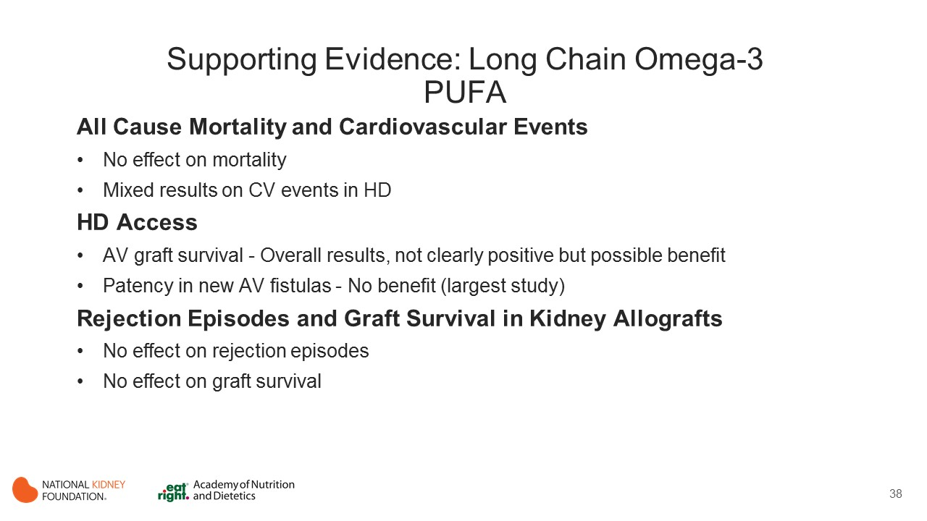
Notes:
All -Cause Mortality and Cardiovascular Events
Despite the putative overall benefits of LC n-3 PUFAs and the elevated risk for death in patients with CKD, 3 RCTs demonstrated no improvement in mortality with supplementation. However, the studies were heterogeneous in terms of study population (1 in patients with MHD [Svensson 2006], 2 in patients with CKD with kidney allografts [Berthoux 1992, Maachi 1995]), the dose of LC n-3 PUFAs (Maachi et al, 1.44 g/d of EPA + 0.96 g/d of DHA; Berthoux et al,²⁴⁵ 1.62 g/d of EPA + 1.08 g/d of DHA; Svensson et al, 0.77 g/d of EPA + 0.64 g/d of DHA), and study duration (1-2 years), with the combined study population being fairly modest in size (n = 264).
Two well-designed but modestly sized (combined n = 351) RCTs in patients receiving MHD reported mixed results on the effect of LC n-3 PUFA supplementation on cardiovascular events. (Svensson 2006, Lok 2012) Lok et al reported that 4 g/d of fish oil (1.6 g/d of EPA and 0.8 g/d of DHA) for 12 months as compared with corn oil–based placebo significantly lowered the cardiovascular event rate 0.41 (0.20-0.85) (P = 0.02) and improved cardiovascular event–free survival 0.43 (0.19-0.96) (P = 0.04 ) but did not influence the number of patients with 1 or more event 0.78 (0.55-1.09) (P = 0.15). All were secondary outcomes in a trial designed to study MHD vascular access. In a secondary prevention trial, Svensson et al reported that 1.7 g/d of fish oil (0.77 g/d of EPA and 0.64 g/d of DHA) for 2 years had no effect on the primary combined end point of cardiovascular events or death as compared with olive oil–based placebo, but improved the secondary end points of myocardial infarctions (MIs) (0.30 (0.10-0.92) (P = 0.036) and major coronary events (0.40 (0.17-0.97) (P = 0.043).
HD Access
4 RCTs examined whether LC n-3 PUFA supplementation could improve the patency of arteriovenous (AV) grafts or AV fistulas in patients receiving MHD.
Of the 3 RCTs (Lok 2012, Bowden 2009, Schmitz 2002) studying AV graft survival, the 2 smallest (using 0.96-1.76 g/d of EPA and 0.6-0.96 g/d of DHA) had mixed results, with 1 showing no benefit at 6 months (n = 29) (Bowden 2009) and the other (n = 24) reporting higher primary patency rates compared with the placebo group at 1 year (P < 0.03).(Schmitz 2002)
The third and much larger trial (n = 201) noted a borderline statistically significant improvement in the loss of native patency at 1 year 0.78 [0.60-1.03] (P = 0.064) after providing 1.6 g/d of EPA and 0.8 g/d of DHA.(Lok 2012) Although the overall results are not clearly positive, they suggest at a possible beneficial effect.
The largest study in this field (n = 567), which examined patency rates in new AV fistulas at 12 months, (Irish 2017) reported that fish oil, 4 g/d (1.84 g/d of EPA and 1.52 g/d of DHA), had no benefit.
Rejection Episodes and Graft Survival in Kidney Allografts
Although LC n-3 PUFAs have been reported to mediate the immunologic response, they have not yet demonstrated any benefits on kidney transplants.
Two RCTs (Maachi 1995, Bennett 1995) with differing study interventions (2.4 g/d of EPA + DHA for 1 year, 9 vs 18 g/d of EPA for 26 weeks) found no benefit on rejection episodes or a relationship between supplementation dose and rejection episodes.
Supplementation using approximately 2.5 g/d of EPA plus DHA also did not influence graft survival. (Berthoux 1992, Maachi 1995)

Slide 39
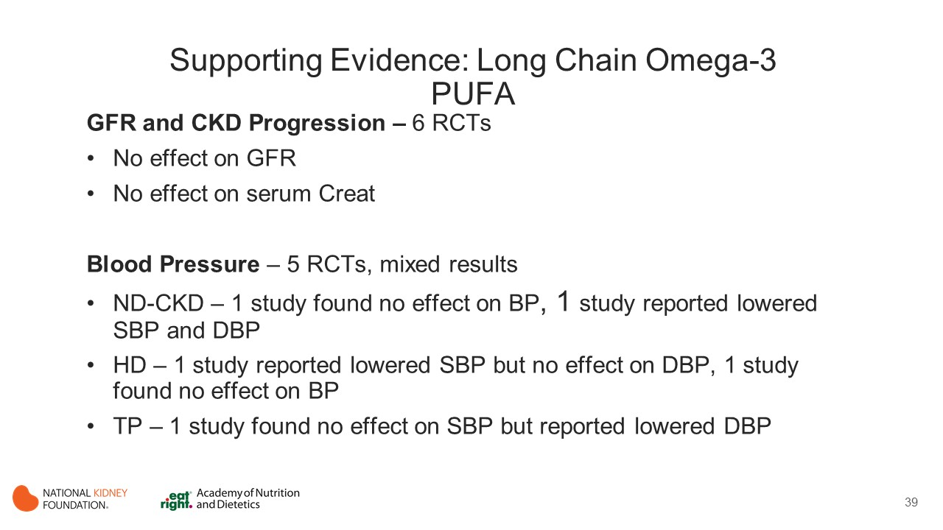
Notes:
GFR and CKD Progression
Based on 6 RCTs with widely differing study designs and populations (CKD stage 3, MHD, and kidney allografts), (Berthoux 1992, Maachi 1995, Bennett 1995, Bouzidi 2010, Guebre-Egziabher 2013, Mori 2009) fish oil supplementation was not found to influence eGFR or measured GFR. In the study by Guebre Egziabher et al, participants received 1.8 g of n-3 fatty acids, but authors do not describe EPA or DHA amounts. In the study by Bennett et al, participants received “9 or 18g/d EPA capsules.” In the remaining studies, EPA dose ranged from 0.46 to 1.62 g/d, and DHA dose ranged from 0.25 to 1.08 g/d.
Fish oil supplementation for 8 to 12 weeks did not influence serum creatinine levels in 3 studies of nondialyzed patients who used placebo or non–placebo-based control groups. In the study by Guebre Egziabher et al, participants received 1.8 g/d of n-3 fatty acids, but authors do not describe EPA or DHA amounts. In the remaining studies, EPA amounts ranged from 0.69 to 1.44 g/d, and DHA amounts ranged from 0.25 to 0.96 g/d. (Bouzidi 2010, Guebre-Egziabher 2013, Svensson 2004)
Blood Pressure
Five RCTs examined the effect of LC n-3 PUFA supplementation on BP, 2 in nondialyzed patients (no stage reported), (Svenson 2004, Mori 2009) 2 in patients receiving MHD, (Lok 2012, Khajehedehi 2000) and 1 in patients with CKD with kidney allografts.(Bennett 1995). The results were mixed.
In nondialyzed patients, Svensson et al reported that fish oil (0.96 g/d of DHA and 1.44 g/d of EPA) for 8 weeks did not affect BP, whereas Mori et al found that fish oil (0.38 g/d of DHA and 0.46 g/d of EPA) for 8 weeks lowered both SB and DBP. A pooled analysis of these 2 trials did not find an overall beneficial effect.
In patients receiving MHD, Lok et al reported an improvement in SBP in patients receiving MHD with fish oil (0.8 g/d of DHA and 1.6 g/d of EPA) for 1 year and a reduction in the number of BP medications, but no effect on DBP. In contrast, Khajehdehi et al found no effect on BP of 1.5 g/d of fish oil (DHA and EPA content not reported) as compared to placebo for 2 months. Data from these 2 trials could not be pooled.
Bennett et al randomly assigned patients with CKD with kidney allografts and reported no benefit of “9 or 18 g EPA capsules” per day versus placebo for 26 weeks on SBP but noted a reduction in DBP in both EPA arms (P < 0.05 for each) only.

Slide 40
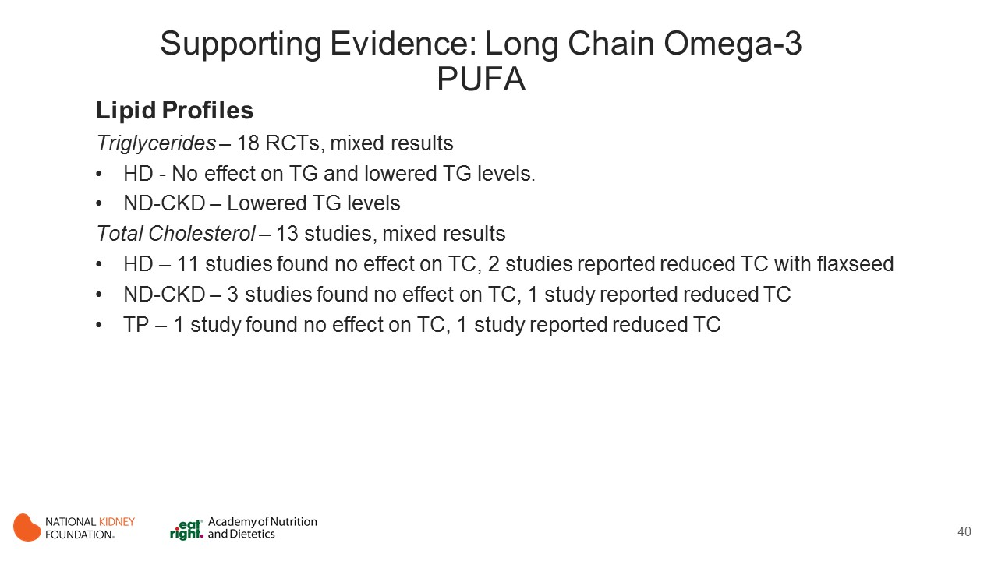
Notes:
Triglycerides
Eighteen RCTs studied the impact of LC n-3 PUFAs on serum TG levels.
Seven of the 13 trials studying patients with MHD found no effect (Lemos 2012, Bowden 2009, Daud 2012, Ewers 2009, Poulia 2011, Saifullah 2007, Tayebi-Khoosroshahi 2013) and 6 reported a reduction in levels. (Lemos 2012, Khalatbari 2013, Khajehdehi 2000, Kooshki 2011, Sorensen 2015, Taziki 2007) In a pooled analysis of 12 of these studies, LC n-3 PUFA supplementation lowered TG levels by an average of −33.78 (95% CI, −63.21 to −4.36) mg/dL as compared with placebo/controls, though heterogeneity was high (I² = 92.36%; P < 0.001). Although outcomes did not appear to be related to study quality or duration, TG lowering tended to be associated with using lower doses of LC n-3 PUFAs (0.42-0.96 g/d of EPA and 0.24-0.6 g/d of DHA), flaxseed oil (2 g/d), or ground flaxseed (40 g/d), a counterintuitive finding.
Positive results were more consistent in nondialyzed patients, for whom fish oil supplementation (1.8 g/d total or 0.46-1.44 g/d of EPA with 0.25-0.96 g/d of DHA) for 8 to 12 weeks consistently lowered TG levels.
Total cholesterol
Eleven of 13 studies in patients receiving MHD reported no effect (0.42-1.8 g of EPA and 0.24-1.14 g of DHA per day for 4 weeks to 6 months), (Lemos 2012, Bowden 2009, Khajehdehi 2000, Daud 2012, Ewers 2009, Kooshki 2011, Poulia 2011, Saifullah 2007, Sorensen 2015, Tayebi-Khoroshahi 2013, Taziki 2007) while the 2 studies supplementing with flaxseed oil (2 g/d for 120 days) (Lemos 2012) or ground flaxseed (40 g/d for 8 weeks) (Khalatbari 2013) noted a significant reduction in TC levels (though 1 study did not compare differences between groups). A pooled analysis of all 13 studies did not find any effect on mean TC level but noted a high level of heterogeneity in the data (I² = 95.77%; P < 0.001).
Three of 4 supplementation studies in nondialyzed patients reported no effect on TC levels, (Svensson 2006, Mori 2009, Guebre-Egziabher 2005) whereas the fourth demonstrated a reduction at 3 months (P < 0.05) with no difference between arms. (Bouzidi 2010). Results could not be pooled for these 4 studies.
Although Ramezani et al reported lower cholesterol levels in patients with CKD with kidney allografts compared to placebo after 6 months of supplementation with 1.76 g/d of EPA with 0.96 g/d of DHA in fish oil, Schmitz et al found no such benefit in a similar population.
Lemos 2012 - the evidence states: Though the median decrease in triglyceride levels was not significant in the intervention group (p=0.06), there was a significant increase in the placebo group (p<0.05).

Slide 41
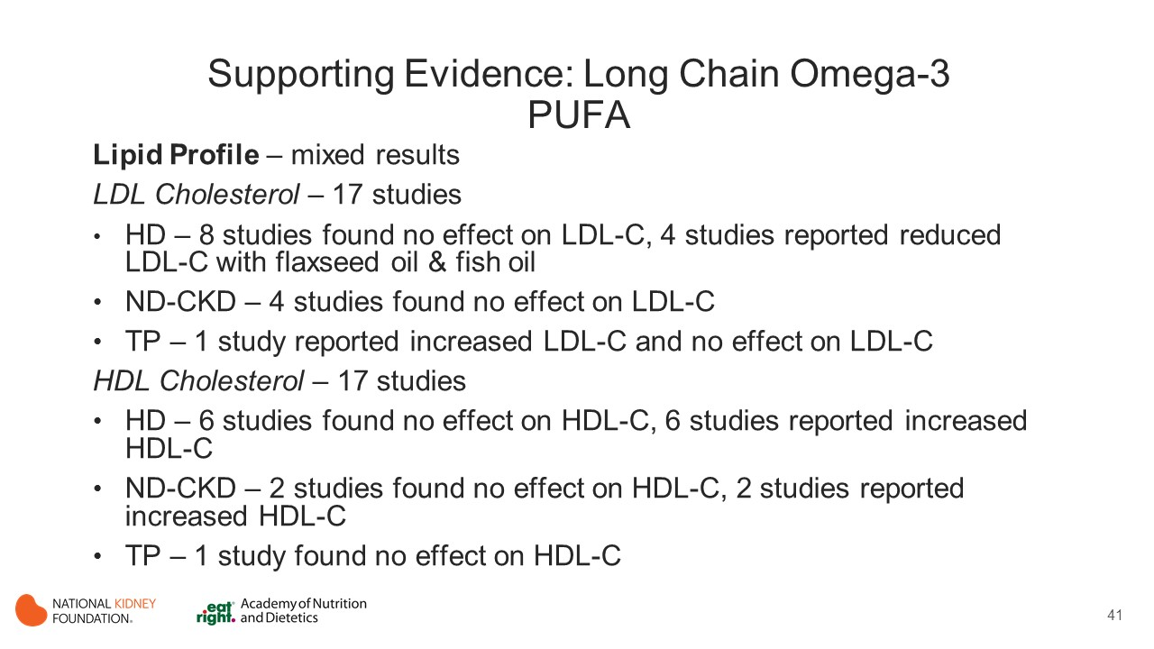
Notes:
LDL Cholesterol
Eight of 12 studies in patients receiving MHD found no benefit of supplementation, (Lemos 2012, Daud 2012, Ewers 2009, Kooshi 2011, Saifullah 2007, Sorensen 2015, Tayebi-Khosroshahi 2013, Taziki 2007) while 4 reported a reduction in LDL-C levels. (Lemos 2012, Khalatbari 2013, Bowden 2009, Khajehdehi 2000).
Two of the 4 positive studies supplemented with fish oil (1.5 g total in Khajehdehi et al and 0.96 g/d of EPA with 0.6 g/d of DHA in Bowden et al, while the other 2 used flaxseed oil or ground flaxseed (Lemos, Khalatbari) [with both latter studies observing a decrease in LDL-C levels]). (Lemos, Khalatbari)
Study quality or duration or type of comparison group used did not influence the outcome. A pooled analysis of all 12 studies noted an improvement in LDL-C levels only when excluding the flaxseed-based supplement studies (mean difference, −5.26 [95% CI, −9.51 to −1.00] mg/dL) and even then, the result was clinically marginal.
Nondialyzed patients, 4 studies of 8 to 12 weeks length using fish oil found no effect on LDL-C levels (1.8 g/d total in Guebre-Egziabher et al and 0.46-1.44 g/d of EPA with 0.25-0.96 g/d of DHA).
In patients with CKD with kidney allografts, 1 study reported that EPA “9g capsules” per day increased LDL-C levels (but a higher dose did not), while another study reported negative results.
The preponderance of evidence suggests that omega 3 supplementation from fish oil may lower LDL cholesterol levels by approximately 5 mg/dL in HD patients compared to controls when administered at 1.3-3g/d, though evidence was somewhat mixed. Ground flaxseed may have a much larger effect on lowering LDL cholesterol levels in HD patients, but results were limited. Omega 3 fish oil supplementation did not affect LDL cholesterol levels in non-dialyzed patients and evidence was limited and inconclusive with renal transplant patients.
HDL Cholesterol
Seventeen RCTs included HDL-C level as an outcome. Though HDL-C level may be influenced by physical activity, smoking status, and sex, the preponderance of these studies did not control for these factors.
Of the 12 studies in patients receiving MHD, 6 reported negative results (Lemos 2012, Daud 2012, Ewers 2009, Kooshi 2011, Saifullah 2007, Tayebi-Khosroshahi 2013) and 6 found that HDL-C levels were increased. (Lemos 2012, Khallatbari 2013, Bowden 2009, Khajehedehi 2000, Sorensen 2015, Taziki 2007) Effects were not clearly influenced by study quality or duration. However, the positive studies tended to use lower doses of LC n-3 PUFAs (0.72-0.96 g/d of EPA with 0.42-0.6 g/d of DHA), flaxseed oil (2 g/d), or ground flaxseed (40 g/d). In a pooled analysis of all 12 studies, LC n-3 PUFA supplementation was found to increase HDL-C levels by a mean of 7.1 (95% CI, 0.52-13.63) mg/dL. However, heterogeneity was high overall.
Results were mixed in the 4 trials of predialysis patients, with 2 showing a benefit (Svensson 2004, Guebre-Egziabher 2005) and 2 reporting no effect. (Bouzidi 2010, Mori 2009) Again, the outcome was not clearly influenced by quality of study, study duration, or dosage, and results could not be pooled.
Finally, the only study in patients with CKD with kidney allografts showed no benefit.
Omega 3 supplementation (1.3-3g/d) increased HDL cholesterol levels approximately 7 mg/dL in HD participants, but heterogeneity of results was high, and most studies did not appropriately control for confounding variables, so results should be interpreted with caution. The effect of omega 3 supplementation on HDL cholesterol levels in non-dialyzed patients was unclear and research was limited in renal transplant patients.

Slide 42
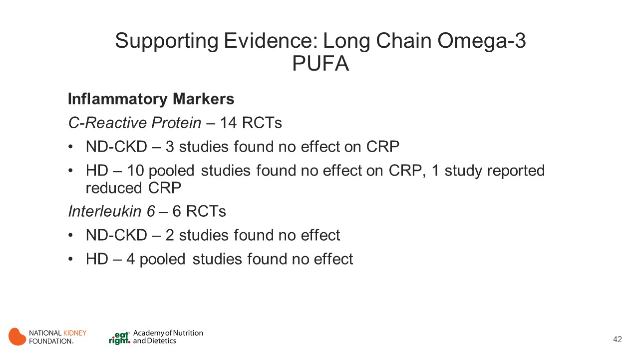
Notes:
C-Reactive Protein
Fourteen RCTs studied the effect of fish oil supplementation on circulating CRP levels.
In predialysis patients throughout the stages of CKD, fish oil either compared to placebo (Mori 2009, Madsen 2007) or at varying doses (Guebre-Egziabher 2005) had no effect.
The pattern in patients receiving MHD was similar. A pooled analysis of 10 studies (Lemos 2012, Khalatbari 2013, Bowden 2009, Daud 2012, Kooshki 2011, Poulia 2011, Saifullah 2007, Gharekhani 2014, Harving 2015, Hung 2015) found no effect of LC n-3 PUFA supplementation (9 using fish oil containing 0.42-1.8 g/d of EPA with 0.24-1.14 g/d of DHA, 1 using 2 g/d of flaxseed oil) on circulating CRP levels as compared to placebo. Ewers et al found that fat supplementation (which also included fats other than LC-n-3 PUFAs and specific n-3 PUFAs were not described) was associated with a reduction in CRP levels (P = 0.01) after 12 weeks as compared with nonsupplemented patients.
Interleukin 6
Six RCTs studied the effect of LC n-3 PUFAs on circulating IL-6 levels.
Neither of the 2 studies in predialysis patients comparing fish oil supplementation with placebo or at varying doses found a significant effect on IL-6 levels (1 study reported 1.8 g/d of n-3 PUFAs total and 1 reported 1.4 g/d of EPA with 1.0 g of DHA) (Guebre-Egziabher 2005, Deike 2012), nor did a pooled analysis of 4 studies in patients receiving MHD in which participants received 0 to 1.93 g/d of EPA with 0.72 to 0.97 g/d of DHA. (Kooshki 2011, Gharekhani 2014, Hung 2015, Himmelfarb2007)

Slide 43
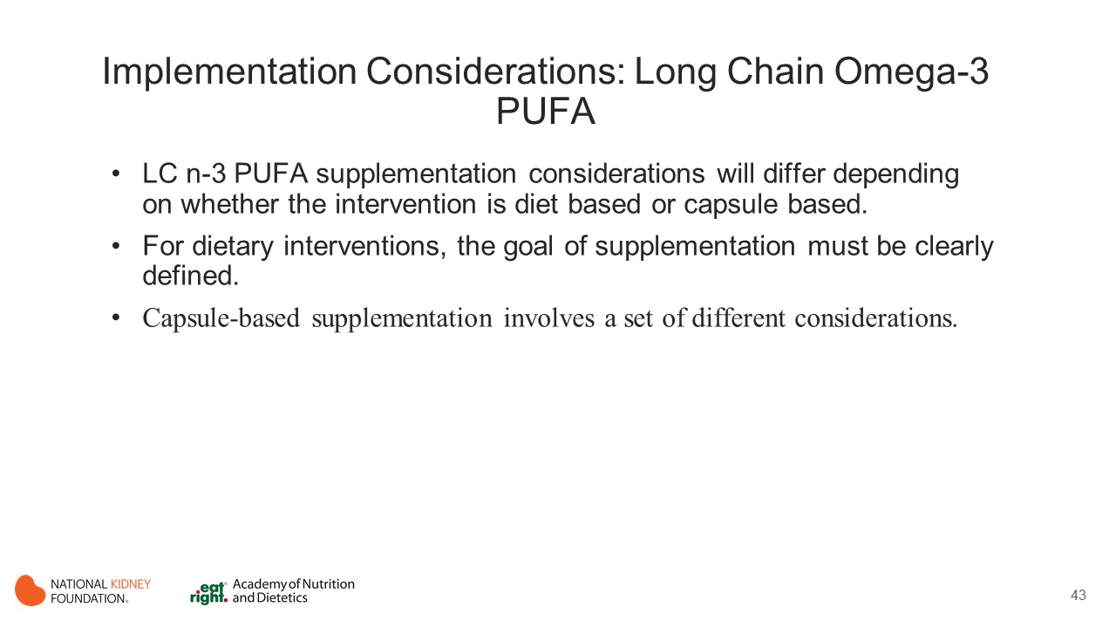
Notes:
LC n-3 PUFA supplementation considerations will differ depending on whether the intervention is diet based or capsule based.
For dietary interventions, the goal of supplementation must be clearly defined. If it is to increase blood levels of α-linolenic acid (ALA), supplementation should focus on soybean, flaxseed, and other oils, as well as meat and dairy products. If it is to increase EPA or DHA blood/tissue levels, the primary dietary sources must be sardine, mackerel, salmon, and other high-content marine-based foods. Potential limitations to dietary supplementation include their relatively high cost and difficulty achieving high daily intake. In addition, the source and processing method will influence LC n-3 PUFA foodstuff content. For example, farmed fish typically (but not always) have lower LC n-3 PUFA content compared with wild fish, while frying fish could alter the n-3 to n-6 ratio, which may be of clinical significance.
Capsule-based supplementation involves a set of different considerations. Although dozens of commercial LC n-3 PUFA supplements are available, quality control is often lacking. This makes precise dosing recommendations difficult. An alternative route is to have the patient obtain supplements through physician prescription (eg, icosapent ethyl and omega-3 ethyl esters). For either option, cost could be an issue. Achieving high-dose supplementation will be easier with capsules than through dietary consumption. Adverse effects of capsule-based supplementation may lead to gastrointestinal side effects such as stomach upset and eructation (though the latter can be masked by different formulations). Theoretical risks such as bleeding have not been borne out in clinical trials. LC n-3 PUFA content is listed on the website of the National Institutes of Health.

Slide 44
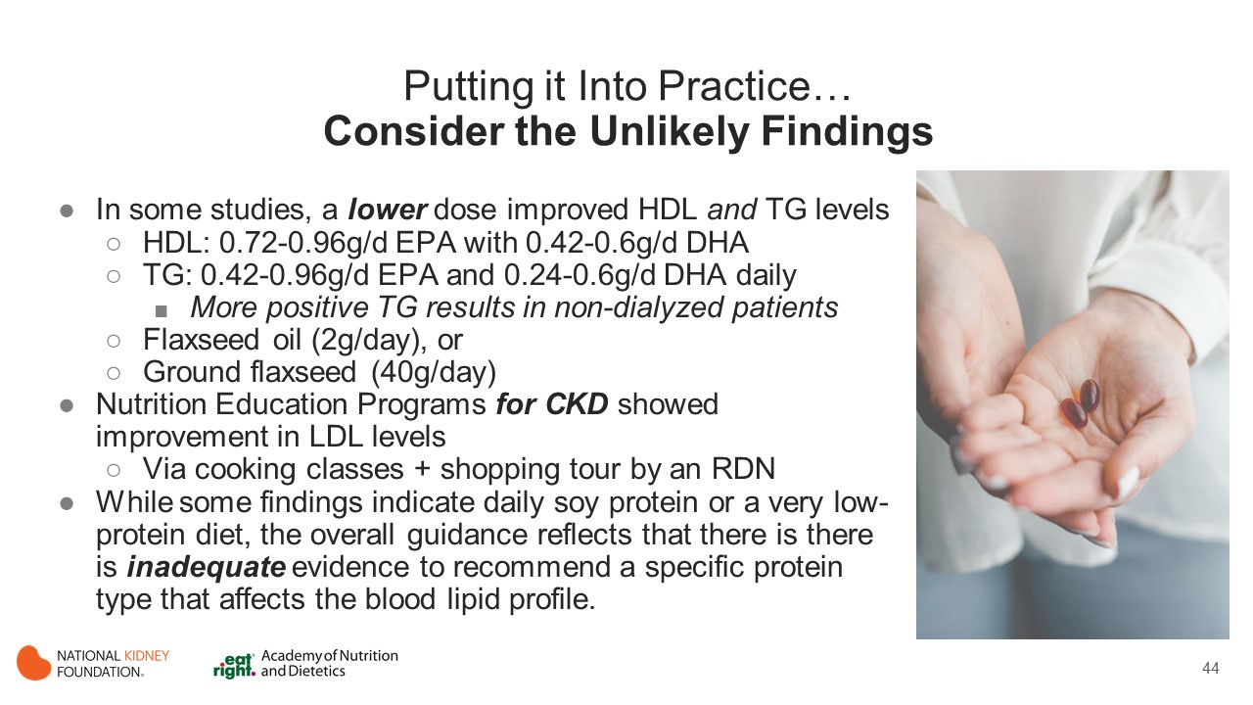

Slide 45

Notes:
Sure, some studies show that lipid profiles may improve with supplementation, with specific food changes, or with specialized MNT through cooking and shopping sessions. But consider that there are many other areas of MNT that may need to be addressed first before focusing on getting a patient to supplement with an expensive or GI intolerant supplement or with a new eating regimen soley for a change in the TGs or another lipid profile indicator alone. Take a step back and prioritize what the IDT and the patient agree are important and are equally willing and able to address. Consider interventions that align with what is already known to improve quality of life and reduce mortality (think healthy dietary patterns that are high in fiber and antioxidants).

Slide 46
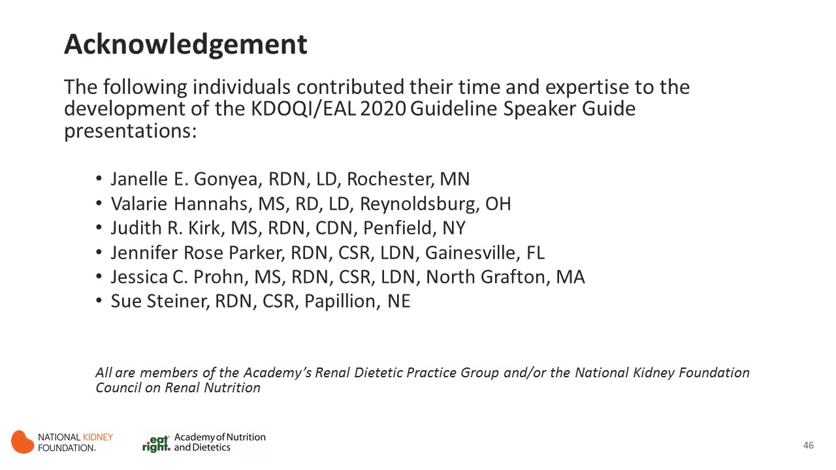

Slide 47
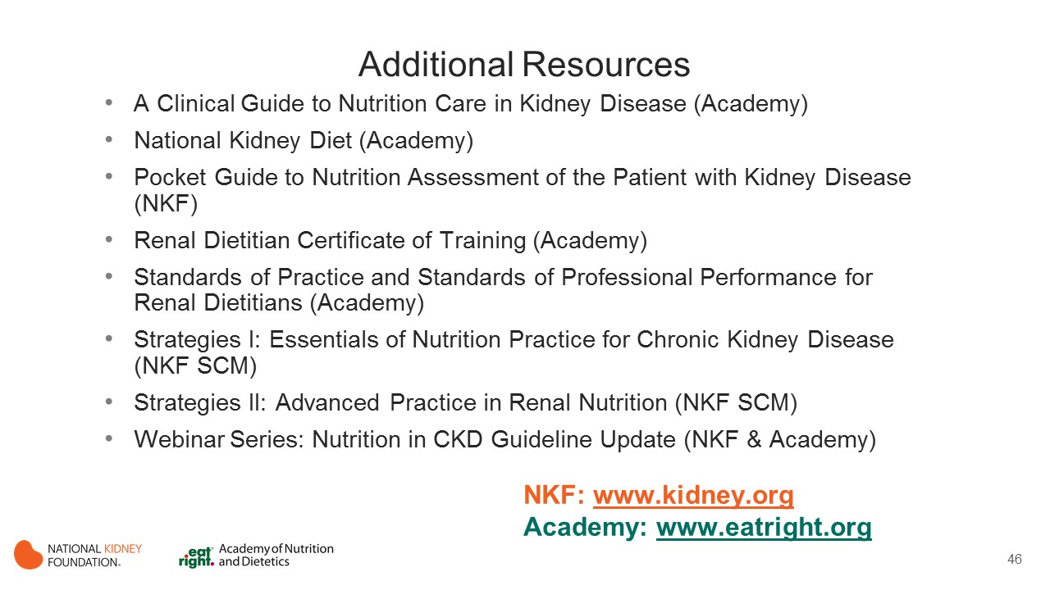
Notes:
These resources from the Academy of Nutrition and Dietetics and the National Kidney Foundation provide additional information to support implementation of the KDOQI Guideline for Nutrition in CKD.
For NKF resources go to kidney.org
For Academy resources go to eatright.org

Slide 48


