Slide 1
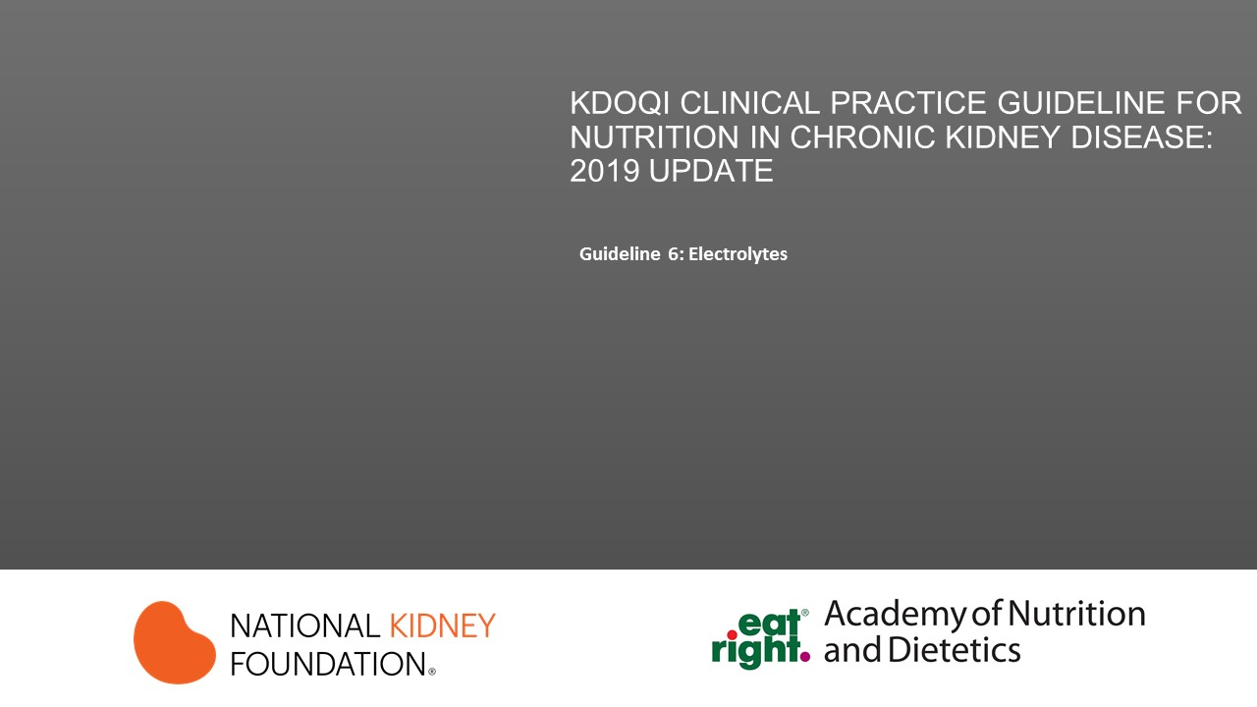

Slide 2
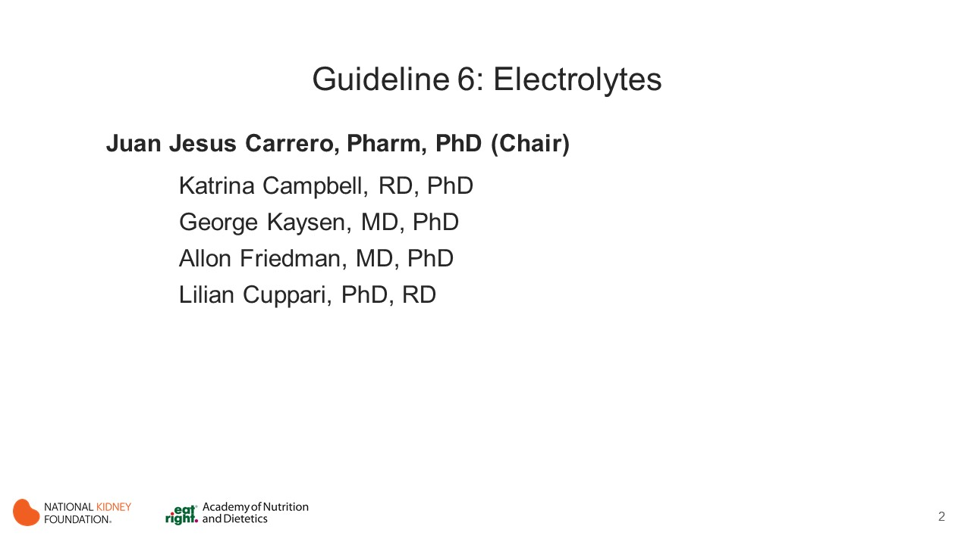
Notes:
Chapter Chair: Juan Jesus Carrero, Pharm, PhD
Chapter Committee:
Katrina Campbell, RD, PhD
George Kaysen, MD, PhD
Allon Friedman, MD, PhD
Lilian Cuppari, RD, PhD

Slide 3

Notes:
The learning objectives for this activity are to:
Interpret the guideline recommendations and supporting evidence related to electrolytes.
Discuss implementation strategies for best clinical practices.

Slide 4
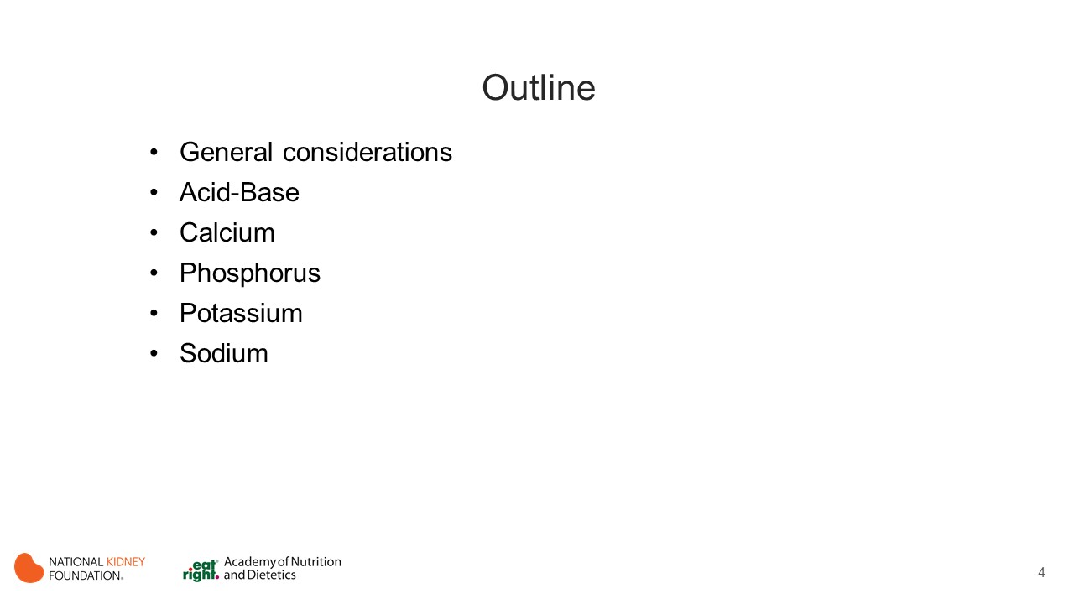
Notes:
Sections
General considerations
Acid-Base
Calcium
Phosphorus
Sodium
Potassium

Slide 5
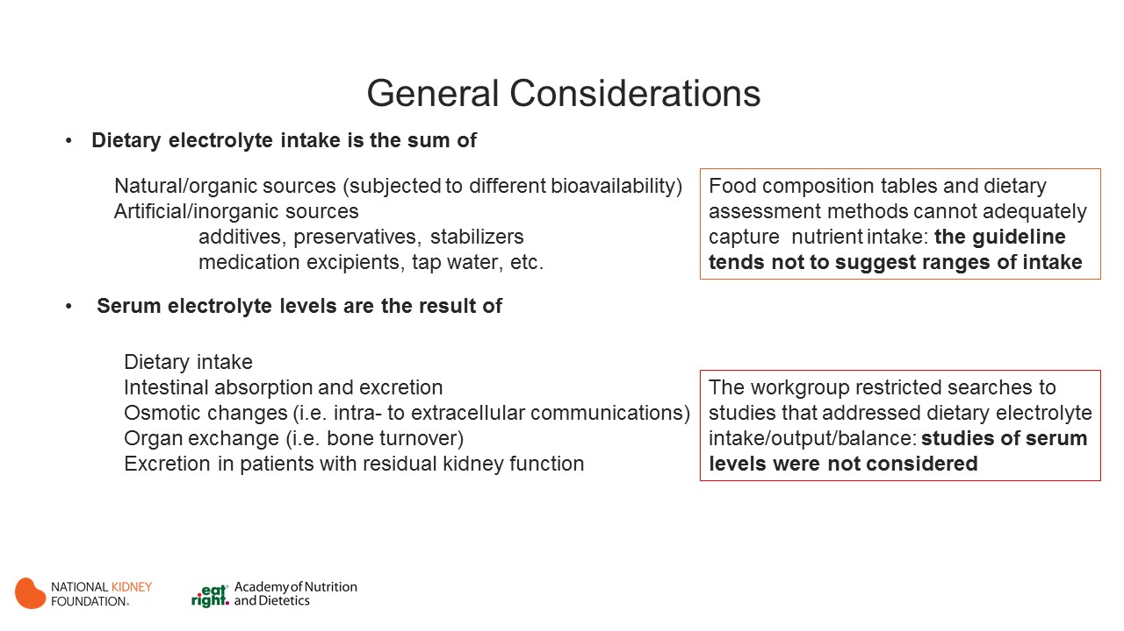
Notes:
There are 2 types of dietary electrolyte sources:
Natural/organic
Artificial/inorganic
Serum electrolyte levels are affected by dietary intake, intestinal absorption, osmotic changes, organ exchange and excretion (in patients with residual kidney function).
Note:
Food composition table and dietary assessment methods cannot adequately capture nutrient intake; therefore the guideline tends not to suggest ranges of intake.
The workgroup restricted literature search to studies that addressed dietary electrolyte intake, output, and balance. Studies of serum levels were omitted.

Slide 6
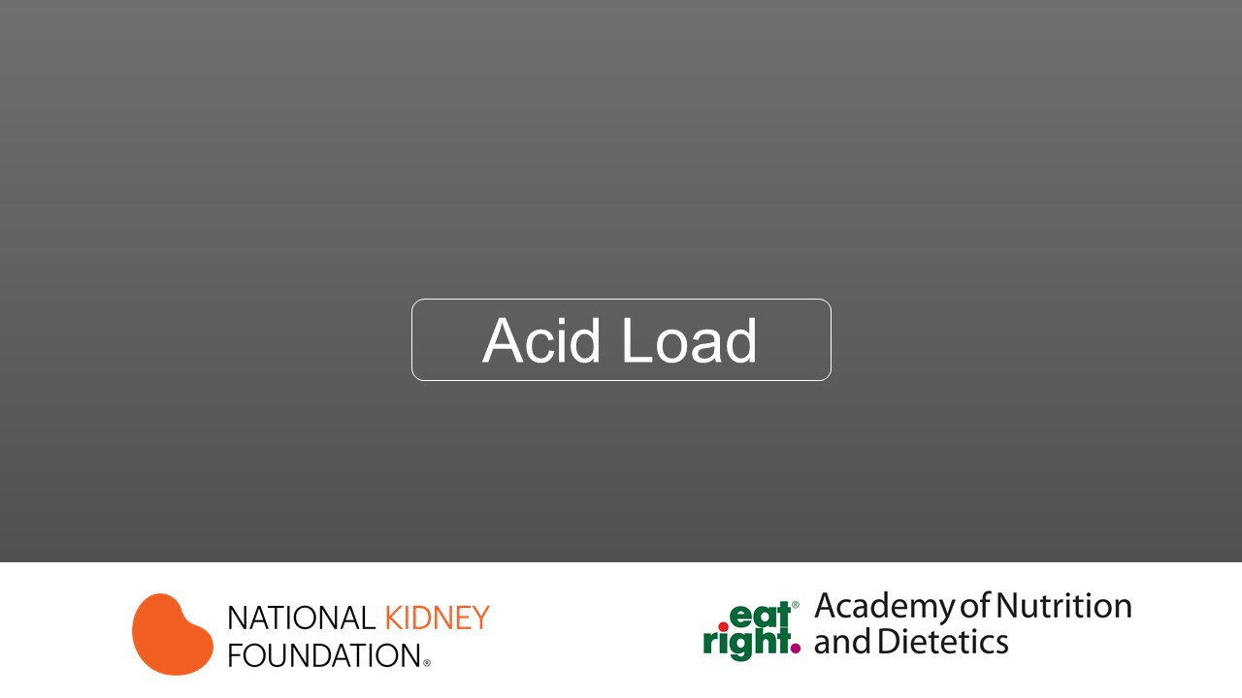

Slide 7
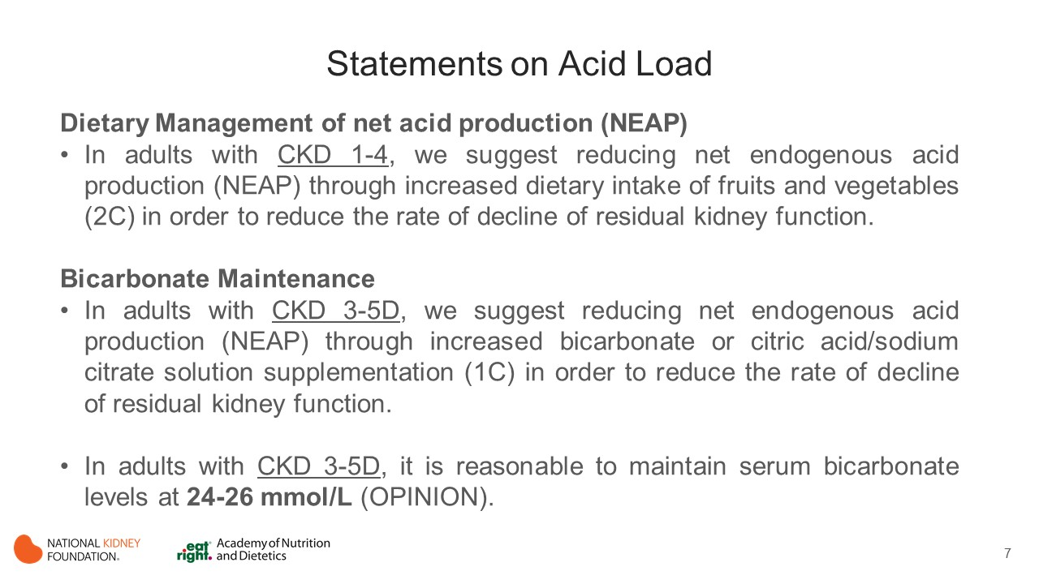
Notes:
Metabolic acidosis increases skeletal muscle proteolysis by a ubiquitin proteasome pathway that degrades actin potentially having adverse nutritional impact on the patient accompanied by an increase in protein catabolic rate.
Eleven studies examined the association between dietary acid load/oral bicarbonate supplements on health outcomes in the CKD population.
Studies aimed at evaluating the effect of reduction in net endogenous acid production (NEAP) have been two-fold; either directly reducing NEAP by administration of sodium bicarbonate, or by dietary alteration using fruits and vegetables, which both decrease NEAP and alter the composition and quantity of dietary protein partially confounding the effect of reduction of NEAP alone.
Studies reducing NEAP by the use of administration of oral sodium bicarbonate are not confounded by alteration in dietary protein composition and easier to study in randomized controlled prospective manner.

Slide 8
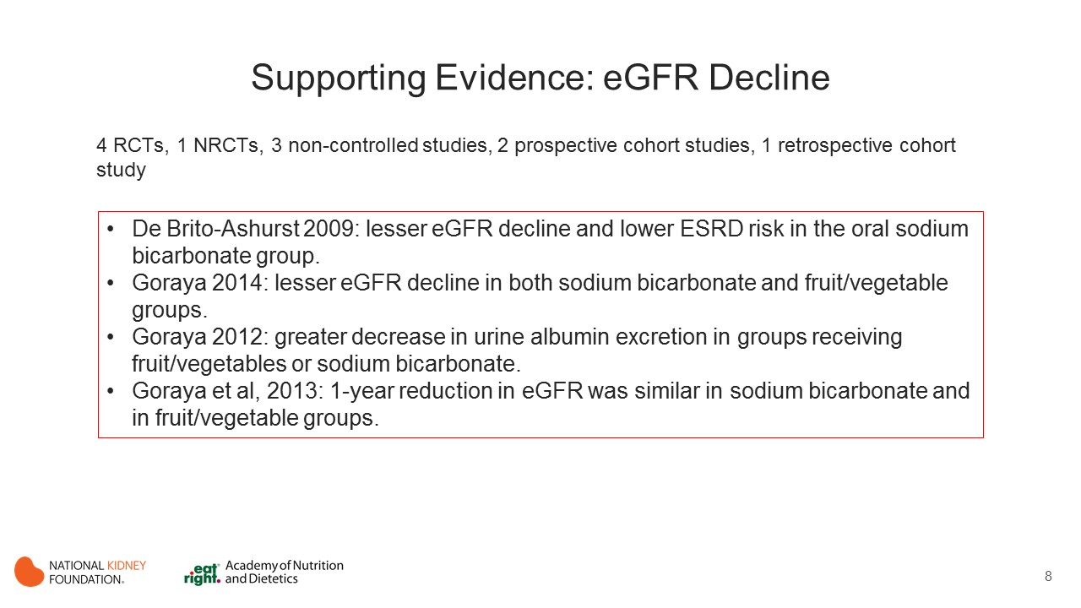
Notes:
4 RCTs (Goraya et al, 2013; de Brito-Ashurst et al, 2009; Goraya et al, 2014; Szeto et al, 2003)
1 non-randomized controlled trial (Goraya et al, 2012)
3 non-controlled studies (Kooman et al, 1997; Movilli et al, 1998; Verove et al, 2002)
2 prospective cohort studies (Scialla et al, 2012; Banerjee et al, 2015)
1 retrospective cohort study (Kanda et al, 2014)
Effect of reducing net acid production on CKD progression
In CKD Stages 4-5, the oral sodium bicarbonate group had significant greater creatinine clearance after 18 and 24 months (p<0.05). Rapid CKD progression and development of ESRD was lower in the oral sodium bicarbonate group. (de Brito-Ashurst 2009)
In CKD Stage 3, there was a reduction in eGFR in all groups, however, at 3 years, lesser reduction in eGFR was observed with HCO3 group or fruits and vegetables than usual care group. (Goraya 2014)
In CKD Stage 2 , fruits and vegetables had greater decrease in net urine albumin excretion than both HCO3 and control (p<0.05) and HCO3 group had greater decrease in net urine albumin excretion than control (p<0.05). (Goraya 2012)
In CKD Stage 4 using either fruits and vegetables or NaHCO3 as the intervention, plasma creatinine levels were comparable between the subjects treated either with HCO3 or fruits and vegetables at baseline and 1-year follow-up (p=0.99, 0.49, respectively), eGFR were comparable between the two groups at baseline and 1-year follow-up (p=0.84, 0.32, respectively). (Goraya 2013) This study does not isolate the effects of alteration in dietary composition and NEAP sufficiently to establish which intervention is associated with any biological change observed.

Slide 9
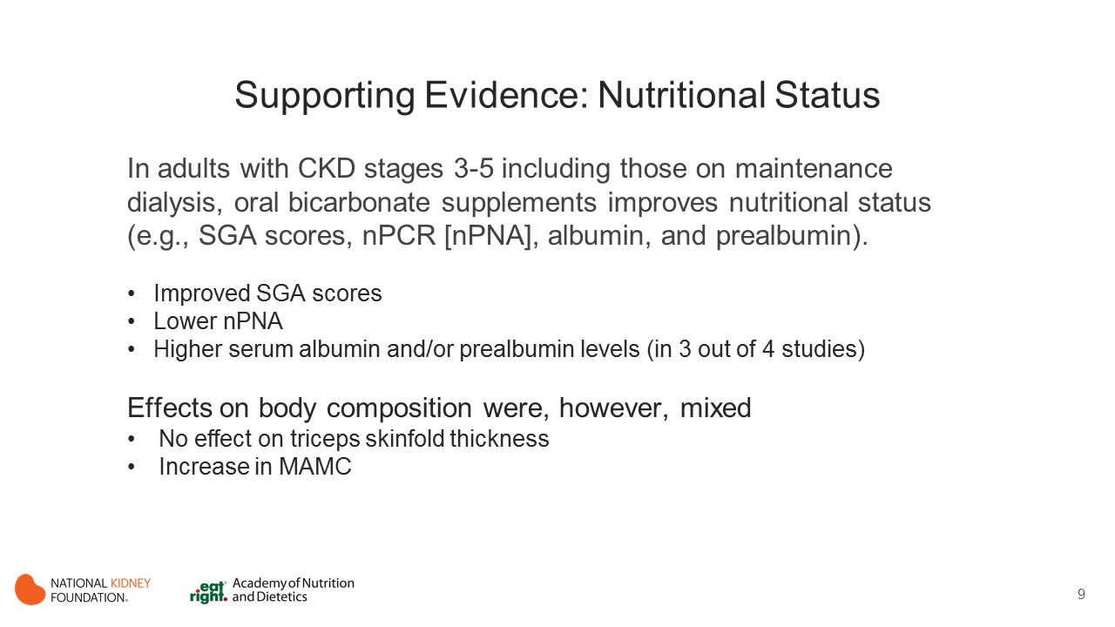
Notes:
In CKD patients Stages 3-5 including ones on maintenance dialysis, oral bicarbonate supplements improved nutritional status (e.g., SGA scores, nPCR, albumin, and prealbumin) in most studies.
Oral bicarbonate supplements increased overall SGA scores (2.7 g/day) (Szeto 2013) and lowered nPNA (nPCR) (de Brito-Ashurst -~1800 mg/day). (de Brito-Ashurst 2009)
Except for Kooman et al.,(dialysate bicarbonate and oral sodium bicarbonate (1500-3000 mg) if pre-dialytic bicarbonate did not reach desired level), the other three studies observed positive effects of oral bicarbonate supplements on serum albumin or prealbumin levels (de Brito-Ashurst -~1800 mg/day; Movilli et al., - mean dose 2.7±0.94 g/day; 1–4 g/day; Verove et al. – mean dose 4.5±1.5g/d.
Oral bicarbonate supplements also had no effects on triseps skinfold (TSF) measurements. de Brito-Ashurst et al., (~1800 mg/day) noted significant increases in mid arm muscle circumference (MAMC) measurements with oral sodium bicarbonate, while Kooman et al. did not.

Slide 10
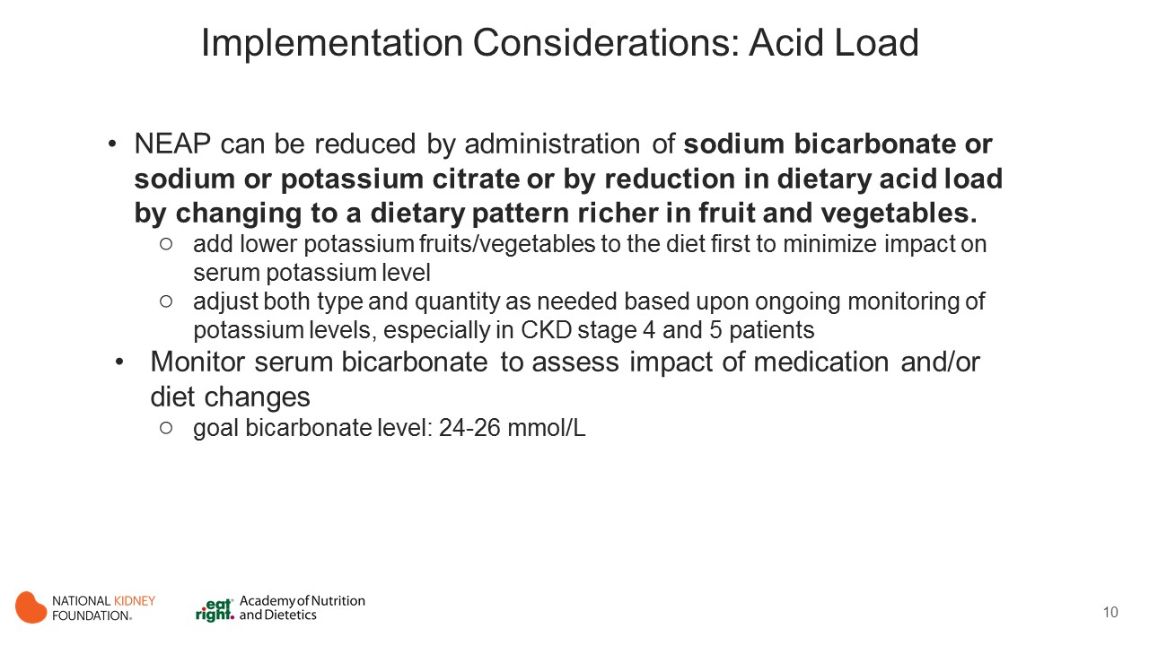
Notes:
Acid load is a consequence of protein load and is inversely associated with potassium intake.

Slide 11
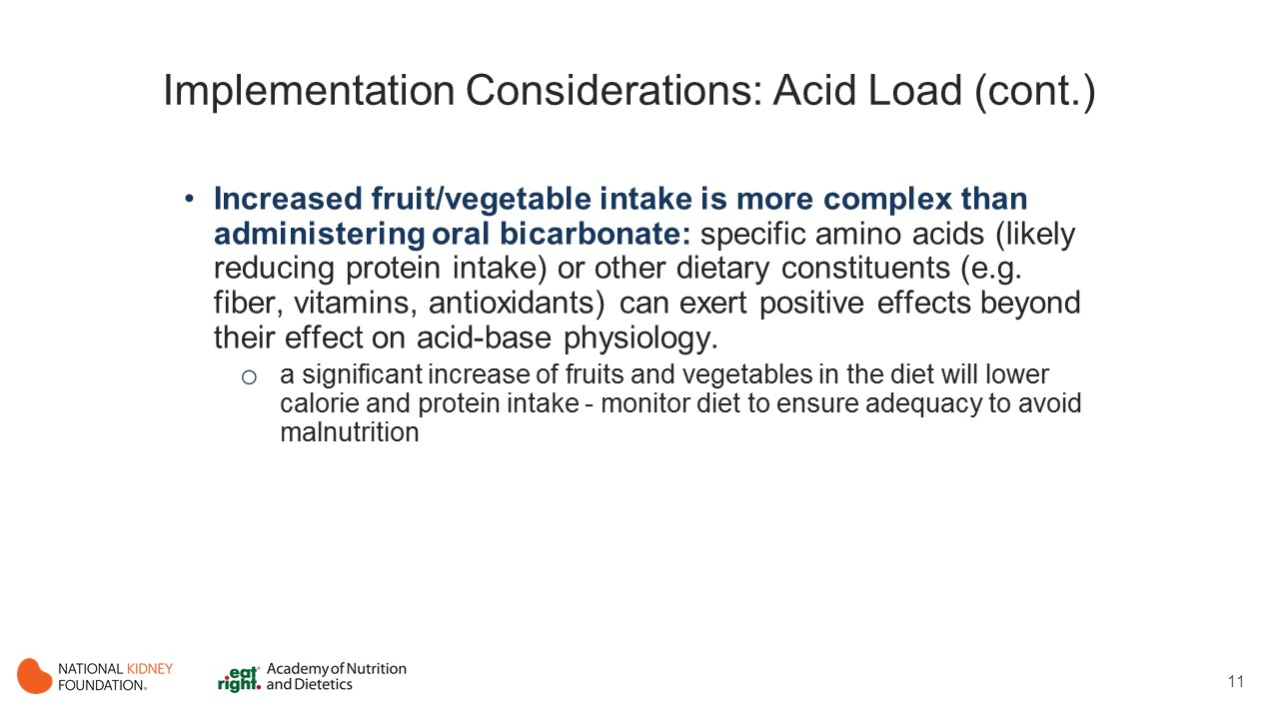
Notes:
When increasing fruits and vegetable intake to correct acid load please use caution and monitor potassium levels.

Slide 12
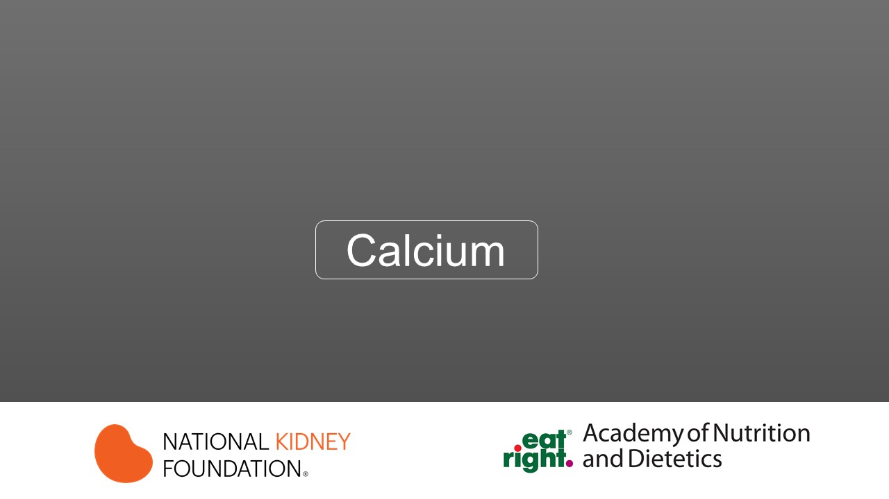

Slide 13
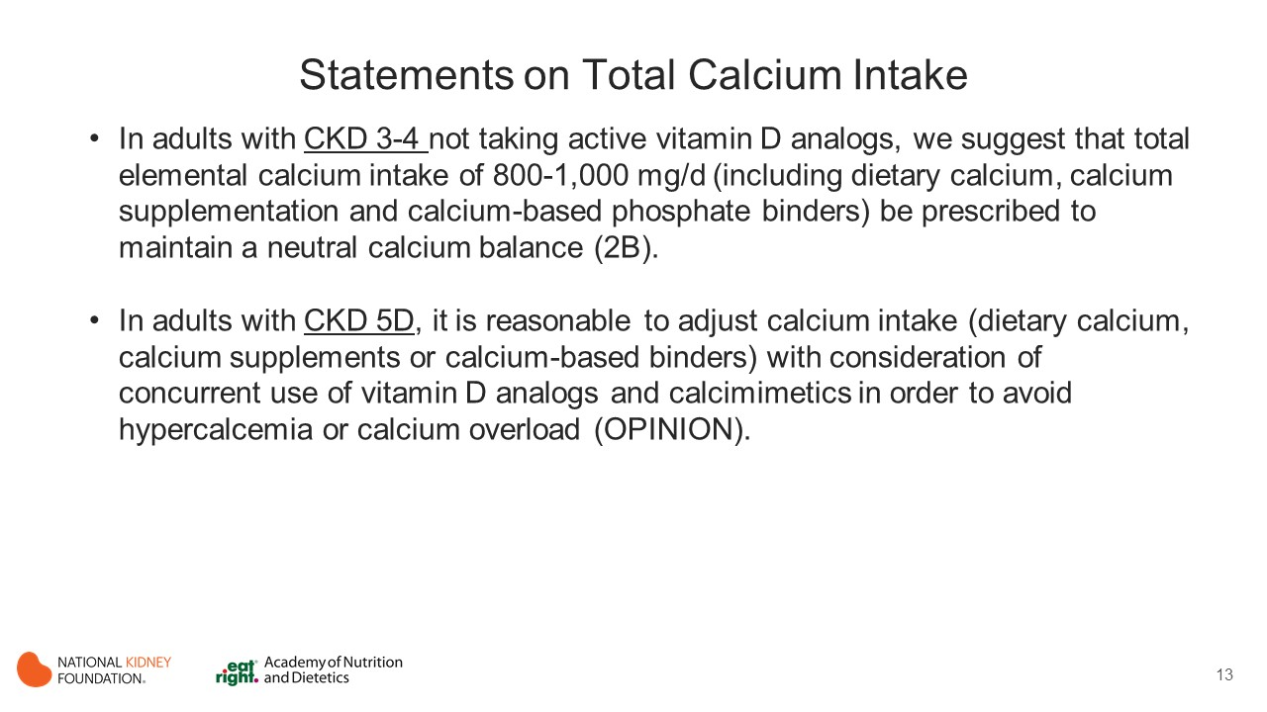
Notes:
Approximately 99% of total body calcium is found in the skeleton and the remainder is present in the extracellular and intracellular spaces. Therefore, serum calcium levels do not reflect the overall body calcium balance and may not be very informative except at extremes.
The maintenance of serum calcium in the normal range in CKD depends on several factors such as bone turnover, mineral regulating hormones, degree of kidney function, use of vitamin D analogues, dialysate calcium concentration and calcium intake especially from supplements.
A careful medical and nutritional history may provide some insight into the adequacy of calcium intake. However, due to the multifactorial causes of altered calcium metabolism in CKD, the establishment of adequate amount of dietary calcium is challenging and depends on the investigation of calcium balance.
There is insufficient data to make a recommendation regarding optimal dietary calcium intake in adults on maintenance dialysis or with kidney transplantation (research priority).

Slide 14
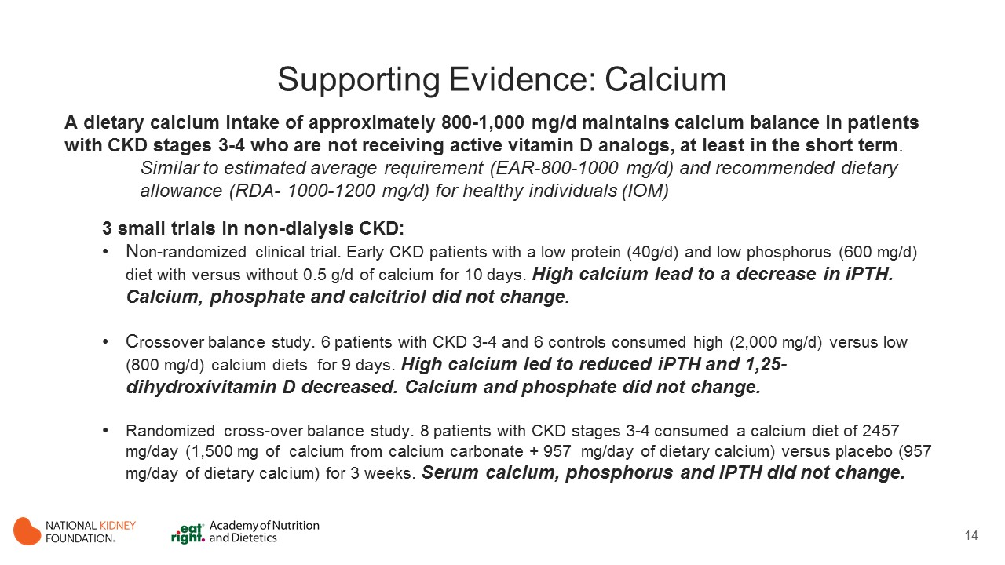
Notes:
Despite the small number of patients investigated, three well performed balance studies showed that a dietary calcium intake of approximately 800 to 1,000 mg/d may be adequate to maintain calcium balance in patients CKD stages 3 and 4 who are not receiving active vitamin D analogs, at least at short term. These values are close to the current estimated average requirement (EAR-800-1000 mg/d) and the recommended dietary allowance (RDA- 1000-1200 mg/d) for healthy individuals proposed by the Institute of Medicine (IOM).
The evidence review included three small short-term clinical trials in pre-dialysis CKD patients that investigated the effect of calcium intake in food or supplements on mineral bone biomarkers and on calcium balance:
In an NRCT, 51 patients in the early stage of CKD (creatinine clearance: 66 to 82 mL/min) were placed in a low protein (40g/d) and low phosphorus (600 mg/d) diet supplemented with or without 0.5 g/d of elemental calcium for 10 days. A decrease in intact parathyroid hormone (iPTH) was observed only in the group receiving calcium supplementation and no changes in serum calcium, phosphorus and calcitriol were found in the other groups. (Martinez 1997)
In a crossover study, six patients with CKD stages 3 and 4 consumed controlled high (2,000 mg/d) and low calcium diets (800 mg/d) for 9 days. Calcium balance was slightly negative to neutral in both patients and healthy controls on the low calcium diet and more positive in patients than in controls on the high calcium diet. Serum calcium and phosphate concentrations were unchanged and iPTH and 1,25-dihydroxivitamin D decreased in the high calcium diet. (Spiegel 2012)
In a 3-week randomized cross-over balance study, eight patients with CKD stages 3 and 4 were randomized to a controlled calcium intake of 2457 mg/day (1,500 mg of elemental calcium from calcium carbonate used as phosphate binder + 957 mg/day of dietary calcium) versus placebo (957 mg/day of dietary calcium). The calcium balance was neutral in the placebo and positive in the calcium carbonate groups (508 vs. 61 mg/d, respectively, p=0.002). Serum calcium, phosphate and iPTH concentrations were unchanged in both groups. (Hill 2013)

Slide 15
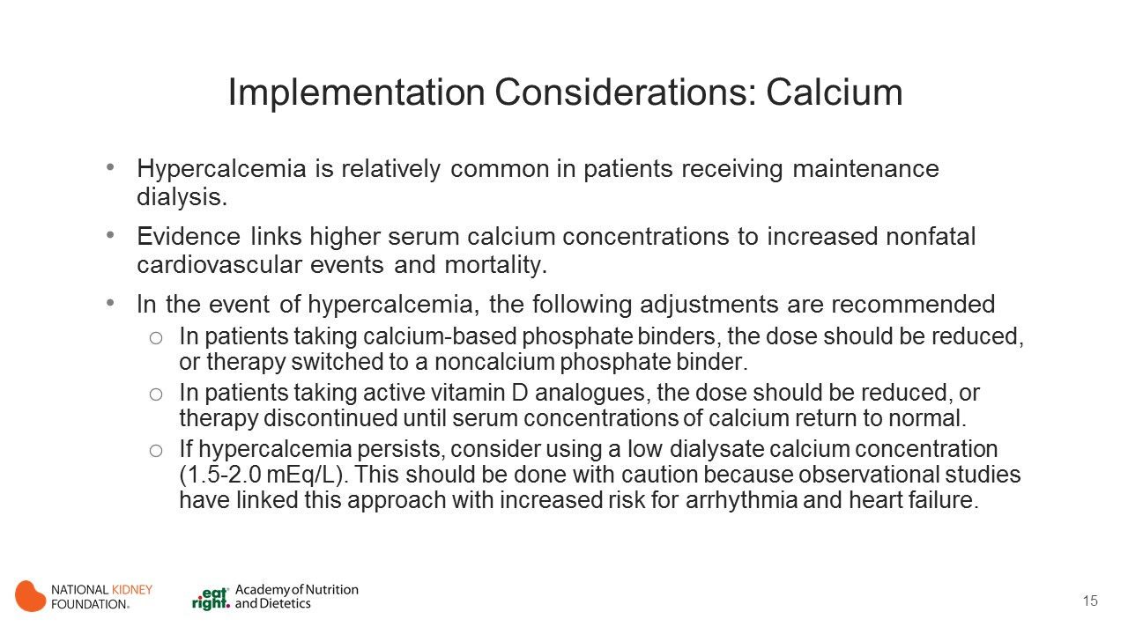
Notes:
In maintenance dialysis patients, calcium balance is more complex. In addition to dietary calcium load and use of vitamin D analogues, calcium concentration in the dialysate and mode of dialysis also determine the mass balance of calcium.
Studies using mathematical modeling have shown a positive calcium balance mass in patients receiving MHD. According to estimates and assumptions made, extracellular fluid calcium levels increased with an elemental daily calcium intake > 1.5 g and were numerically more positive when patients are given active vitamin D analogues.
The excess of extracellular calcium is deposited in either osseous or extraosseous sites.
The extensive soft tissue calcification highly prevalent in MHD patients suggests that extraosseous sites seem to be the repository for this calcium.
Although calcium balance studies are demanding, they are essential to provide data to make conclusive recommendation for calcium intake from diet or supplements for patients receiving maintenance dialysis.
Notably in KDIGO (CKD-MBD) 2009 and 2017, there are no recommendations for calcium intake for patients receiving maintenance dialysis or with a kidney transplant.

Slide 16
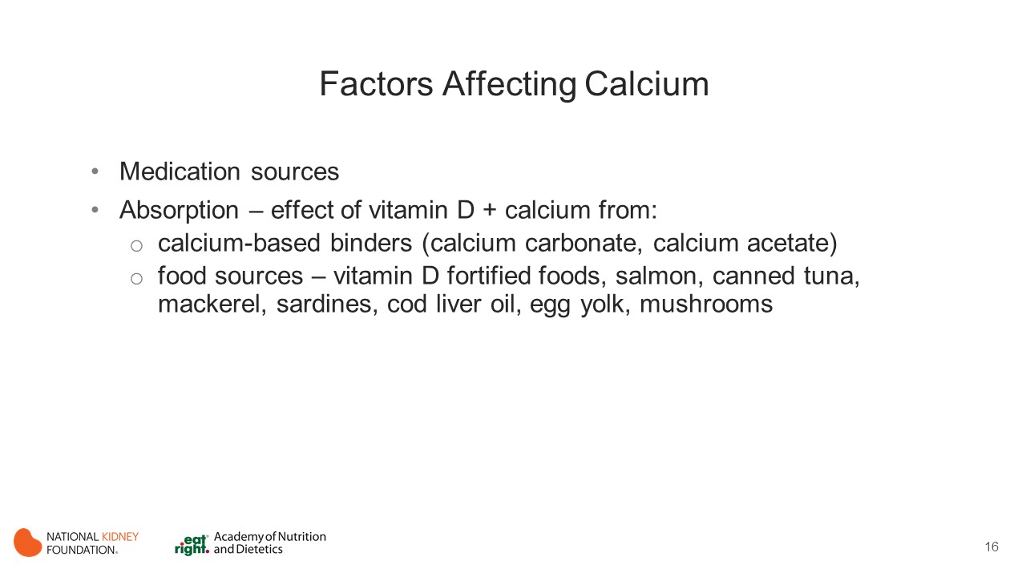
Notes:
Factors affecting calcium include medication sources and the effect of vitamin D on calcium absorption.

Slide 17
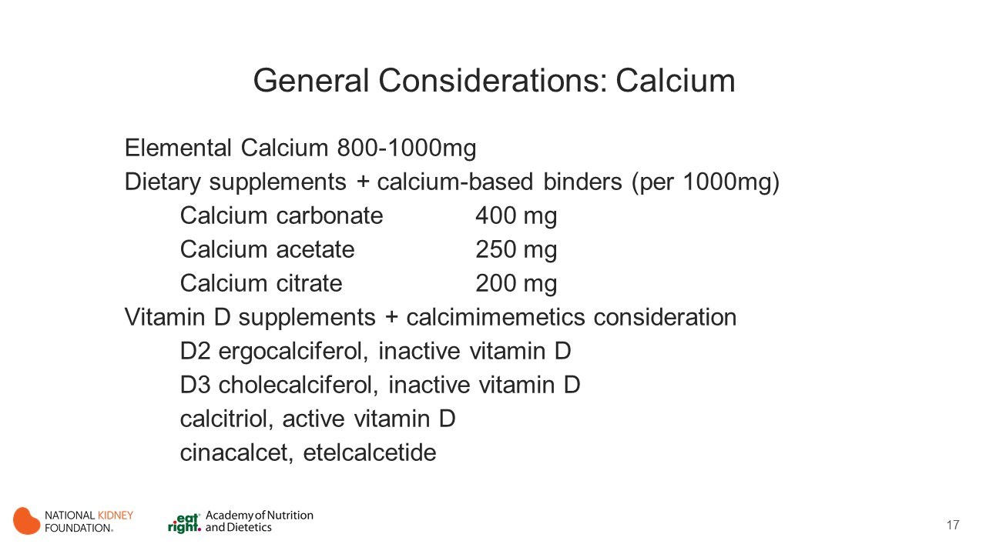
Notes:
In HD studies, extracellular fluid calcium levels increased with an elemental daily calcium intake > 1.5 g and were numerically more positive when patients are given active vitamin D analogues.
Calcimimetics decrease the set-point for calcium homeostasis. This enables decrease in serum PTH and calcium levels.

Slide 18
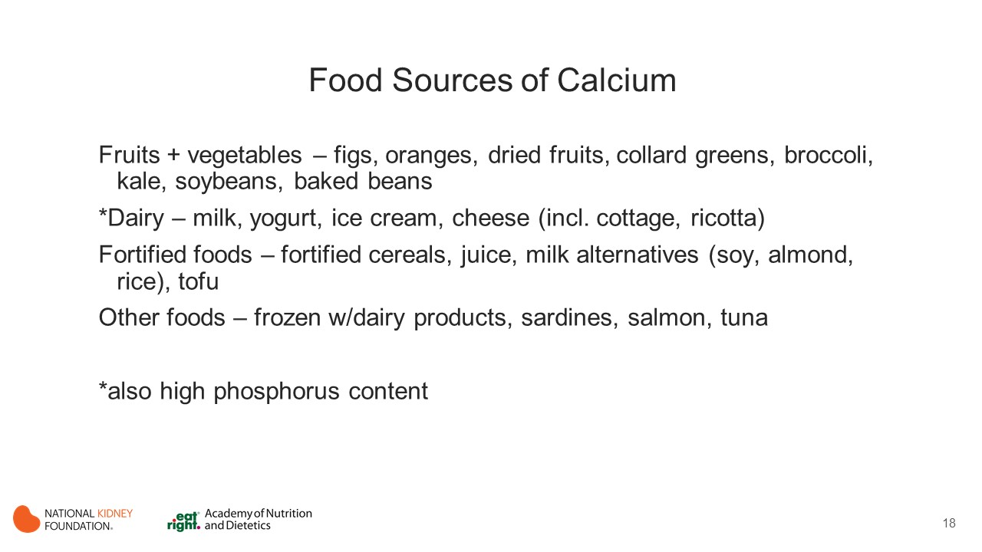
Notes:
Consider all dietary sources of calcium, naturally occurring and fortified foods.

Slide 19
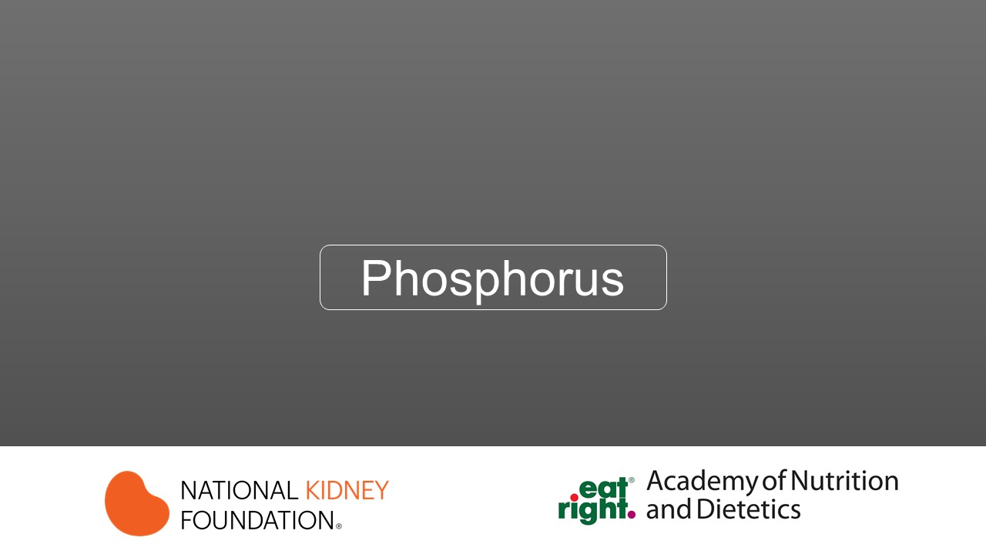

Slide 20
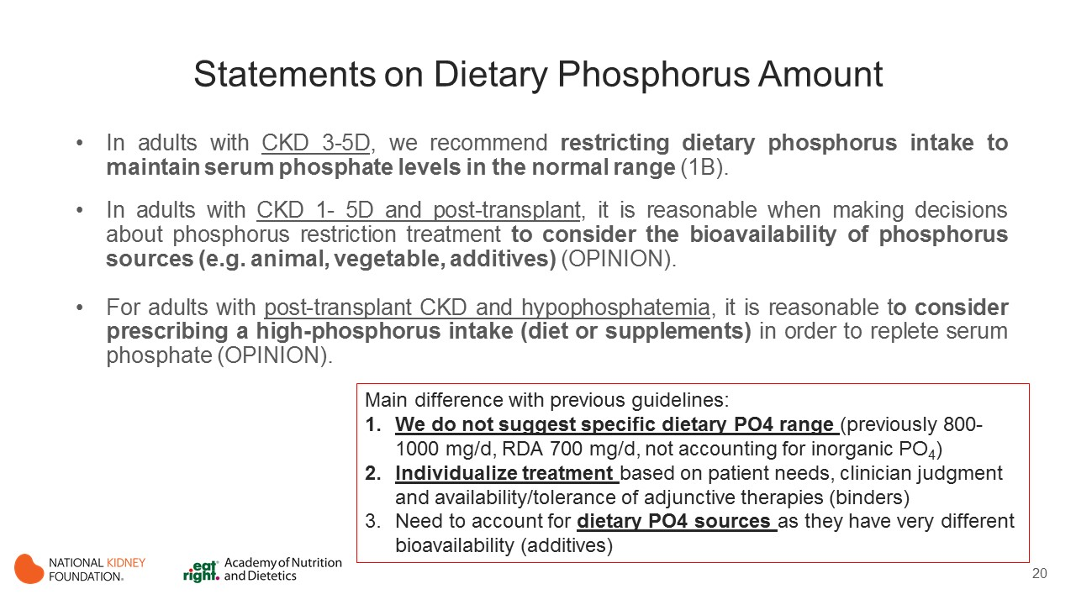
Notes:
Dietary phosphorus recommendations.
1. Because of difficulties of persons with CKD to clear excess phosphorus, additional means of serum phosphate control is necessary to avoid hyperphosphatemia, which could lead to bone and mineral metabolism disorders of CKD.
2. How much should dietary phosphorus be restricted in adult patients with CKD is not well established.
Traditionally, CKD-specific recommendations suggest maintaining phosphorus intake between 800-1000 mg/day in patients with CKD stages 3-5D in order to maintain serum phosphate in the normal range.
Dietary phosphorus intake range is higher than current recommended dietary allowance for phosphorus in the adult general population (700 mg/d). RDA is most likely exceeded due to increased use of P04 additives.
Factors other than intestinal phosphorus absorption (namely exchange with bone and excretion by the kidneys in patients with residual renal function) may be major determinants of serum phosphate levels.
Therefore, the guideline does not suggest specific dietary phosphate ranges, and instead emphasizes the need to individualize treatments based on patient needs and clinical judgment, taking into consideration natural sources of organic phosphorus (animal vs. vegetal protein-based dietary phosphorus), or the use of phosphorus additives in processed foods.

Slide 21
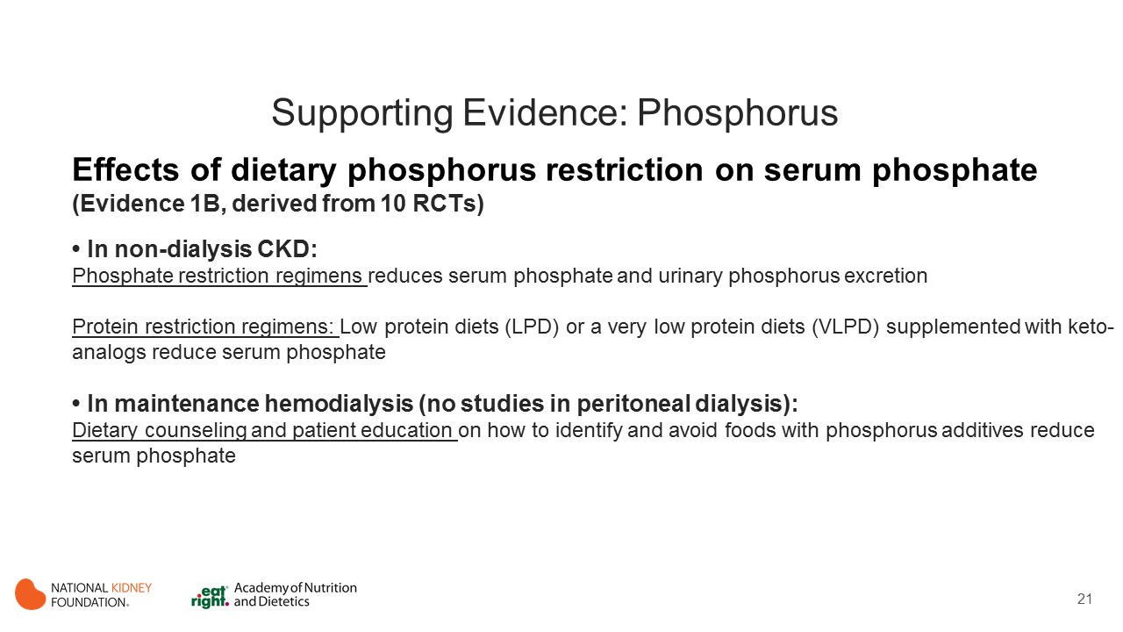
Notes:
Dietary Phosphorus restriction lowers serum phosphate
In non-Dialysis CKD
Phosphate restriction regimes:
Two RCTs examined the effects of reduced dietary phosphorus in patients with CKD not undergoing dialysis. (Williams 1991; Martinez 1997)
These studies evaluated the effect of a low phosphorus diet alone or in combination with a low protein diet
These studies observed significant reductions in serum phosphate, and urinary phosphorus excretion post-intervention.
Protein restriction regimens:
Five RCTs in CKD patients not undergoing dialysis stages 4-5 evaluated the effect of a low protein diet (LPD) or a VLPD supplemented with keto-analogs on serum phosphate levels. (Feiten 2005; Garneata 2016; Malvy 1999; Mircescu 2007; Rosman 1989)
All five studies reported statistically significant or borderline-significant reductions in serum phosphate levels at the end of intervention.
In maintenance hemodialysis
Phosphate restriction regimes:
Two RCTs10,379 examined the effects of limiting dietary phosphorus in patients with CKD undergoing MHD. (Lou 2012; Sullivan 2009)
Lou et al tested the effect of 3-month intensified dietary counseling in order to achieve 800 – 900 mg/d of dietary phosphorus and observed a greater decrease in serum phosphate concentration compared to standard care.
Sullivan et al tested the effect of patient education on identifying foods with phosphorus additives and observed, compared to standard care, a significant reduction in serum phosphate levels after 3 months.
No studies were identified that included PD patients.

Slide 22
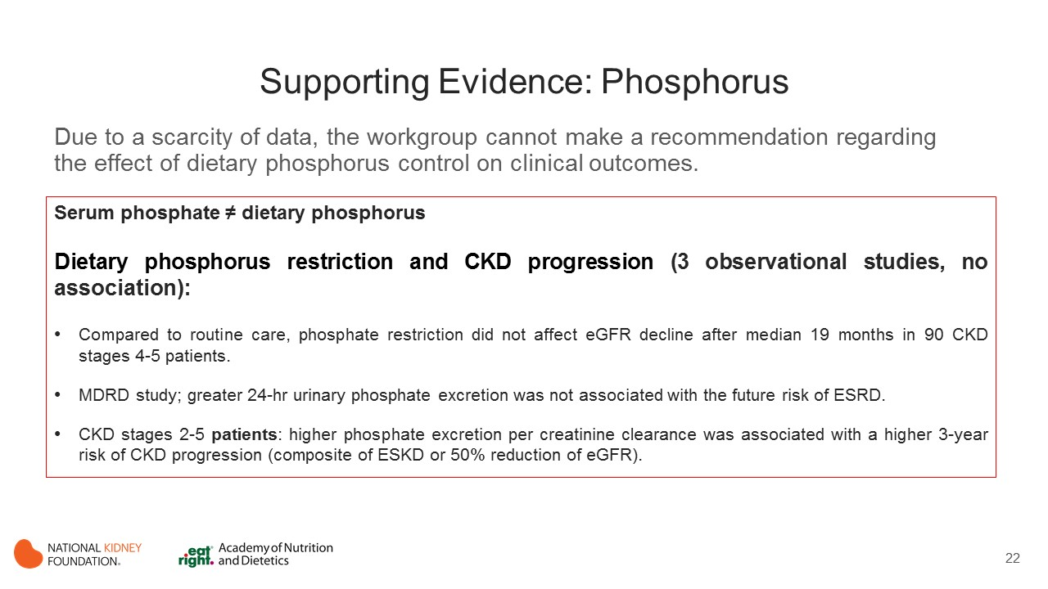
Notes:
Dietary Phosphorus and CKD Progression
Three observational studies evaluated the effects of dietary phosphate restriction on CKD progression. Results were mixed and evidence was limited.
Williams et al, studied impact of a dietary phosphorus restriction (alone or in combination with protein restriction) on creatinine clearance among 90 CKD patients of unreported etiology or CKD stage over a median intervention time of 19 months. Compared to routine care, dietary protein and phosphate restriction or phosphate restriction only did not show any significant difference in the mean rate of fall of creatinine clearance. (Williams 1991)
In an observational analysis from the Modification of Diet in Renal Disease (MDRD) study, greater 24-hr urinary phosphate excretion (taken in this study as an estimate of dietary phosphorus intake) was not associated with the future risk of ESRD. Note that in this study baseline phosphate levels were well controlled and normal on average, which may not be the case of real-world settings. (Selamet 2016)
A small retrospective observational analysis from Japan including CKD stages 2-5 patients observed that higher phosphorus excretion per creatinine clearance was associated with a higher 3-year risk of CKD progression (defined as the composite of ESKD or 50 % reduction of eGFR). (Kawasaki 2015)

Slide 23
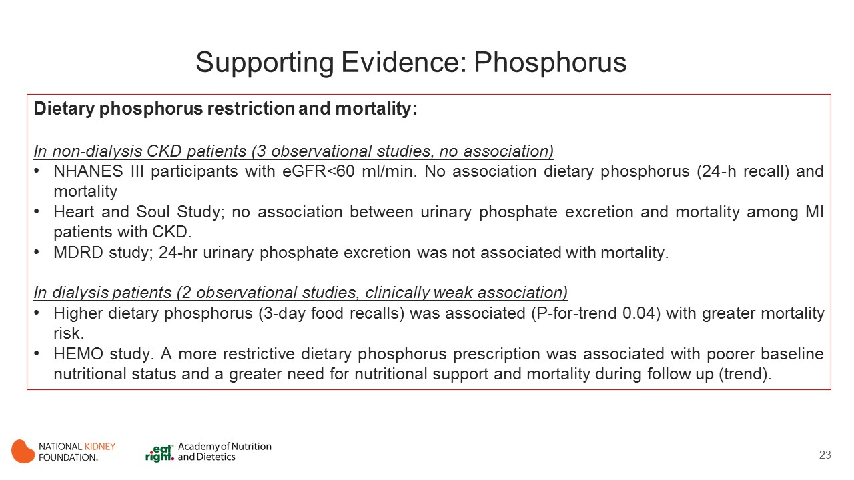
Notes:
Dietary Phosphorus Restriction and Mortality
In observational studies involving CKD patients, the associations of dietary phosphorus intake on mortality are mixed, impacted by residual confounding and probably pointing to a null association.
1. In non-dialysis CKD patients
Three studies evaluated the cross-sectional association between measures of dietary phosphorus and mortality in individuals with non-dialysis CKD.
Murtaugh et al. evaluated the association between 24-h dietary recall estimation of phosphorus intake in participants with eGFR<60 ml/min/1.73m2 from the community-based U.S survey National Health and Nutrition Examination Survey III and observed no association between dietary phosphorus and mortality. (Murtaugh 2012)
Palomino et al. examined myocardial infarction patients from the Heart and Soul Study, the majority of which with normal kidney function, and observed no association between higher urinary phosphorus excretion and mortality but noted an association with CVD-related mortality (P-trend across tertiles =0.02). (Palomino 2013)
Selamet et al. involved nephrology referred patients with CKD from the MDRD study and failed to observe an association between 24-hr urinary phosphorus excretion and mortality. (Selamet 2016)
In dialysis patients
One study in MHD patients that examined the association between dietary phosphate (as estimated from 3-day food recalls) and mortality. Patients with higher dietary phosphorus intake were associated with greater 5-year mortality risk (p-trend across tertiles=0.04). (Noori 2010)
Lynch et al. explored the association between prescribed dietary phosphorus restriction and mortality in a post hoc analysis of the Hemodialysis (HEMO) study, which included 1751 MHD patients. The study exposure was ascertained by the serum phosphate targets that the dietitians from the clinical dialysis centers settled annually to prescribe their dietary recommendations. A more restrictive prescribed dietary phosphate was associated with poorer indices of nutritional status on baseline analyses and a persistently greater need for nutritional supplementation but not longitudinal changes in caloric or protein intake. There was a stepwise trend toward greater survival with more liberal phosphate prescription, which reached statistical significance among subjects prescribed 1001 to 2000 mg/d and those with no specified phosphate restriction. (Lynch 2011)

Slide 24
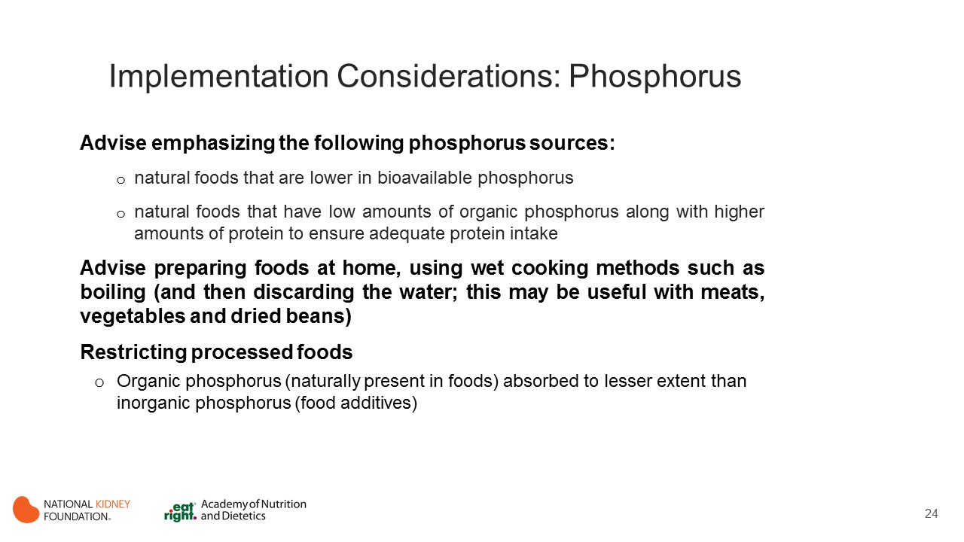
Notes:
Implementation considerations
Recommendations to lower dietary phosphorus intake in patients with CKD have been met with concerns, often relating to the risk of limiting the intake of other nutrients, particularly protein, which is the main source of phosphate in the diet. These concerns are particularly relevant to patients treated with dialysis because of protein losses in dialysate and greater protein catabolism from hypermetabolic stress. Dietary counselling that includes information on not only the amount of phosphate but also on the source of protein from which the phosphate derives and suggestion on methods of cooking phosphate-rich foods can achieve phosphorus intake without compromising dietary quality or protein status.
Advise choosing natural foods that are lower in bioavailable phosphorus.
Advise choosing commercial food items prepared without phosphorus-containing food additives.
Advise choosing natural foods that have low amount of organic phosphorus versus high amount of protein.
Advise preparing foods at home, using wet cooking methods such as boiling (and discard the water).

Slide 25
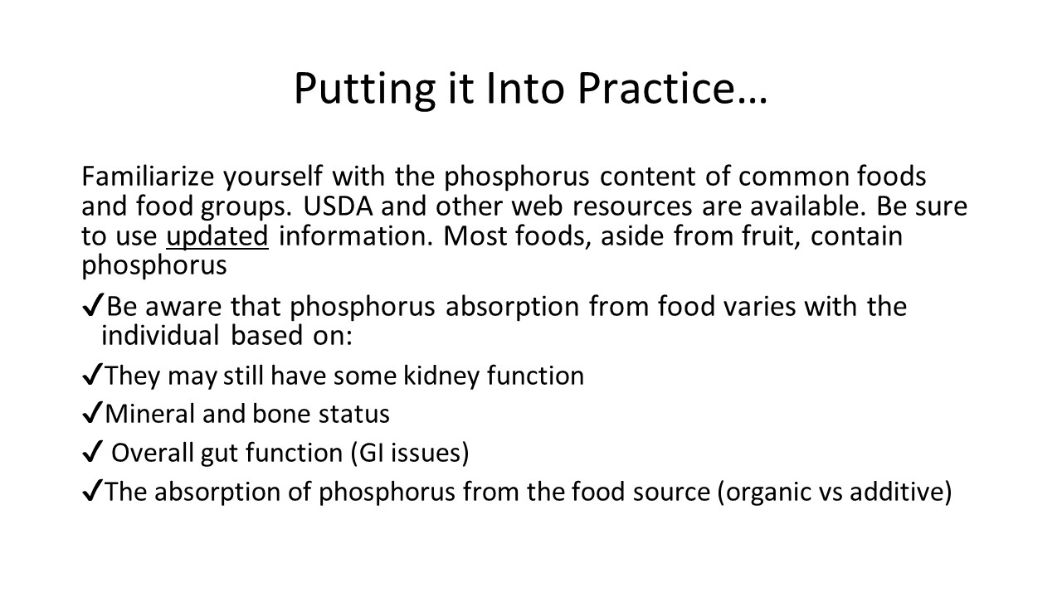
Notes:
Phosphorus is ubiquitous in the food supply. Therefore it is important to be aware of phosphorus content of common foods.
Several factors affect phosphorus absorption.

Slide 26
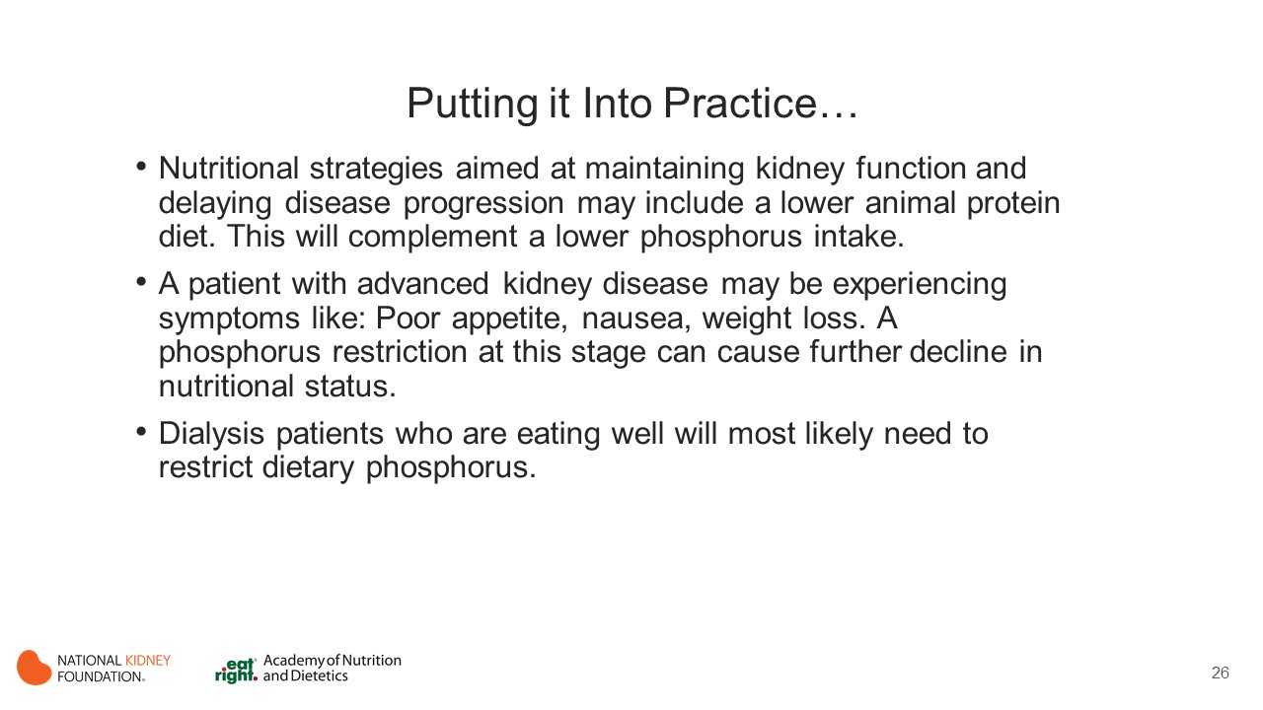

Slide 27
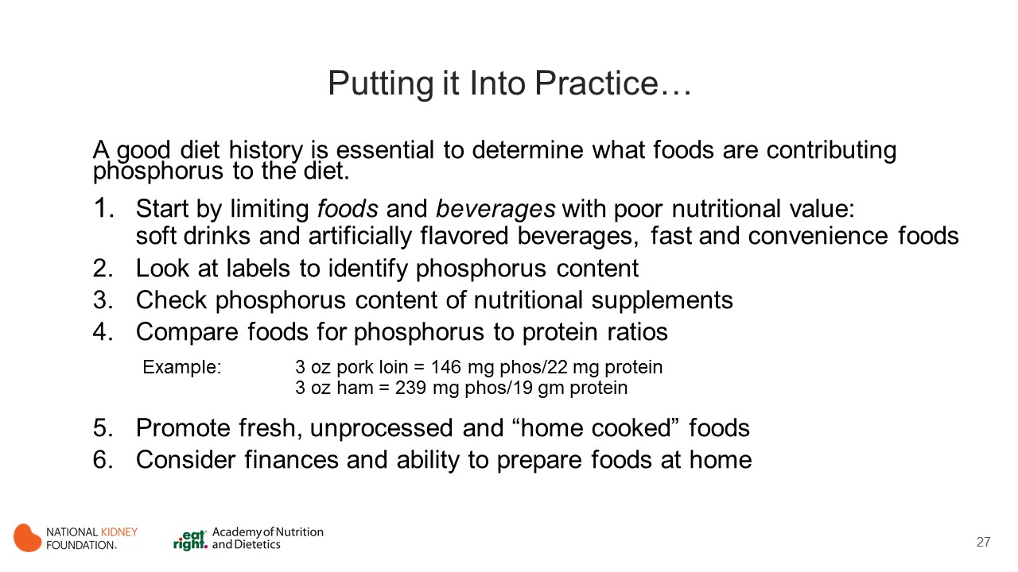
Notes:
Food labels may list the milligrams, percentages, or may not list anything for phosphorus, because it’s not required. Look at the ingredient list to identify phosphate additives. Choose an alternate food or brand with less or no phosphorus

Slide 28
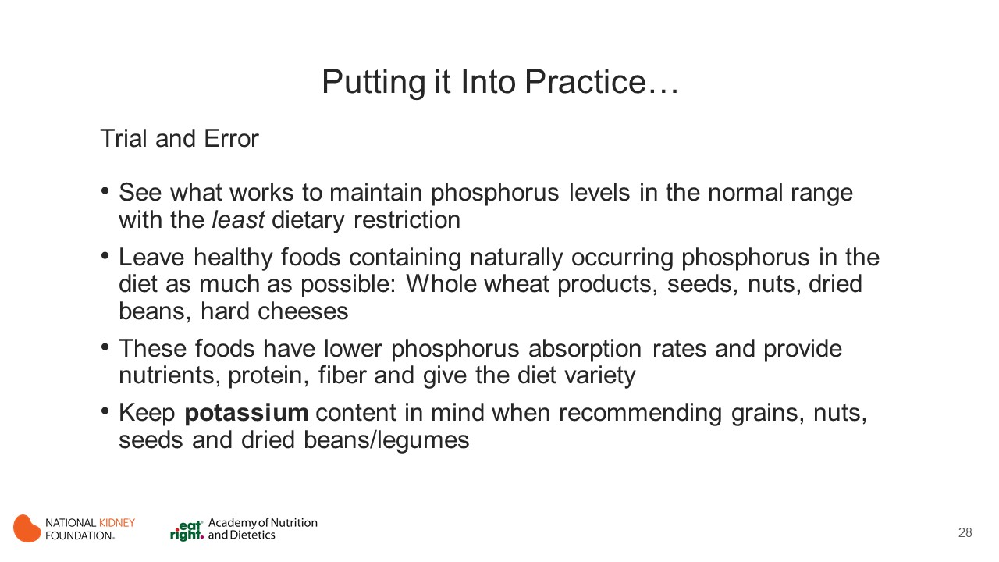

Slide 29
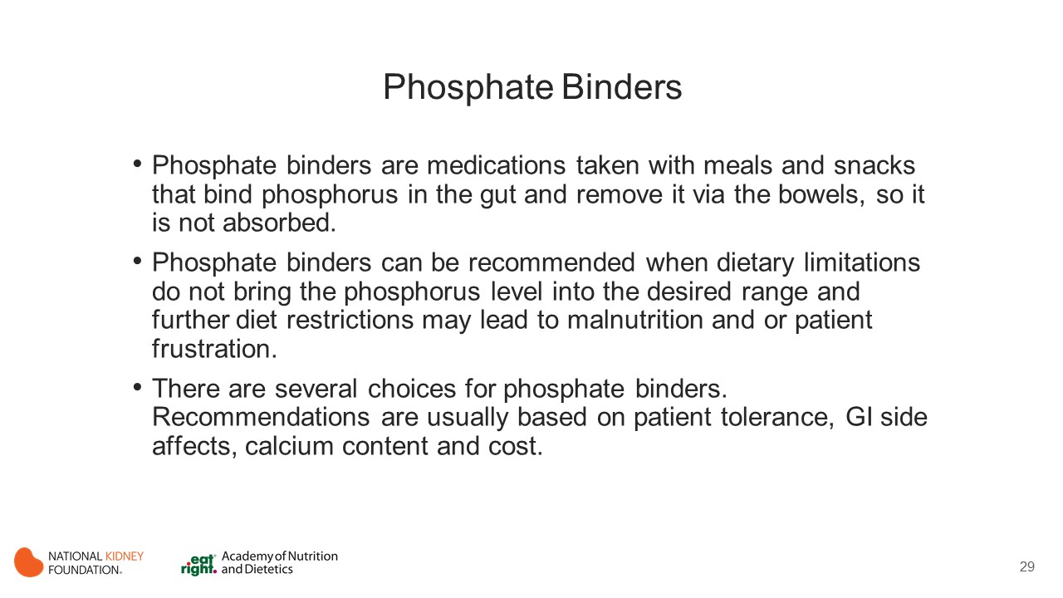

Slide 30
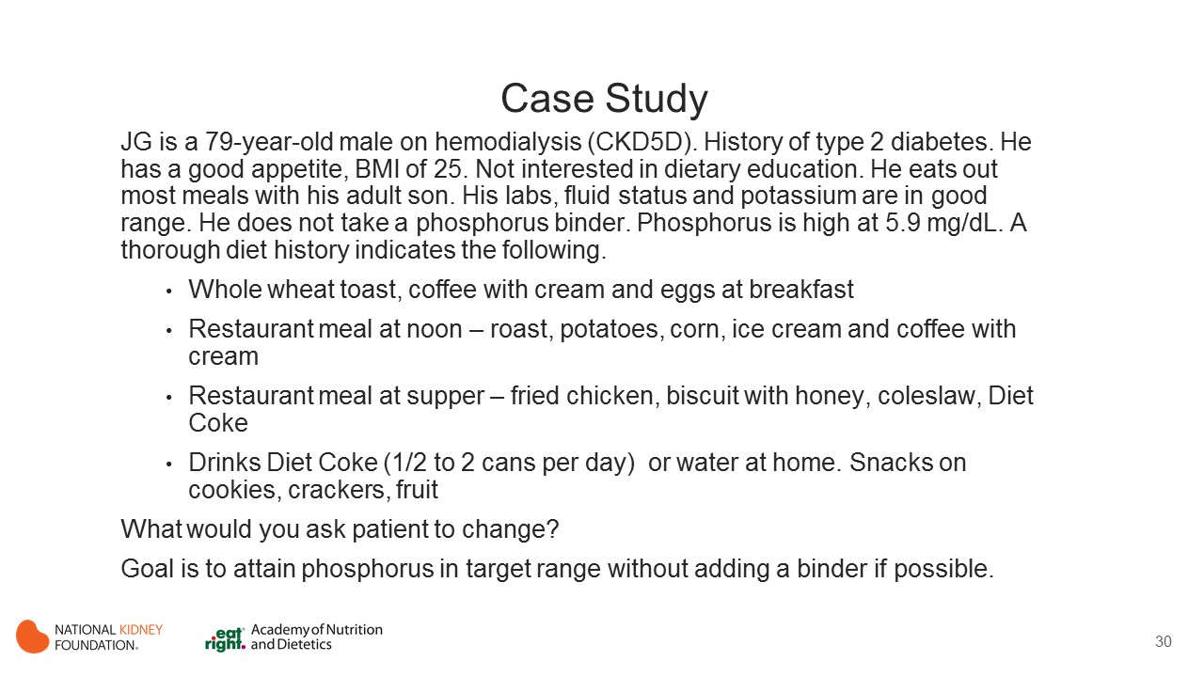
Notes:
Asked patient if he could substitute water or brewed iced tea for Diet Coke when out to eat, and drink diet lemon lime flavored soda at home in place of the Diet Coke.
Patient said he would do so. Phosphorus level came down into goal range with this simple change.

Slide 31
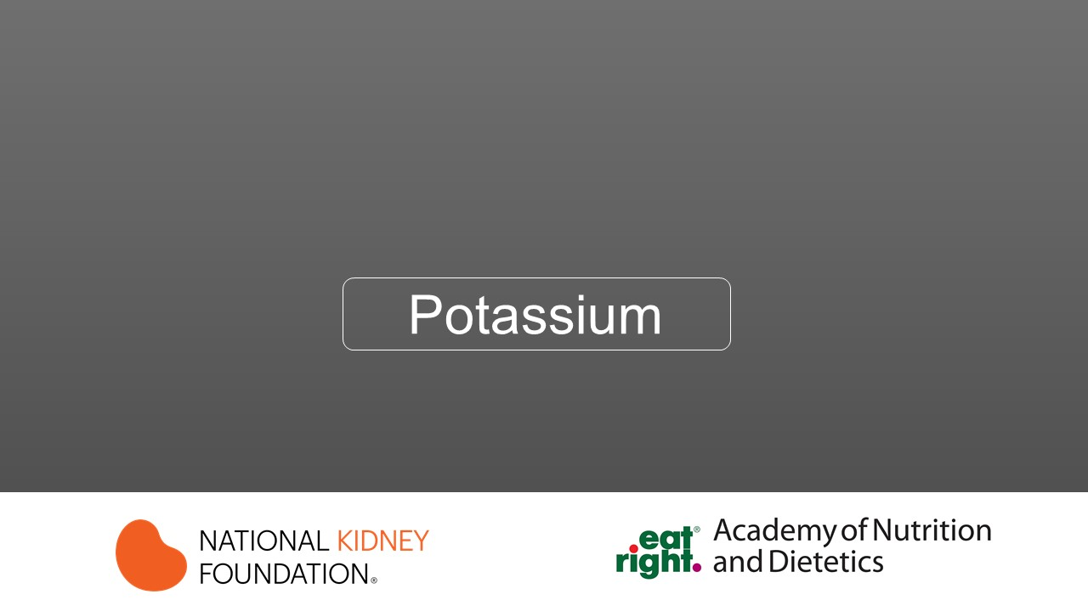

Slide 32
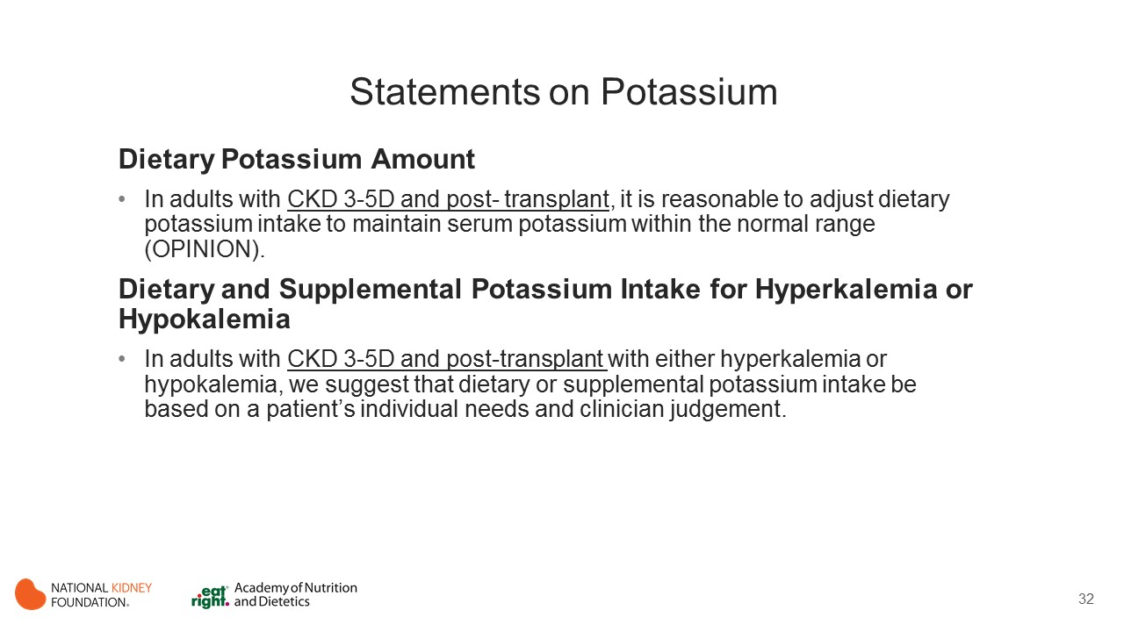
Notes:
The workgroup did not suggest specific dietary K range (restriction per se may favor other nutrient deficiencies)
High or low serum potassium levels have been associated with muscular weakness, hypertension, ventricular arrhythmias, and death. The influence of dietary potassium consumption on serum potassium content is therefore of great clinical relevance.
Because the mechanisms involved in potassium homeostasis and excretion (i.e. adrenergic system, insulin, aldosterone, and urinary clearance) are commonly impaired in patients with CKD and ESRD hyperkalemia is an especially salient concern.

Slide 33
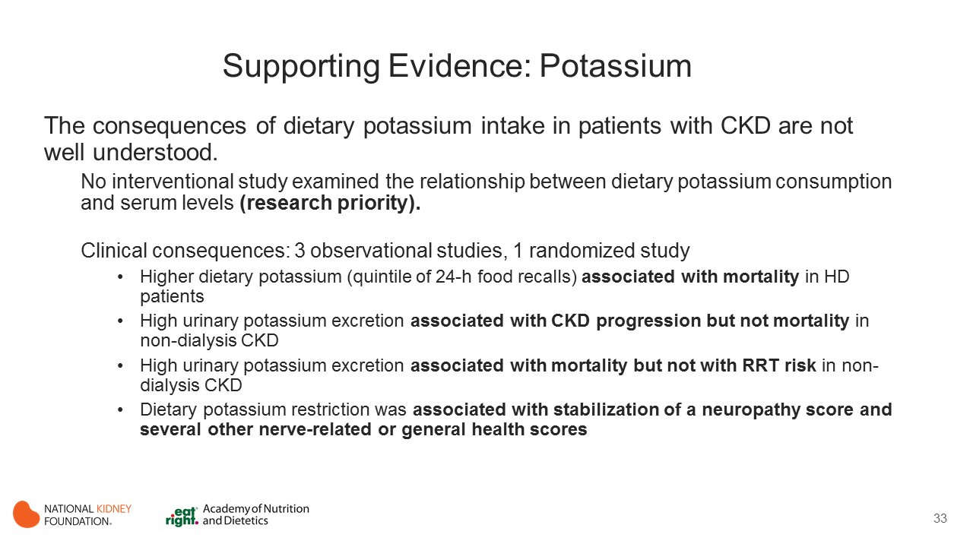
Notes:
There is a scarcity of studies on this topic and the work group found no interventional studies that examined the relationship between dietary potassium consumption and serum levels or clinical outcomes in patients with CKD.
Several studies used urine potassium excretion or other surrogates for dietary intake to assess the following outcomes: mortality (Noori 2010), CKD progression (He 2016; Leonberg-Yoo 2017), and nerve function (Arnold 2017).

Slide 34
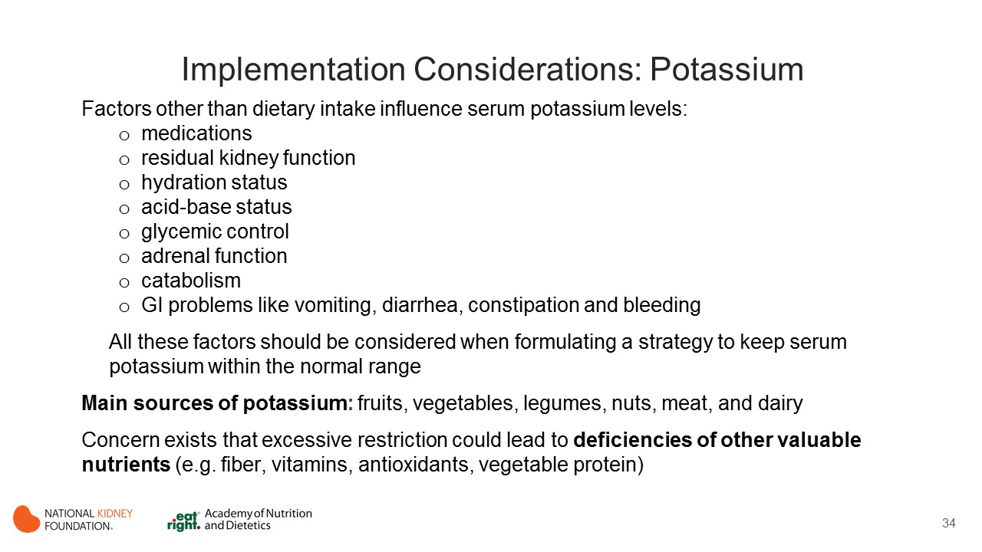
Notes:
Factors other than dietary intake influence serum potassium levels including medications, kidney function, hydration status, acid-base status, glycemic control, adrenal function, a catabolic state, or GI problems like vomiting, diarrhea, constipation and bleeding.
Potassium is widely distributed in foods, but the main sources are fruits, vegetables, legumes, nuts, meat, and dairy. As these foods are major sources of fiber, vitamins, minerals and other important nutrients, efforts should be made to avoid restricting dietary potassium.
When treating hyperkalemia clinicians are advised to consider the following:
1. Identify non-dietary contributing factors that can be corrected
2. Identify the most important dietary sources of potassium by using dietary recalls
3. Recommend fruits, vegetables, and other foods with low potassium content that still contain higher levels of fiber and other micronutrients.
4. Boiling vegetables can reduce potassium content.

Slide 35
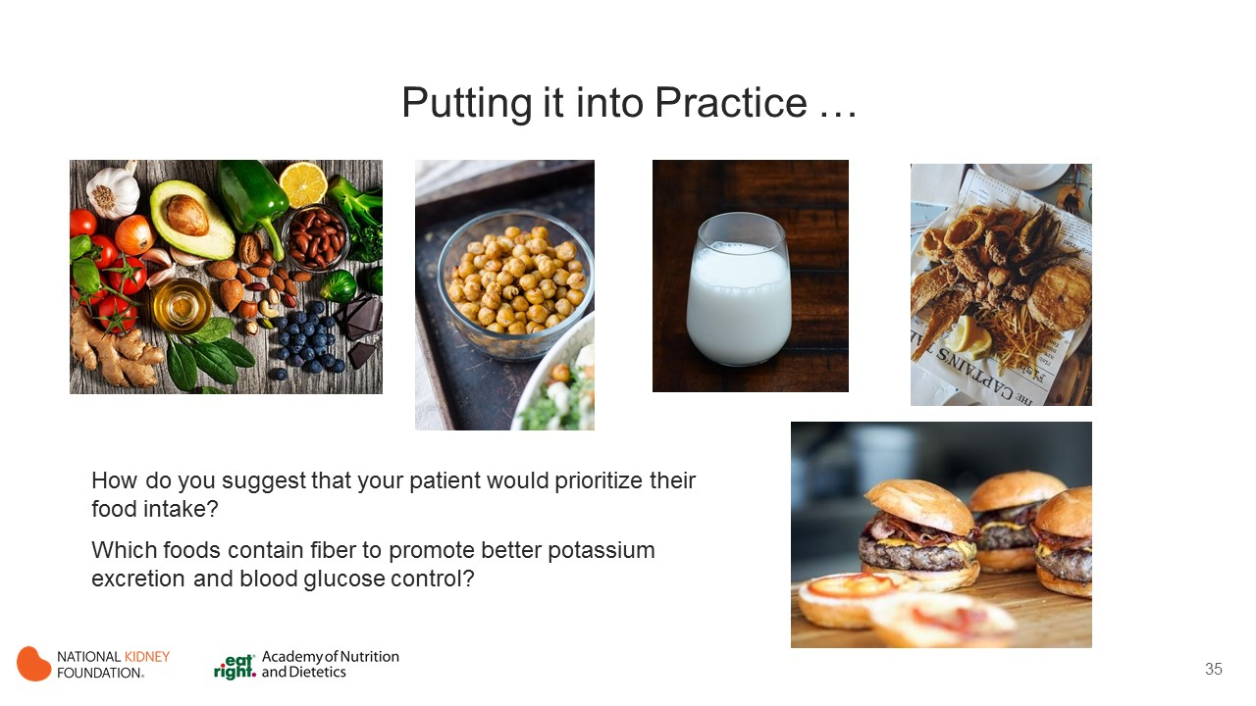
Notes:
Audience participation. Ask:
How do you suggest that your patient prioritize their food intake?
Which foods contain fiber to promote better potassium excretion and blood glucose control?

Slide 36
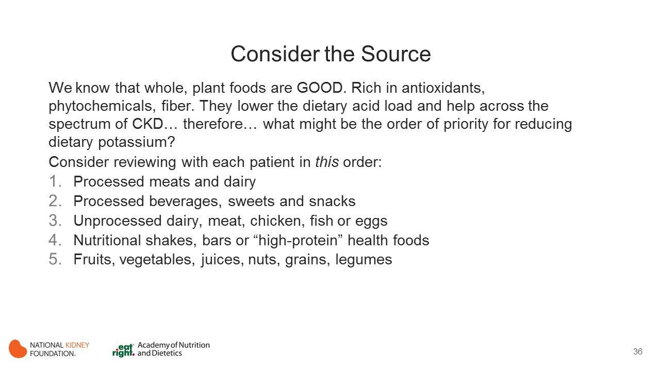
Notes:
Help patients prioritize high potassium foods to restrict to ensure maximum nutritional benefit.

Slide 37
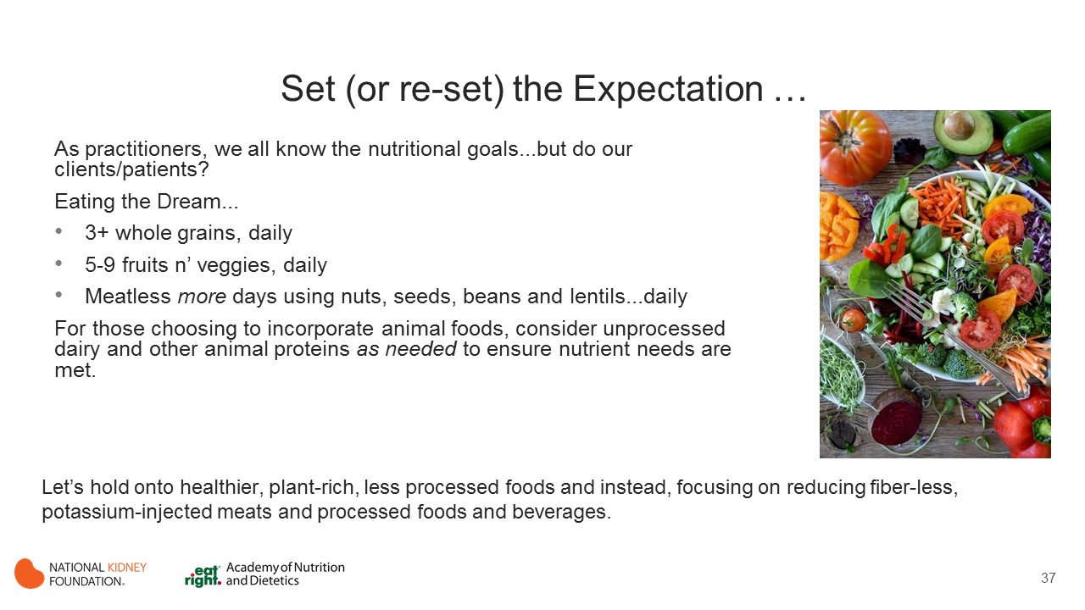
Notes:
Encourage more plant-based, meatless meals.

Slide 38
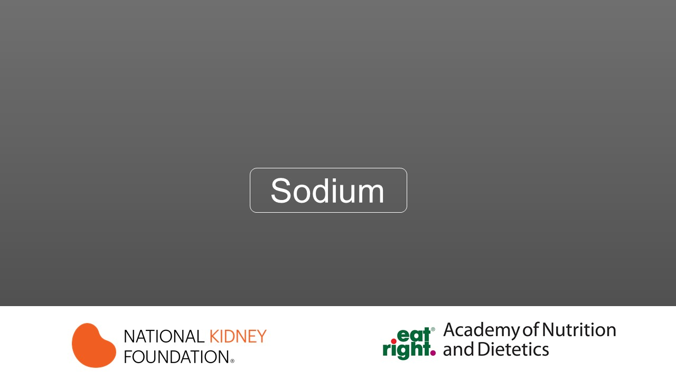

Slide 39
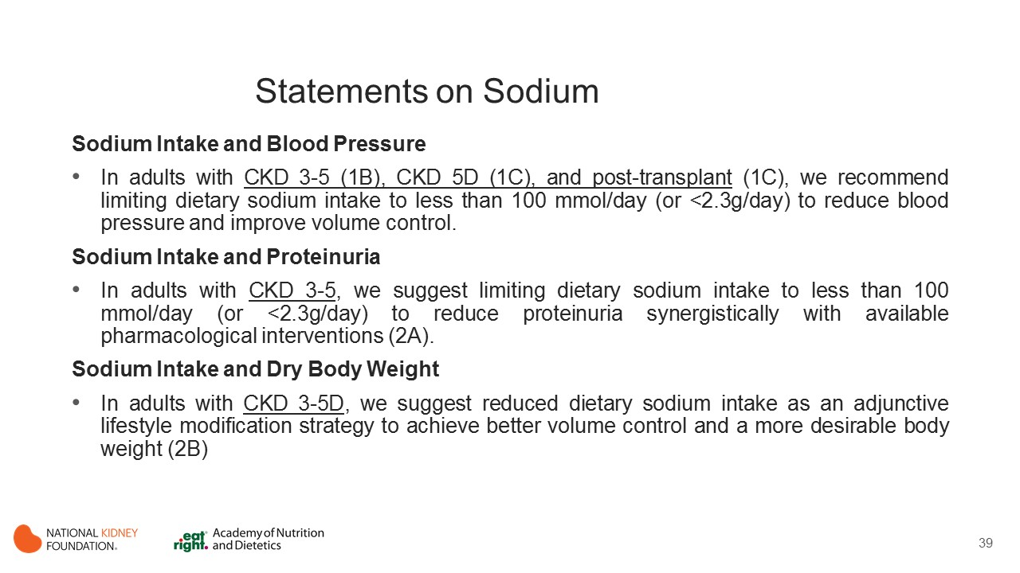
Notes:
Chronic high sodium intake may impact on several physiological functions relating to the vasculature, heart, kidneys and sympathetic nervous system.
Excessive sodium intake is thought to exert toxic effects on blood vessels through mediating factors such as oxidative stress, inflammation and endothelial dysfunction.
Of interest in CKD is the role of sodium reduction in improving the pharmacological effect of antihypertensive medication thereby controlling hypertension.

Slide 40
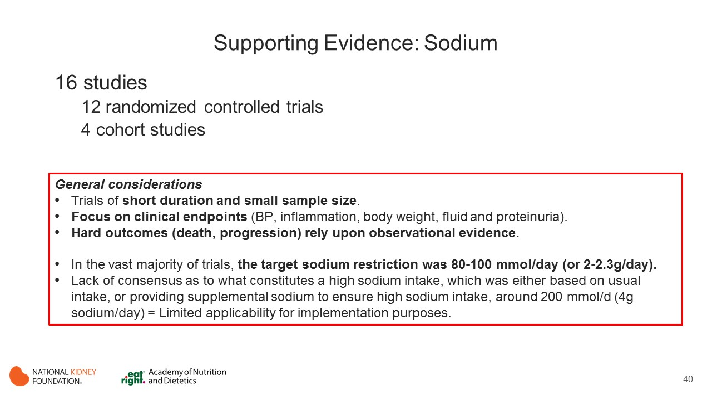
Notes:
16 studies:
12 randomized controlled trials (de Brito-Ashurst 2013, Rodrigues 2014; Keven 2006, McMahon 2013; Campbell 2014; Fine 1997; Vogt 2008; Slagman 2011, Konishi 2011, Liang 2013, Koomans 1985, Magden 2013)
4 cohort studies (He 2015; Mc Causland 2012; Mills 2016, Dong 2010).
Overall, the evidence for reducing sodium intake comes from randomized controlled trials of short duration and typically small sample size. As a result, there is a focus on clinical markers such as blood pressure, inflammation, body weight, fluid and proteinuria.
There is limited evaluation of hard outcomes, which thereby rely upon observational evidence.

Slide 41
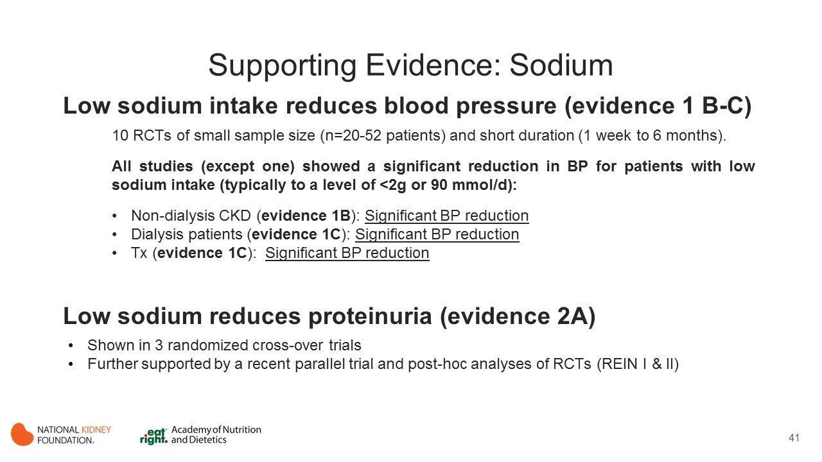
Notes:
Blood Pressure
Sodium reduction probably reduces BP in kidney disease.
Lower sodium intake significantly decreased systolic BP in all but one study.(Rodrigues 2014) However, the certainty of evidence was limited by risk of bias (selection, attribution, and performance).
The vast amount of evidence exists in pre-dialysis CKD.(de Brito-Ashurst 2013; Konishi 2001; McMahon 2013; Slagman 2011; Vogt 2008) However the BP benefits were also apparent in trials in dialysis (Rodrigues 2014; Fine 1997; Magden2013; Koomans 1985) and transplantation (Keven 2006) populations.
Proteinuria
Restriction of sodium intake may reduce proteinuria as demonstrated in 3 randomized cross-over trials. (McMahon 2013; Slagman 2011; Vogt 2008)
This evidence is supported by further parallel RCTs and observational studies.
Meuleman et al. demonstrated a reduction in proteinuria over 3 months using a sodium intake <100mmol/d that reversed to baseline proteinuria after cessation of dietary sodium restriction. (Meuleman 2017)
Post-hoc analyses of clinical trials (REIN I & II) in proteinuric patients with CKD demonstrated a higher sodium diet was associated with an increased risk of progressing to ESRD compared to a lower sodium diet <100mmol/d. (Vegter 2012)

Slide 42
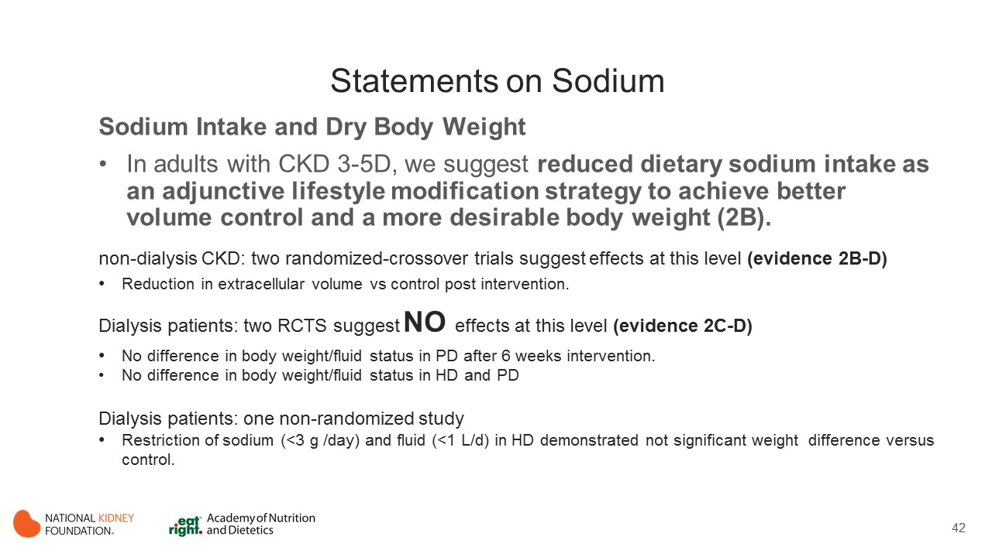
Notes:
Normovolemia is maintained through the action of the renin-angiotensin aldosterone system. This system acts to adjust the quantity of sodium excreted by the body, and thereby ECF volume and arterial BP.
Excess sodium intake is excreted in the urine and serum levels are tightly controlled. requiring normal kidney and blood vessel function.
This system may be compromised with excessive sodium intake, and/or inadequate excretion, which may occur with chronic kidney disease.
Body Weight and Fluid
Sodium restriction may slightly reduce body weight and total body fluid in non-dialysis CKD (low certainty evidence). However, it is uncertain whether sodium restriction reduces body weight and body water in dialysis.
The evidence from non-dialysis CKD comes from two randomized-crossover trials, one using sodium supplementation to compare intake of 60-80mmol/d to 180-200mmol/d for 2 weeks (McMahon 2013) together with a more recent investigation by Saran et al. evaluating the effect of sodium restriction <2g/day vs usual diet for 4 weeks (with a 2-week washout in-between). (Saran 2017) Both trials demonstrated a reduction in extracellular volume.
In maintenance dialysis, two RCTS demonstrated no significant difference in body weight with salt restriction in peritoneal (Fine 1997) or hemodialysis and peritoneal dialysis. (Sevick 2016)
In one non-randomized study in hemodialysis, the group advised to restrict sodium (<3 g /day) and fluid (<1 L/d) intake demonstrated within group decrease in interdialytic fluid gain, but there was no change in the control group, and between group difference was not significant. (Liang 2013)

Slide 43
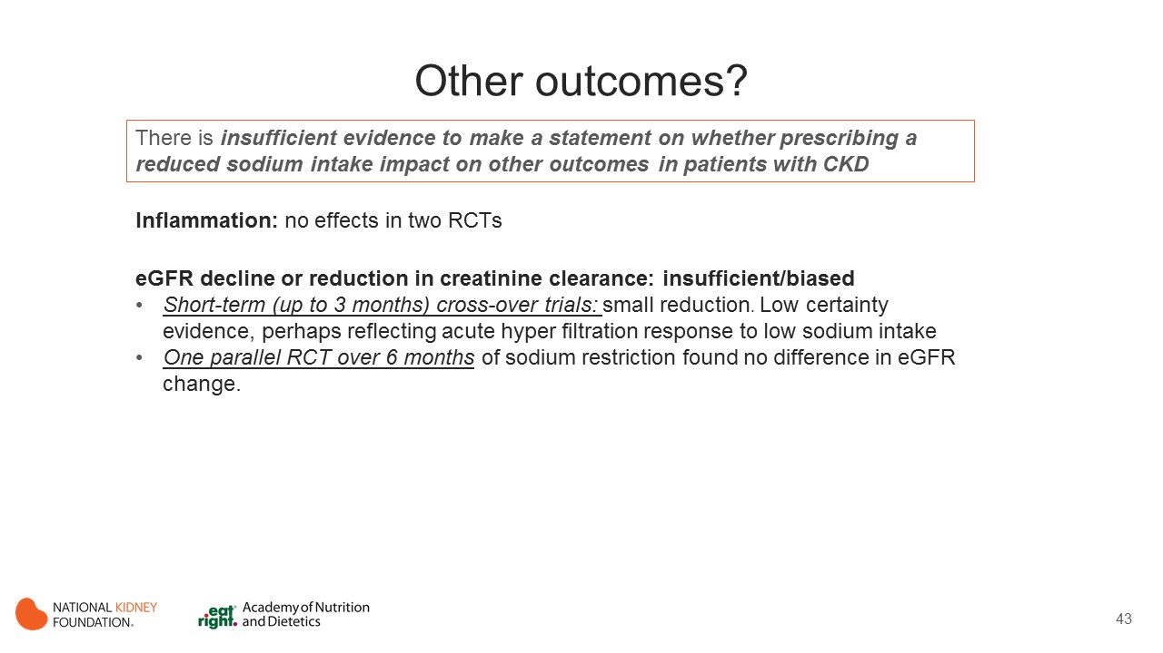
Notes:
There is insufficient evidence to make a statement on whether prescribing a reduced sodium intake impact on other outcomes in patients with CKD
Inflammation
Sodium reduction may make little to no difference to inflammation (low certainty evidence).
Two RCTs, a parallel RCT in MHD, (Rodrigues Telini 2014) and a crossover in Stage 3 and 4, (McMahon 2013) investigated the impact of sodium restriction on inflammation, measured by CRP, IL-6, TNF-alpha.
In the Rodrigues Telini study there was a significant reduction in all inflammatory markers within the intervention group, however not reported between group differences (and no difference within control group). The single crossover study in Stage 3-4 showed no difference in inflammation comparing high and low sodium intake. (McMahon 2013)
eGFR Decline or Reduction in Creatinine Clearance
Restriction of sodium intake may slightly reduce kidney function markers of creatinine clearance (Konishi 2001; Slagman 2011; Konishi 2001; Slagman 2011; Vogt 2008; Koomans 1985) and eGFR (Campbell 2014) demonstrated in short-term cross-over trials in stages 1-5 non-dialysis population (low certainty evidence).
In the single parallel RCT over 6 months of sodium restriction, deBrito-Ashurst found no difference in eGFR. The inconsistency in results may be due to the short-term cross-over trials demonstrating acute hyper filtration response to low sodium intake, compared with the longer-term parallel trial, reflecting a more clinically stable circumstance.

Slide 44
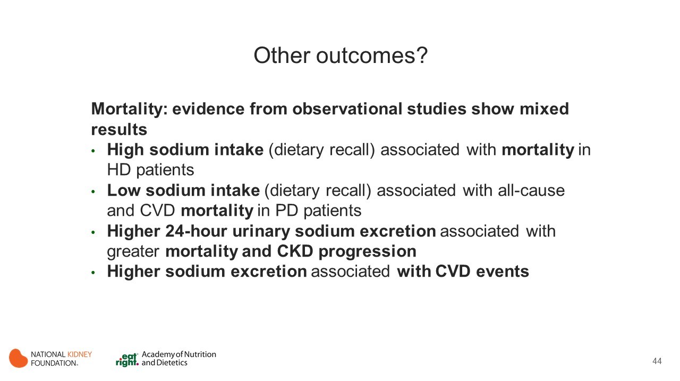
Notes:
Mortality
The evidence for clinical endpoints is derived from observational studies as there were no RCTs in sodium reduction in CKD that reported CKD progression cardiovascular events, mortality outcomes.
In a post-hoc analysis of a prospective cohort of 1770 MHD patients, McCausland et al. found higher dietary sodium intake associated with increased mortality. (Mc Causland 2012)
The retrospective cohort study in 303 PD patients in Japan indicated that low sodium intake was significantly associated with higher overall and cardiovascular mortality. However, this study was open to indication bias as sodium intake was also associated with higher LBM, younger age and higher BMI. (Dong 2010)
More consistent results were demonstrated from a large high-quality prospective cohort (CRIC study) of predialysis Stage 2-4, using urinary sodium excretion.
In He et al., 24-hour urinary sodium excretion was associated with greater all-cause mortality and CKD progression (defined as incident ESRD or halving of eGFR from baseline). (He 2015)
Sodium excretion was also associated with composite CVD (heart failure, myocardial infarction, stroke). (Mills 2016)

Slide 45
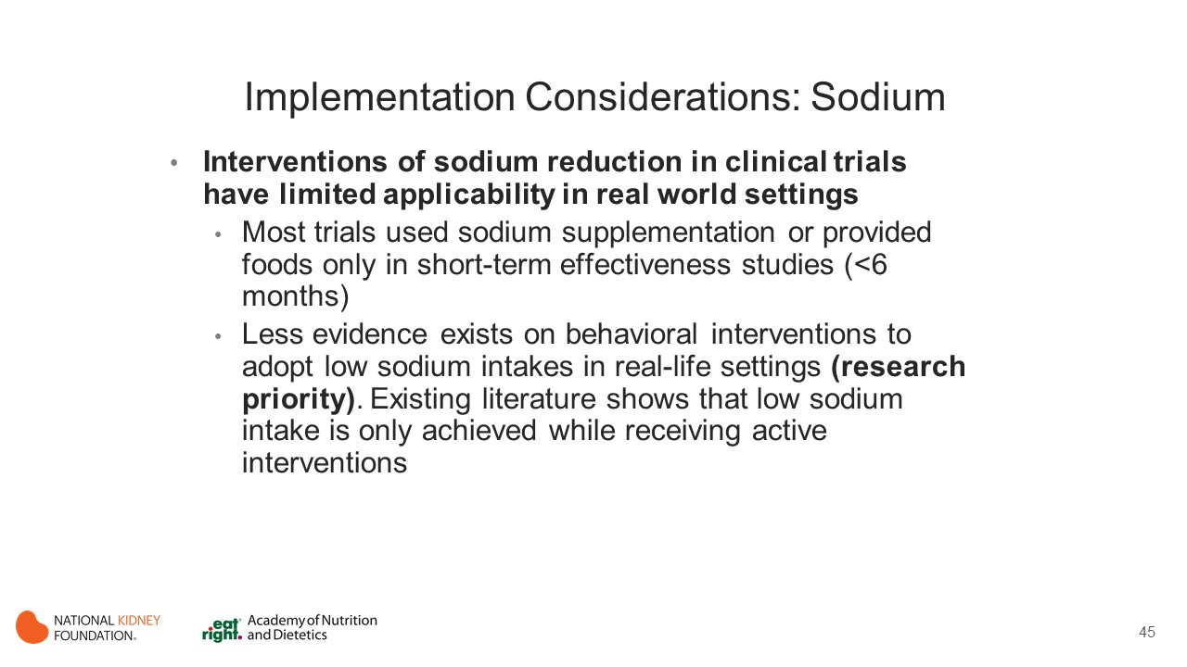
Notes:
The interventions undertaken in clinical trials of sodium reduction have limited applicability when translating into practice. Many trials to date have used sodium supplementation or provided foods to enhance adherence in short-term effectiveness studies. Investigations of efficacy and behavioral interventions to adopt low sodium intakes in real-life settings are limited in the literature. Of those that exist, the evidence is either short term (< 6 months) or demonstrate that achieving a reduced sodium intake is only apparent whilst receiving active intervention.

Slide 46
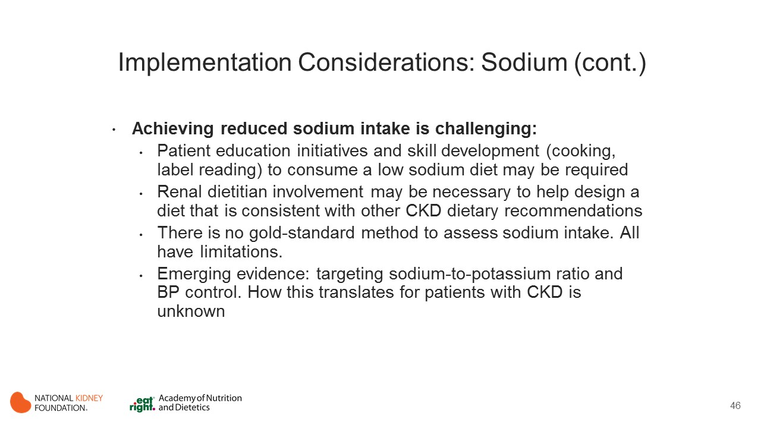
Notes:
Achieving a reduced sodium intake in CKD is recommended, however can be particularly challenging to achieve. This is a result of the need to navigate a complex interplay between individual food choice and food supply, together with a range of other dietary recommendations that come with CKD. Consuming a low sodium diet generally requires education and skill development (cooking, label reading) and explicit choice to consume a low sodium diet. Therefore, a concerted and multi-faceted intervention strategy is required to support achieving this intake in clinical practice. This includes targeting individual behavior change for dietary choices, together with a wider public health strategy to reduce availability of sodium in the food supply.

Slide 47
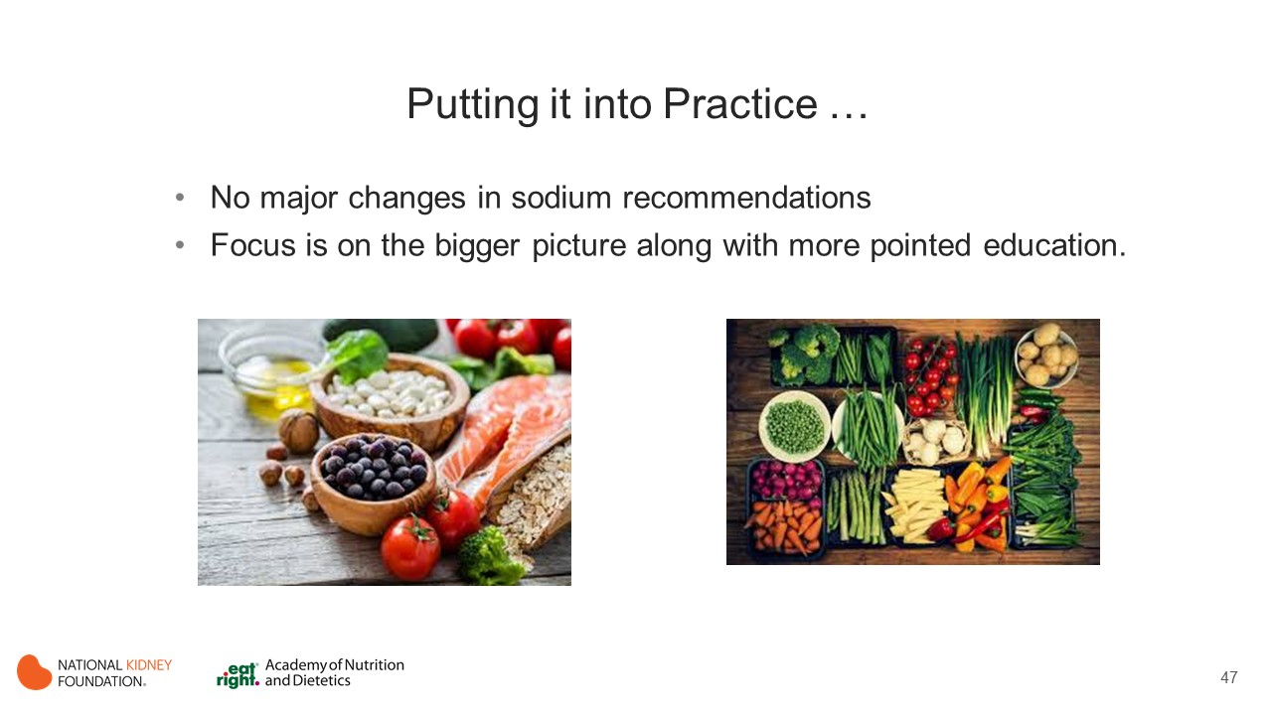
Notes:
There are no major changes in dietary sodium recommendation.

Slide 48
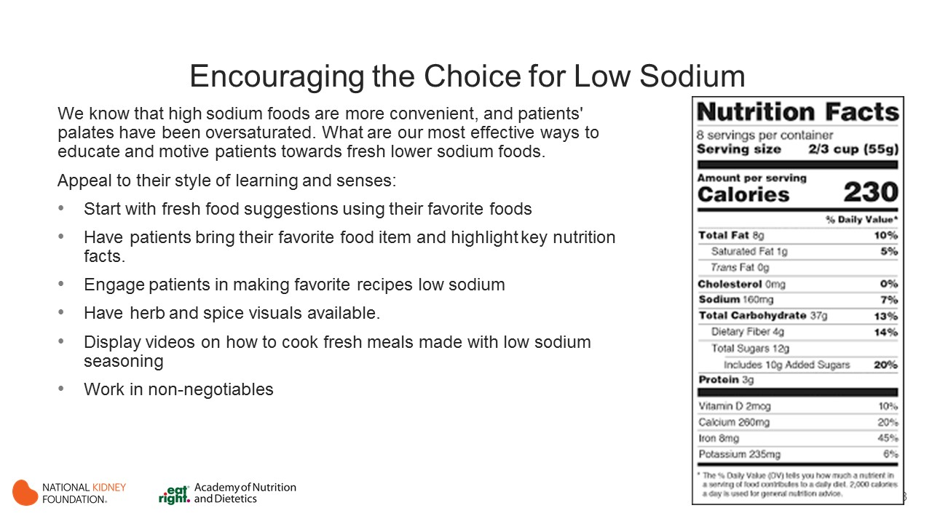
Notes:
Sodium is an acquired taste and may be difficult to overcome for some patients. Implement educational strategies that support gradual change.

Slide 49
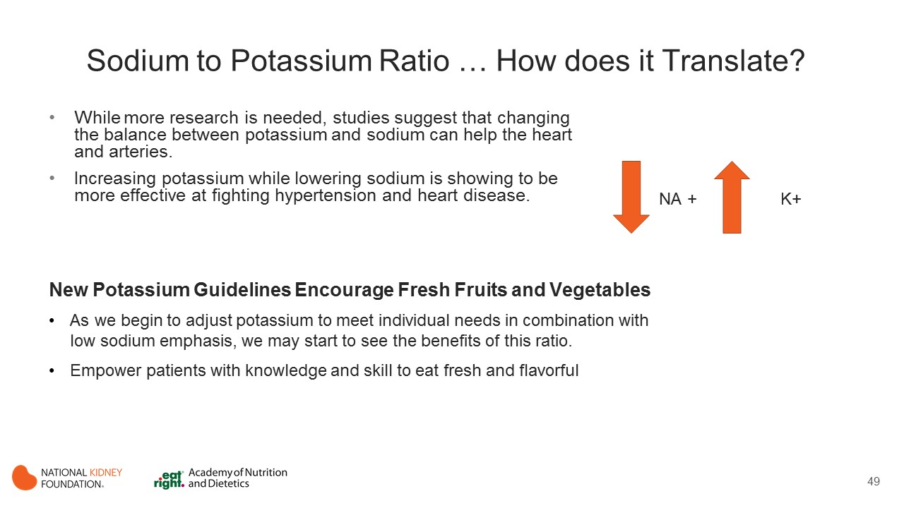
Notes:
Evidence supports the benefits of increasing potassium intake while lowering sodium intake.

Slide 50
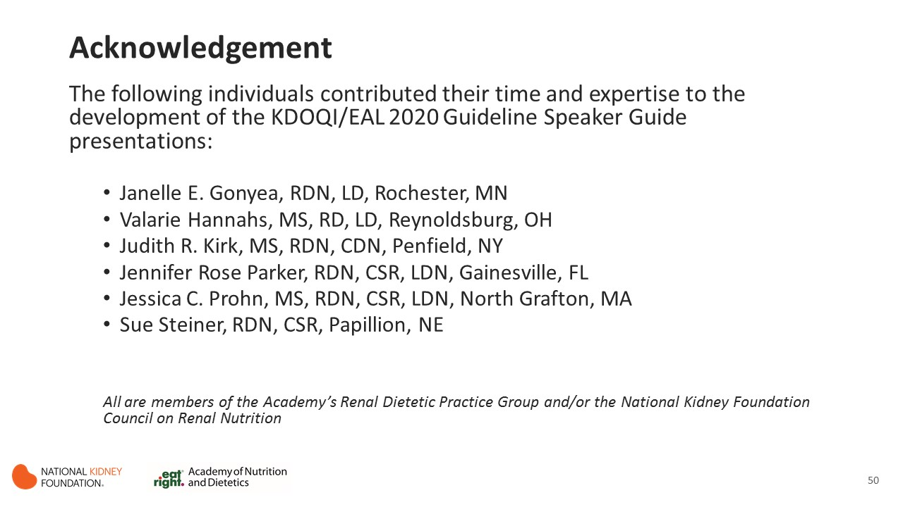

Slide 51
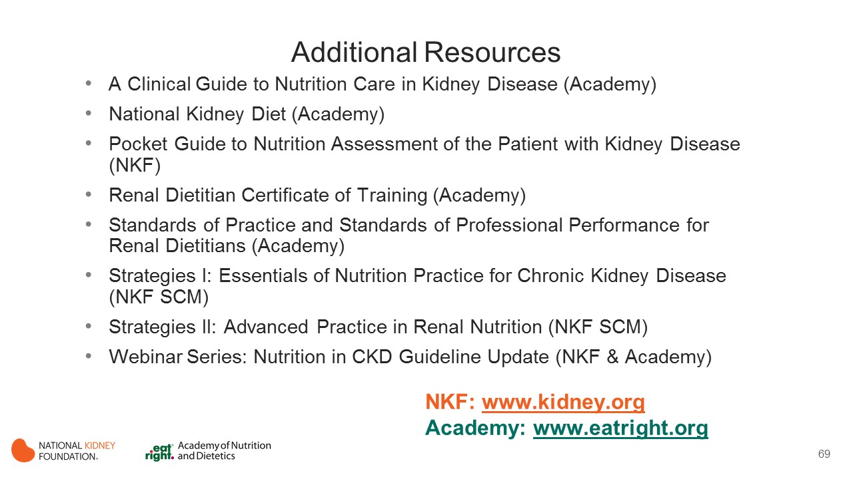

Notes:
These resources from the Academy of Nutrition and Dietetics and the National Kidney Foundation provide additional information to support implementation of the KDOQI Guideline for Nutrition in CKD.

Slide 52


