Slide 1

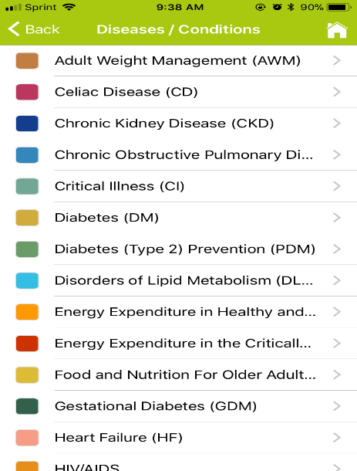

NutriGuides
EAL on
the Go!

Slide 2
What is a “Recommendation”?
Recommendations are:
The essence of evidence-based guidelines.
A series of guiding statements developed using systematic reviews
Designed to assist practitioner and patient decisions about appropriate nutrition care for specific disease states or conditions in typical settings.
Evidence Summaries & Conclusion Statements = what the evidence says
Guideline = course of action for the practitioner based on the evidence

Slide 3

On the Go with NutriGuides
This mobile application is designed for the busy healthcare professional by providing easy access to all EAL recommendations right at your fingertips!
NutriGuides includes 450 EAL© evidence-based nutrition practice recommendations.

Slide 4




Where to Purchase
NutriGuides is available from the Apple iTunes store for the iPhone and iPad; and from GooglePlay for Android devices.

Slide 5


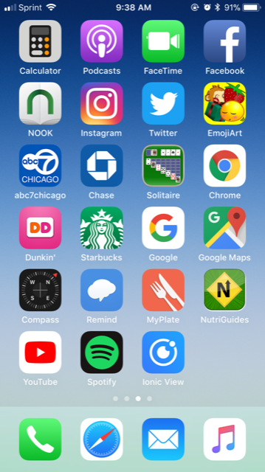
Download the App

Slide 6
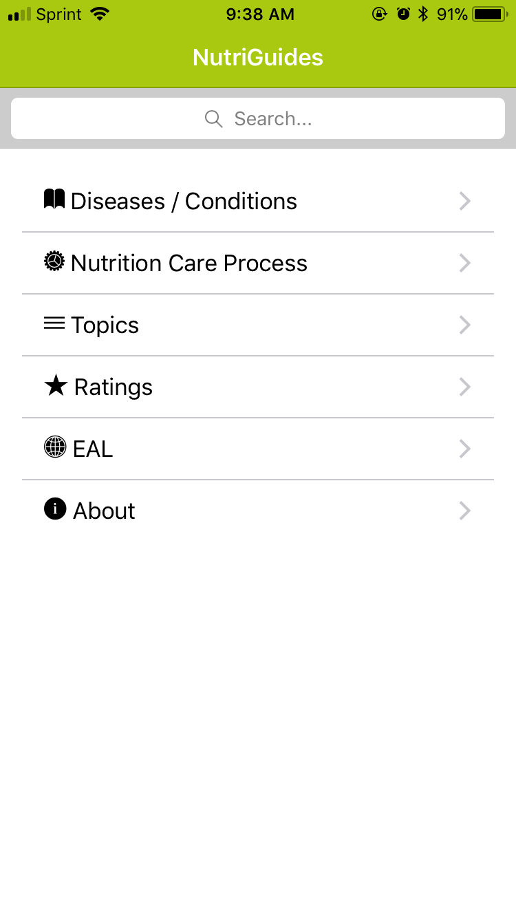
NutriGuides Home Screen
The Home screen allows you to search the recommendations by:
Disease/Condition
Nutrition Care Process category
Topic area
Enter a term in the Search engine
You can also:
Learn about the EAL’s Recommendation Ratings
Visit the EAL (separate website)
Information on this app

Slide 7

Diseases/Conditions
The EAL has 21 guidelines. All 450 recommendations from these diseases/health conditions are available on NutriGuides.

Slide 8
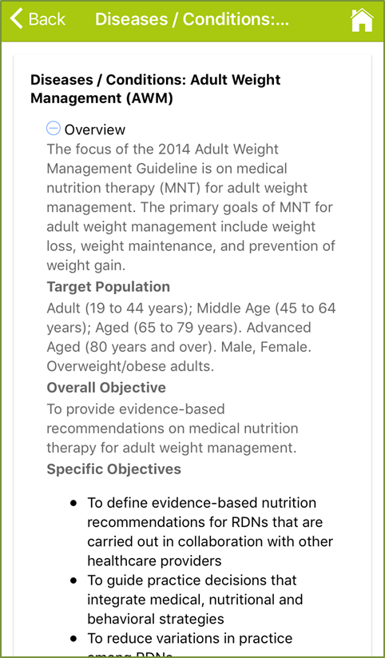
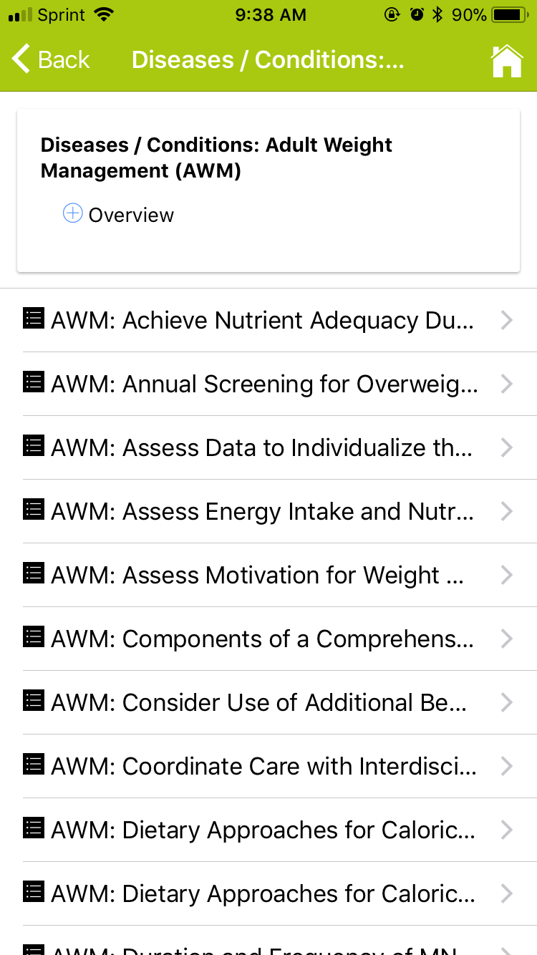
Recommendations by Disease
Expand the Overview section to learn more about the Guideline. The Overview includes information on the development of the guideline including the target audience and objective.
The recommendations are listed in alphabetical order.

Slide 9
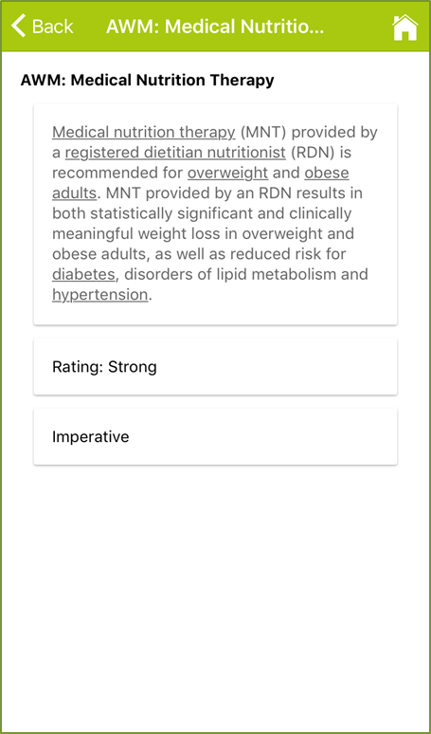
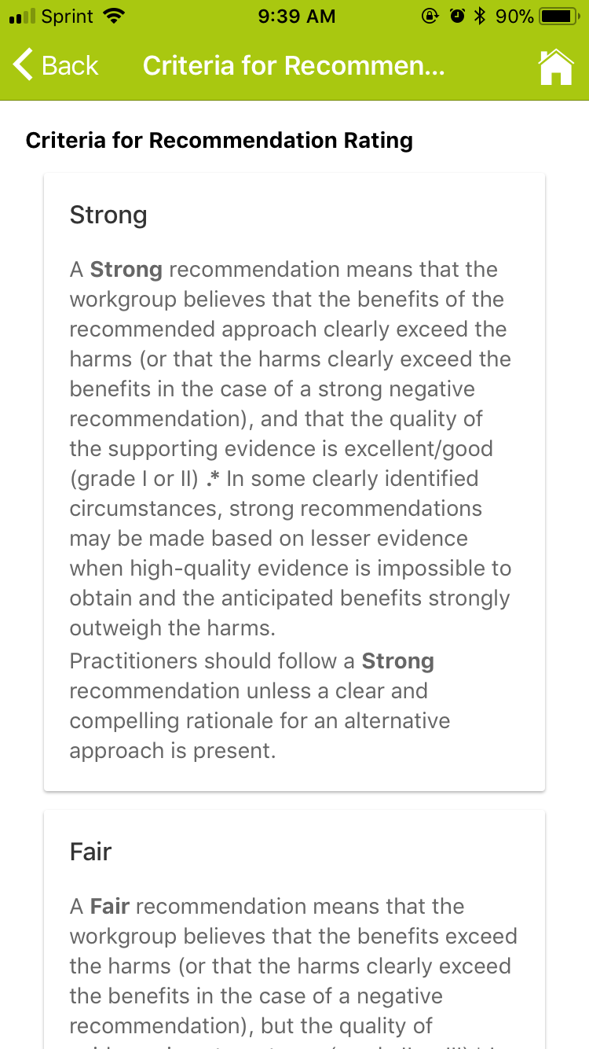
Recommendation and Rating
Click on a recommendation title to view the detail.
Click on the rating to view an description of the criteria for a rating of Strong, Fair, Weak, Consensus, Insufficient Evidence, Imperative and Conditional

Slide 10
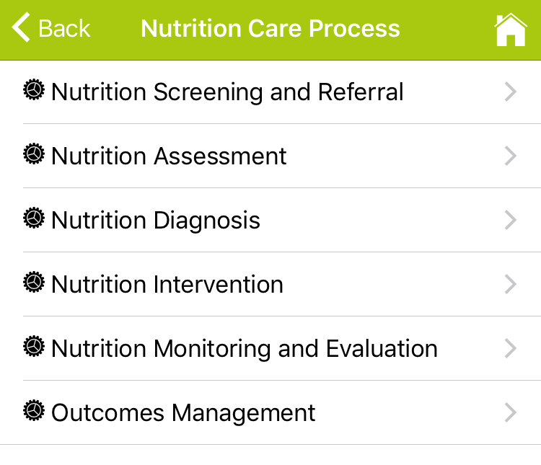
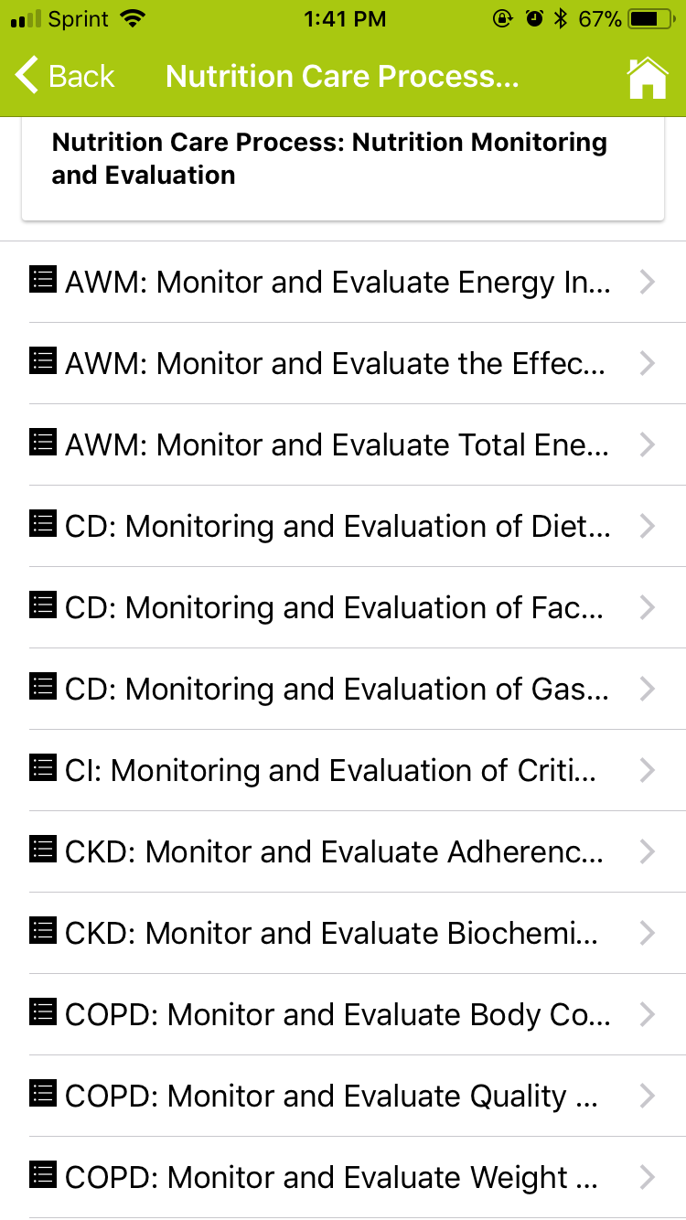
Search by NCP Category
The Nutrition Care Process (NCP) is designed to improve the consistency and quality of individualized care for patients/clients and the predictability of the patient/client outcomes.
Select a category to view recommendations by each NCP step.

Slide 11
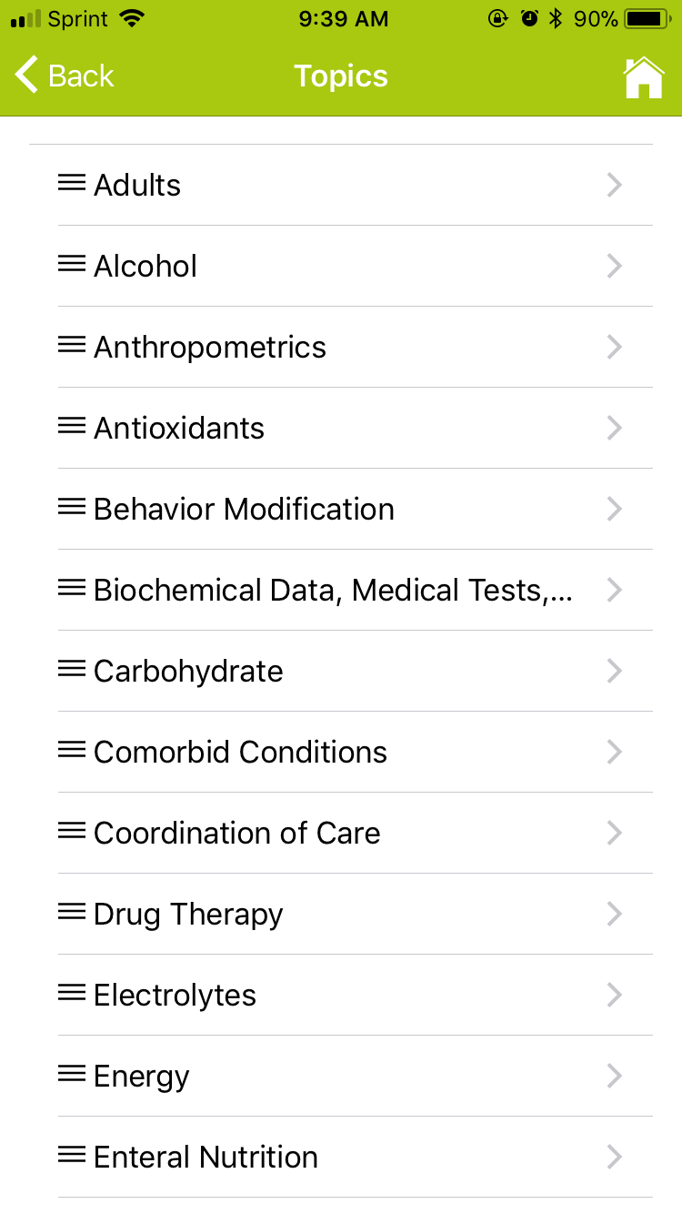
Search by Topics
Search recommendations by Topics such as Anthropometrics, Energy, Gluten Free, Minerals, Protein, and more …

Slide 12
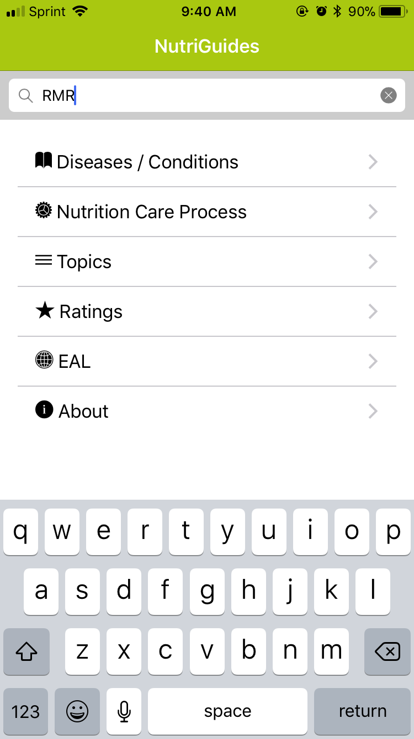
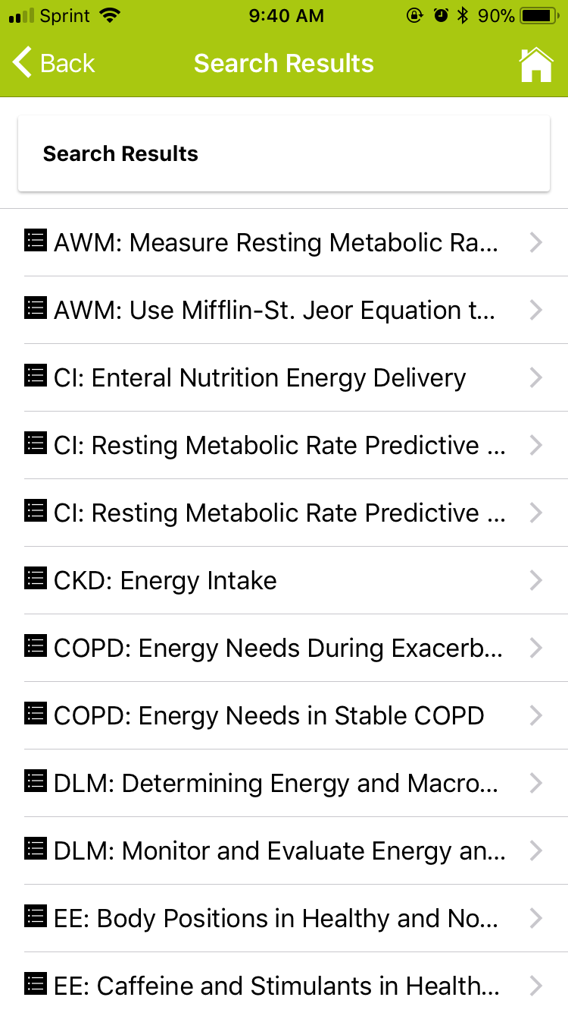
Use the Search Engine

Slide 13
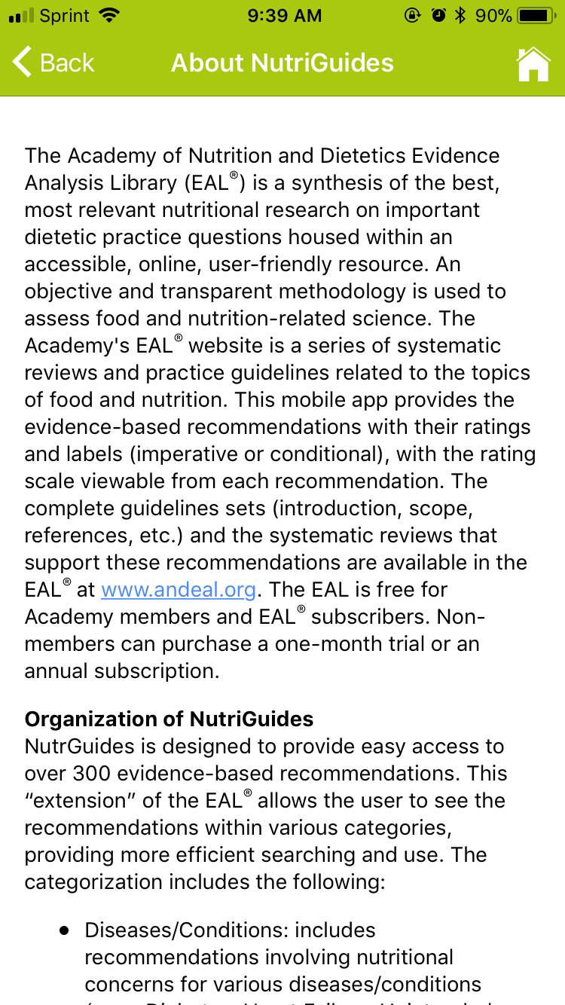

About NutriGuides and the EAL
Learn about NutriGuides from the About tab.
The EAL tab will redirect you to the EAL (www.andeal.org).
The EAL is free for members of the Academy of Nutrition and Dietetics. Non-members can purchase a subscription.

Slide 14

Components of EAL Guideline
NutriGuides only provides the recommendation and rating.
Visit the EAL to view the entire guideline. Each EAL Guideline component includes:
Recommendation
Rating
Classification of Conditional or Imperative
Risks/Harms of Implementing this Recommendation
Conditions of Application
Potential Costs Associated with Application
Recommendation Narrative
Recommendation Strength Rationale
Minority Opinions (if needed)
Supporting Evidence

Slide 15
Thank you
Questions and/or comments should be directed to eal@eatright.org

