Slide 1
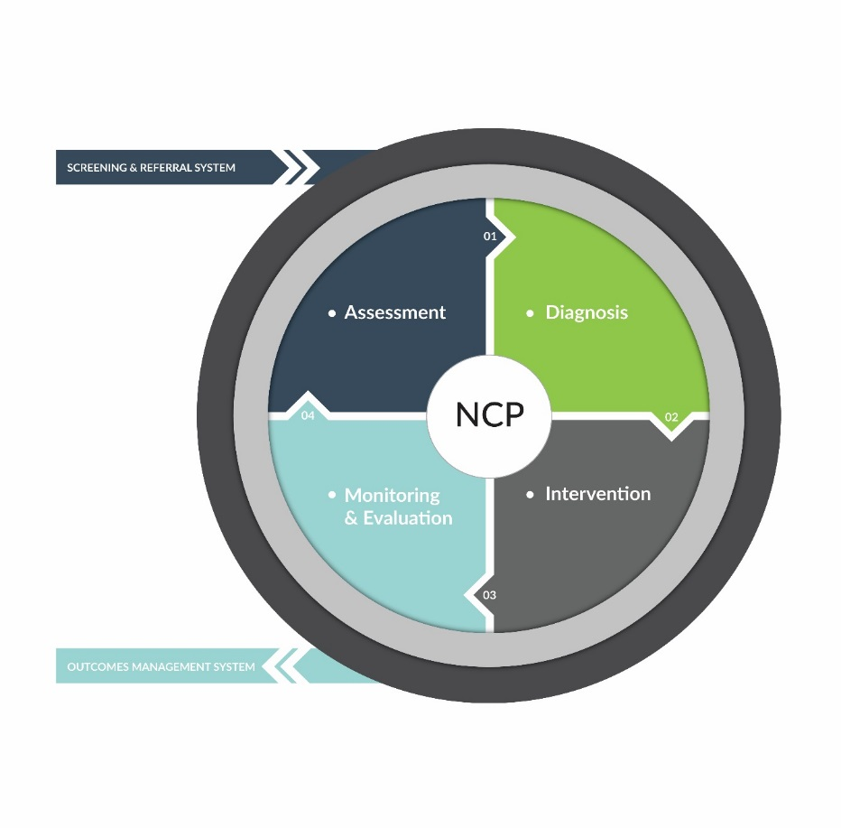
Nutrition Care Process Terminology (NCPT)
Overview
&
Resources

Slide 2
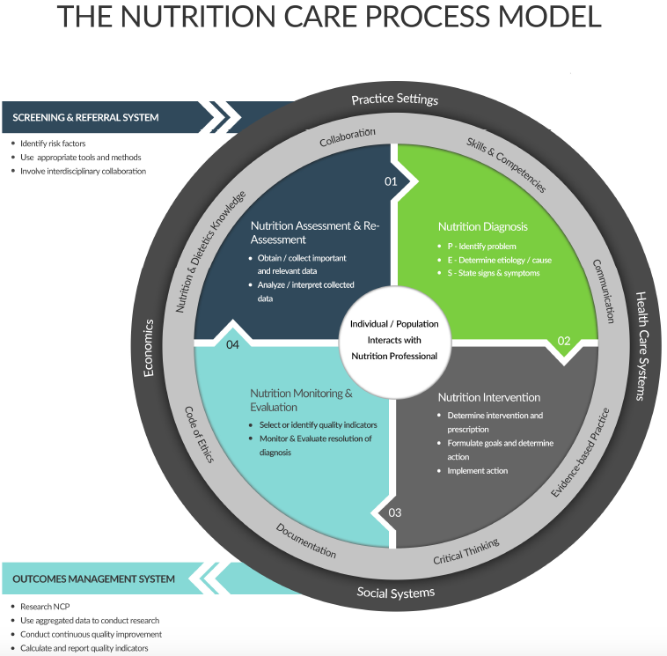
Nutrition Care Process Model

Slide 3
Nutrition Care Process: Steps
Step 1
Nutrition Assessment
Step 2
Nutrition Diagnosis
Step 3
Nutrition Intervention
Step 4
Nutrition Monitoring & Evaluation

Slide 4
Step 1: Nutrition Assessment

Slide 5
Step 1: Nutrition Assessment
Nutrition Assessment (NA)
Obtain adequate information in order to identify nutrition-related problems
Systematic process of
    Obtaining
    Verifying and
    Interpreting the data
Make decisions about the nature and cause of nutrition related problems
Re-assessment at subsequent encounters addresses Monitoring and Evaluation parameters

Slide 6
Step 1: Nutrition Assessment
Critical Thinking Skills
  Determining appropriate data to collect
  Determining the need for additional information
  Selecting appropriate assessment tools and procedures
  Applying the assessment tools in valid and reliable ways
  Distinguishing relevant from irrelevant data
  Distinguishing important from unimportant data
  Validating the data

Slide 7
Nutrition Assessment
Results of Nutrition Assessment
Leads to appropriate initial determination that a nutrition diagnosis/problem exists
If a nutrition diagnosis can be made, the RDN labels the problem and creates a PES* statement in Step 2 of the Nutrition Care Process
*PES: Problem, Etiology, Signs/Symptoms

Slide 8
Nutrition Assessment
Results of Nutrition Assessment
If a nutrition problem is not identified, further information or testing may be necessary to make a determination
If the assessment indicates that no nutrition problem currently exists that warrants a nutrition intervention, the term “No nutrition diagnosis at this time (NO-1.1)” may be documented

Slide 9
Nutrition Assessment
Results of Nutrition Assessment/Reassessment
The RDN will determine
If a nutrition diagnosis/problem exists
The plan for continuation of care, specifically:
  Progression through the NCP
  Need for additional information/testing
  Discharge from nutrition care

Slide 10
Nutrition Assessment
Domains (Categories)
  Food/Nutrition Related History
  Anthropometric Measurements
  Biochemical Data, Medical Tests, Procedures
  Nutrition-Focused Physical Findings
  5. Client History

Slide 11
Nutrition Assessment
Components of Nutrition Assessment Process
  Review data collected for factors that affect nutritional and health status
  Cluster individual data elements to identify a nutrition diagnosis as described in the nutrition diagnosis reference sheets
  Identify standards for data comparison

Slide 12
Nutrition Assessment
Nutrition Care Indicators
Clearly defined markers – measureable
  Food and nutrient intake
  Medication use
  Growth and body composition
  Food and nutrition related knowledge
  Attitudes and behaviors
  Food access
  Physical activity
  Anthropometric data
  Laboratory values
  Physical findings (observed or reported)
  Personal and family medical history, social factors

Slide 13
Nutrition Assessment
Assessment of Nutrition Care Indicators
  Nutrition Care Criteria – what it is compared against
  Nutrition Prescription or Goal
      Dietary Intervention
      Behavior change
  Reference Standard: select what is appropriate for intervention or goal
      National
      Institutional
      Regulatory standards

Slide 14
Nutrition Assessment
Reference Sheet Content for each Term includes:
  Definition
  Indicators for
    Assessment
    Monitoring and Evaluation
  Measurement methods or data sources
  Nutrition interventions that are associated
  Nutrition diagnoses with which data are used
  Criteria for evaluation
  Example for assessment and M&E
  Literature references

Slide 15
Nutrition Assessment
Data Sources and Tools
    Screening or referral form
    Patient interview
    Medical or health records
    Consultation with caregivers and family
    Community based surveys
    Statistical reports, administrative data, epidemiological studies

Slide 16
Nutrition Assessment
Summary
  Nutrition Assessment is the first step of the NCP
  Dynamic process that develops throughout the NCP
  Data is used for all other steps of the NCP
  New information may provide reason for reassessment or change in approach and intervention

Slide 17
Step 2: Nutrition Diagnosis

Slide 18
Step 2: Nutrition Diagnosis
New concept for dietetics profession
Definition of Diagnosis
  The act of identifying a disease or condition from it’s signs and symptoms
  Investigation or analysis of the cause or nature of a condition, situation, or problem.
This implies
  Pre-defined list of potential conditions
  Pre-defined criteria (signs and symptoms) to which the current situation can be compared

Slide 19
PES Statement
The nutrition diagnosis or nutrition problem is summarized into a structured sentence called
  Nutrition diagnosis statement
OR
  PES Statement

Slide 20
PES Statement
This statement has 3 distinct components:
  P (Problem)
  E (Etiology)
  S (Signs and Symptoms)
    This information is obtained during the nutrition assessment phase of the Nutrition Care Process

Slide 21
PES Statement
This statement has a distinct format:
  Problem related to Etiology as evidenced by
  Signs and Symptoms

Slide 22
Evaluating Your PES Statement
P (Problem): Can the RDN resolve or improve the nutrition diagnosis? Consider the “intake” nutrition diagnosis as the one more specific to the role of the RDN.
E (Etiology): Determine if this is the “root cause” for the problem. If addressing the etiology will not resolve the problem, can the RDN intervention lessen the signs and symptoms?
S (Signs and Symptoms): Will measuring the signs and symptoms indicate if the problem is resolved or improved? Are the signs and symptoms specific enough that the RDN can monitor and document resolution or improvement of the nutrition diagnosis?

Slide 23
Evaluating Your PES Statement
PES Overall:
Does the nutrition assessment data support the specific nutrition diagnosis, etiology, and signs and symptoms?

Slide 24
Example PES Statements
Excessive Fat Intake related to limited access to healthful options – frequent consumption of high-fat, fast-food meals as evidenced by serum cholesterol level of 230 mg/dL and patient report of 10 meals per week of hamburgers and fries
Excessive Energy Intake related to unchanged dietary intake and restricted mobility while fracture heals as evidenced by 5 lb weight gain during last 3 weeks due to patient report of consumption of 500 kcal/day more than estimated needs
Swallowing Difficulty related to post stroke complications as evidenced by results of swallowing tests and reports of choking during mealtimes

Slide 25
Nutrition Diagnosis Etiology
Identifying the etiology leads to selection of the nutrition intervention aimed at resolving the underlying cause of the nutrition problem
If the intervention cannot be aimed at resolving the underlying cause, as is the case in Physiologic-Metabolic etiologies, then the nutrition intervention is targeted at minimizing the signs/symptoms of the nutrition problem

Slide 26
Nutrition Diagnosis Etiology
Etiologies are grouped by the type of cause or contributing risk factor. See Nutrition Diagnosis Etiology Matrix for definitions.
  Beliefs-Attitudes
  Cultural
  Knowledge
  Physical Function
  Physiologic
  Social-Personal
  Treatment
  For the following, the category alone may be the cause or contributing risk factor of the Nutrition Dx (diagnosis)
  Access
  Behavior

Slide 27
Nutrition Dx Reference Sheets
A reference sheet is available for each nutrition diagnosis. Each reference sheet contains
4 components. See sample reference sheets.
  Problem or Nutrition Diagnosis Label
  Definition of the Nutrition Diagnosis Label
  Etiology (cause/contributing risk factors)
  Signs/Symptoms (defining characteristics)
    Grouped by
      nutrition assessment category, and
      potential indicators of the specific nutrition diagnosis

Slide 28
Nutrition Diagnostic Terminology
Three general domains
  Intake
    Excessive or Inadequate intake compared to requirements (actual or estimated)
  Clinical
    Medical or physical conditions that are outside normal
  Behavioral-Environmental
    Relate to knowledge, attitudes, beliefs, physical environment, access to food, or food safety

Slide 29
Step 3: Nutrition Intervention

Slide 30
Nutrition Intervention
Nutrition intervention is purposeful planned actions intended to positively change a nutrition related behavior, environmental condition, or aspect of health status
  Directed to the etiology or cause of the problem identified in the PES statement
  Sometimes the intervention must be directed toward the signs and symptoms if the RDN cannot impact the etiology

Slide 31
Nutrition Intervention
Two interrelated components
  Planning
  Implementation

Slide 32
Nutrition Intervention
  Planning:
    Prioritize the nutrition diagnoses
    Review practice guidelines (EAL) and policies
    Confer with the patient (and others)
    Set goals and determine expected outcomes
    Defining the specific nutrition intervention strategy
    Define time and frequency of care

Slide 33
Nutrition Internvention
  Implementation
    Communicate the plan of care
    Carry out the plan of care
    Continue data collection
      Monitor and Evaluate
        Follow-up and verify the implementation
        Revise nutrition intervention strategy if needed

Slide 34
Nutrition Intervention
Four Domains
  Food and/or Nutrient Delivery
  Nutrition Education
  Nutrition Counseling
  Coordination of Nutrition Care

Slide 35
Nutrition Intervention
Use of Nutrition Interventions Based on Practice Setting
  Food and/or Nutrient Delivery:
      institutional settings (hospitals, long-term care)
      home care
  Nutrition Education-Content:
      institutionalized settings
  Nutrition Education-Application:
      outpatient/non institutionalized settings
      private practice
      community
  Nutrition Counseling:
      outpatient/non institutionalized settings
      private practice
      community
      Coordination of Nutrition Care:
          all practice settings

Slide 36
Nutrition Intervention
Reference Sheets include:
  Definition
  Details of Intervention
  Examples of typical use
  Other considerations
  References

Slide 37
Nutrition Intervention
Summary:
Defined nutrition intervention terminology-
    Assists in communication within the dietetics profession and among other health care providers.
    Allows documentation of the impact of the profession on specific diagnoses and etiologies in all patient/client populations.

Slide 38
Step 4: Nutrition Monitoring & Evaluation

Slide 39
Nutrition Monitoring & Evaluation
Critical thinking skills for Nutrition Monitoring & Evaluation:
  Selecting appropriate indicators/measures
  Using appropriate criteria (previous status, nutrition intervention goals, or reference standards) for comparison
  Defining where patient/client is now in terms of expected outcome
  Explaining variance from expected outcomes
  Identifying factors that help/hinder progress
  Deciding between discharge or continuation of nutrition care

Slide 40
Nutrition Monitoring & Evaluation
Determines whether the patient is meeting the nutrition intervention goals or desired outcomes
A nutrition reassessment is needed to identify whether the nutrition-related problem still exists and evaluate the progress made toward resolving the problem.

Slide 41
Nutrition Monitoring & Evaluation
Is the nutrition intervention strategy working to resolve the nutrition diagnosis, its etiology, and/or signs and symptoms?
Assesses the patient’s progress by comparing specific markers or nutrition care indicators against recognized, science-based standards or baselines.

Slide 42
Nutrition Monitoring & Evaluation
Definitions
Nutrition Monitoring: preplanned review and measurement of selected nutrition care indicators of patient/client’s status relevant to the defined needs, nutrition diagnosis, nutrition intervention, and outcomes.
Nutrition Evaluation: the systematic comparison of current findings with the previous status, nutrition intervention goals, effectiveness of overall nutrition care, or a reference standard
Nutrition Care Outcomes: the results of nutrition care that are directly related to the nutrition diagnosis and the goals of the intervention plan
Nutrition Care Indicators: markers that can be measured and evaluated to determine effectiveness of nutrition care

Slide 43
Nutrition Monitoring & Evaluation
Nutrition Care Outcomes: intermediate outcomes to other broader health care outcomes
  Acute or chronic disease: occurrence, duration, severity
  Infections
  Wound healing
  Health care cost
  Patient functional ability

Slide 44
Nutrition Monitoring & Evaluation
Nutrition Care Outcome Characteristics:
  Represent results the RDN can impact
  Can be linked to nutrition intervention goals
  Are measureable with tools and resources available to the RDN
  Occur in a reasonable time period

Slide 45
Nutrition Monitoring & Evaluation
Nutrition Monitoring & Evaluation Components
Monitor progress toward the nutrition intervention or goal
Measure the appropriate nutrition care indicators
Evaluate the nutrition care indicators against appropriate standards selected during the nutrition care planning

Slide 46
Nutrition Monitoring & Evaluation
Nutrition Care Indicators:
  Factors that food and nutrition professionals can impact directly, such as food and nutrient intake; growth and body composition; food and nutrition-related knowledge, attitudes, and behaviors; and food access
  Laboratory values, such as HgbA1c, hematocrit, or serum cholesterol
  Functional capabilities, such as physical activity
  Patient perception of nutrition care and results of nutrition care, such as nutrition quality of life

Slide 47
Nutrition Monitoring & Evaluation
Measurement and Evaluation of Nutrition Indicators:
  Nutrition Care Criteria – what it is compared against
  Nutrition Prescription or Goal
      Dietary Intervention
      Behavior change
  Reference Standard: select what is appropriate for intervention or goal
      National
      Institutional
      Regulatory standards

Slide 48
Nutrition Monitoring & Evaluation
Selection and Interpretation of
Nutrition Care Indicators:
Primary factors that influence the selection, measurement, and interpretation of individual nutrition care outcomes:
  Practice setting
  Age of patient
  Disease state and severity

Slide 49
Nutrition Monitoring & Evaluation
Reference Sheets
These reference sheets are combined with the nutrition assessment reference sheets and contain these eight components:
  Definition of the nutrition assessment and nutrition monitoring and evaluation term
  The nutrition assessment and nutrition monitoring and evaluation indicators
  Measurement method or data sources recommended
  The nutrition interventions with which the nutrition assessment and nutrition monitoring and evaluation data are used
  The nutrition diagnoses with which the nutrition assessment and nutrition monitoring and evaluation data are used
  The criteria for evaluation
  The patient/client nutrition assessment and nutrition monitoring and evaluation documentation example
  References

Slide 50
Nutrition Monitoring & Evaluation
Documentation
Quality documentation for nutrition monitoring and evaluation includes the following:
  Date and time
  Indicators measured, results, and the method for obtaining the measurement
  Criteria to which the indicator is compared (nutrition prescription/goal or a reference standard)
  Factors facilitating or hampering progress
  Other positive or negative outcomes
  Future plans for nutrition care, nutrition monitoring, and follow-up or discharge

Slide 51
Nutrition Monitoring & Evaluation
Data Sources and Tools
To monitor and evaluate a patient/client’s progress, the following tools may be used:
  Patient/client questionnaires
  Surveys
  Pretests and posttests
  Patient/client/family member interviews
  Anthropometric measurements
  Biochemical and medical test results
  Food and nutrition intake tools

Slide 52
Nutrition Monitoring & Evaluation
Nutrition Care Outcome Management System
Potential benefits of aggregate nutrition care indicator data include the following:
  Provide for process improvement and foster understanding of what works and what does not
  Can be used for outcomes measurement studies and quality improvement initiatives
  Link care processes and resource utilization
  Give an opportunity to identify and analyze causes of less than optimal performance and outcomes
  Define information for inclusion in centralized data systems relevant to nutrition care
  Can be used to quantify the food and nutrition professional’s contribution to health care

Slide 53
Nutrition Monitoring & Evaluation
Nutrition Care Outcome Management System
Factors that can impact aggregate nutrition care indicator data interpretation include:
  Method for collecting the outcome (diet record, recall)
  Data source (patient, family/caregiver, chart)
  Intervention components (type, duration, and intensity)
  Education and skill level of RDN
  Nutrition program attributes

Slide 54
Nutrition Monitoring & Evaluation
Summary
Nutrition Monitoring and Evaluation describes the patient’s progress through consistent terms that are evaluated based on carefully selected indicators and criteria.
Documentation of patient progress and outcomes with consistent terminology that can be collected using research methodology will result in documenting the value of the work of the RDN

Slide 55
NCP Resources

Slide 56
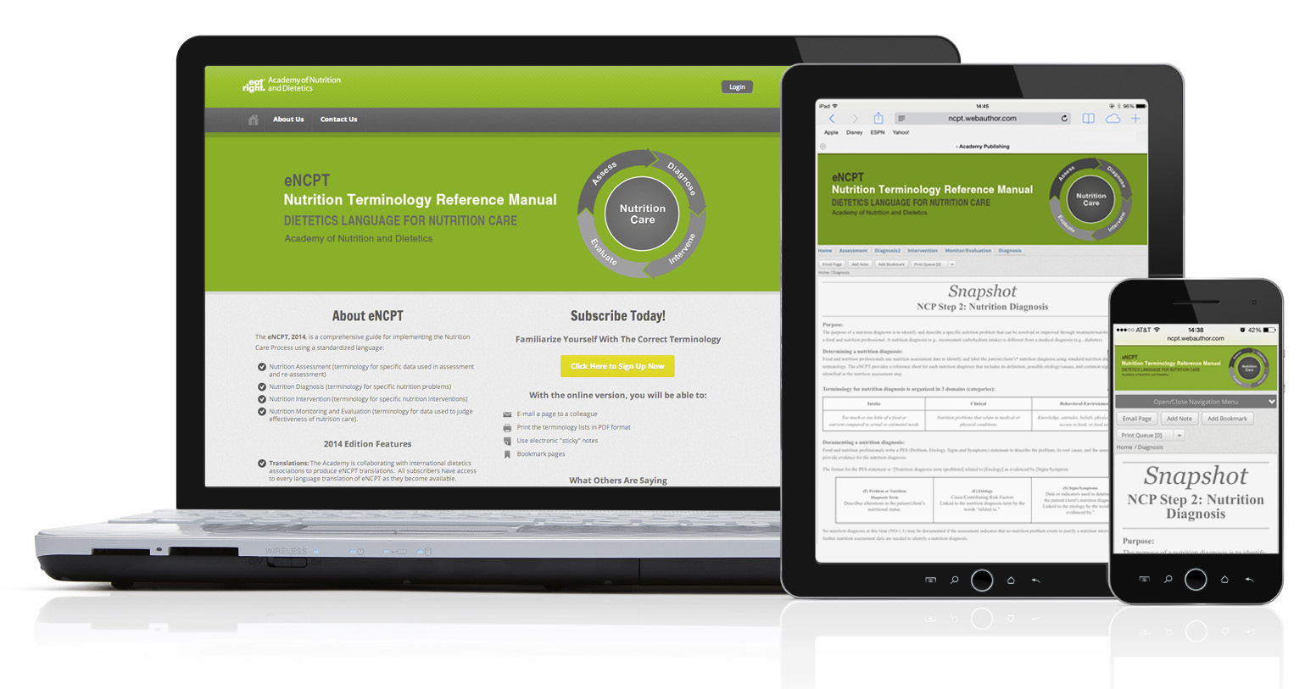
A new electronic format
with a “responsive website”
is available for ease of access around the world.
https://ncpt.webauthor.com/
56

Slide 57
New Features
Translations: The Academy collaborates with international dietetics associations to produce eNCPT translations. These translations are easily accessible to subscribers via tabs on the webpage.
Easy Navigation: Every page in the new eNCPT includes a file path at the top so that users can never get lost. Additionally, with the improved toolbar at the top of the screen, users can now easily get to any section of the eNCPT immediately, no matter where they are on the site.
Modern Functionality: The Scribd tool allows the user to scroll through PDFs on the screen without downloading first.
Improved Organization: The new online platform follows the layout of the print edition so that charts are left intact and information flows in a logical way.
57

Slide 58
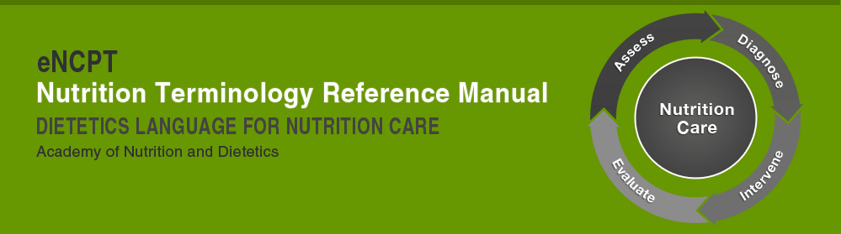
eNCPT
Language translations
  Translations is ongoing collaborative work between the Academy and interested national dietetic associations
Unique URL
  Organizations can purchase a unique link for a specified number of simultaneous users and to provide access to their members
No Terminology License
  Organizations will be granted permission to use the
  eNCPT in their Electronic Health Record by purchasing a multi-seat subscription to eNCPT

Slide 59
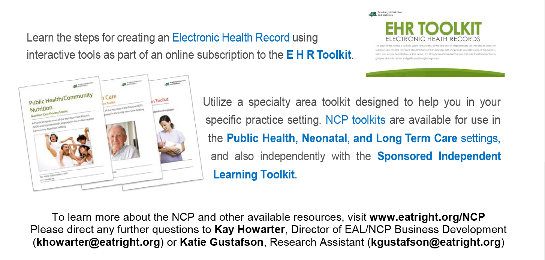
NCPT Toolkits
To learn more about the NCP/NCPT and other available resources,
visit www.eatright/NCP.
Please direct any further questions to ncp@eatright.org

Slide 60

International Website
https://ncpt.webauthor.com/international-collaboration

Slide 61
eNCPT Student Companion Guide
and Instructor’s Solution Manual
The Academy has created a student eNCPT workbook, the NEW eNCPT Student Companion Guide, and Instructor’s Solution Manual. This book, in hard copy format, is designed to assist educators in classroom teaching of the eNCPT, and provides the following:
Documents to help you teach the Nutrition Care Process Terminology
Assessments to measure student comprehension
Activities that promote group or classroom discussion:
  Worksheets to teach development of PES statements
  Case studies that promote active learning
  Activities that students can complete as homework using their eNCPT subscription
61

Slide 62
eNCPT Student Companion Guide
and Instructor’s Solution Manual
62

Slide 63
NCP – Important Links
NCP Website: www.eatright.org/ncp
International Collaboration and Translations
https://ncpt.webauthor.com/international-collaboration
NCP Snapshots:
  http://www.eatright.org/HealthProfessionals/content.aspx?id=5902
NCP Publications and Toolkits: www.eatright.org/shop
NCP Tutorial Modules: http://adaeal.com/ncp/

Slide 64
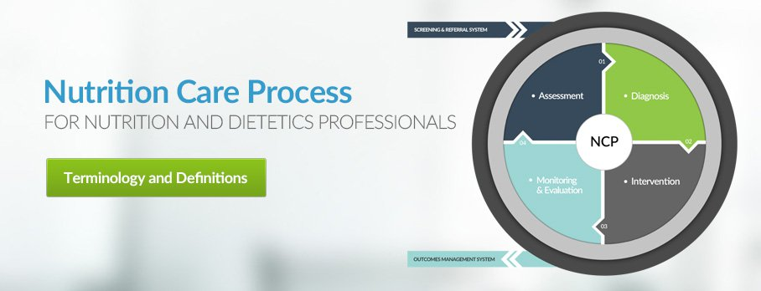
Nutrition Care Process
ncp@eatright.org
64

